Slide 1
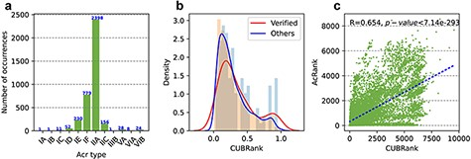
Figure 3. Statistics of Acrs and analysis of CUBRank. (a) Distribution of Acr types. The blue number on each bar ...
Notes:
Figure 3. Statistics of Acrs and analysis of CUBRank. (a) Distribution of Acr types. The blue number on each bar represents the Acr number of corresponding type; (b) Analysis of CUBRank. The red and blue curves on the histogram denote the fitted lines; (c) Correlation between CUBRank and AcRanker. We used AcRank to represent the rank predicted by AcRanker (y-axis), and the blue dotted line is fitted by CUBRank and AcRank.
Unless provided in the caption above, the following copyright applies to the content of this slide: © The Author(s) 2022. Published by Oxford University Press.This is an Open Access article distributed under the terms of the Creative Commons Attribution License (https://creativecommons.org/licenses/by/4.0/), which permits unrestricted reuse, distribution, and reproduction in any medium, provided the original work is properly cited.

