Slide 1
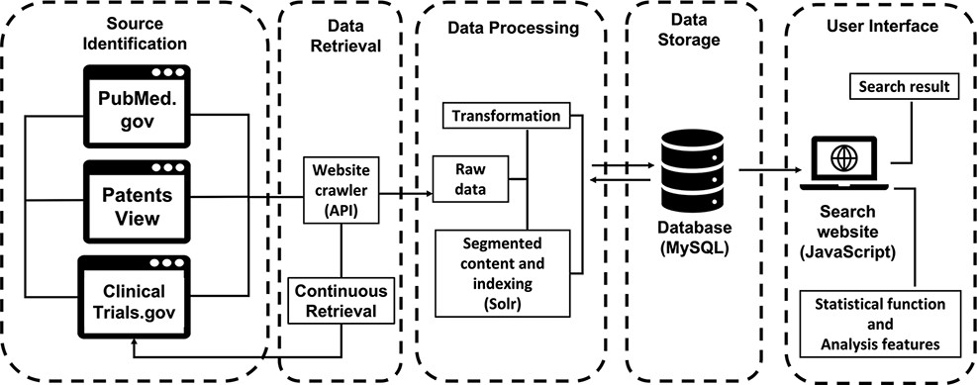
Figure 1. The workflow of ProbioQuest. The database works with continuous data retrieval from 3 public sources via API ...
Notes:
Figure 1. The workflow of ProbioQuest. The database works with continuous data retrieval from 3 public sources via API function. Our in-house Perl script transforms the raw data into the desired structure and then inputs it to MySQL. Subsequently, Solr creates segments of the content and indexes according to the title and abstract or summary of the processed data. The user interface was built by using JavaScript for searching, with its statistical function and analysis feature.
Unless provided in the caption above, the following copyright applies to the content of this slide: © The Author(s) 2022. Published by Oxford University Press.This is an Open Access article distributed under the terms of the Creative Commons Attribution-NonCommercial License (https://creativecommons.org/licenses/by-nc/4.0/), which permits non-commercial re-use, distribution, and reproduction in any medium, provided the original work is properly cited. For commercial re-use, please contact journals.permissions@oup.com

