Slide 1
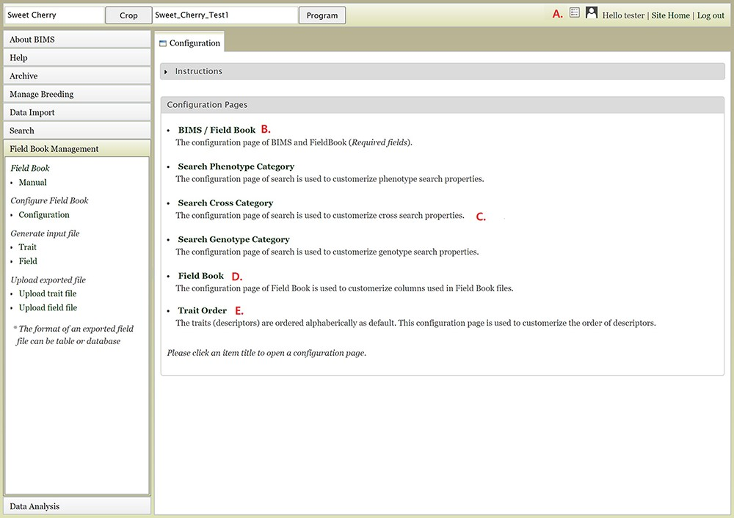
Figure 17. Configuration page of BIMS A. Hyperlink to the configuration page that is shown on top right of each BIMS ...
Notes:
Figure 17. Configuration page of BIMS A. Hyperlink to the configuration page that is shown on top right of each BIMS page. B. BIMS/Field Book link In the configuration page. C. Links to tabs where users can modify the categories in search pages for phenotype, genotype and cross. D. Field Book link in the configuration page where users can choose traits, accession properties, or sample properties to be displayed in the Generate Field Book Input file section. E. Trait Order link in the configuration page.
Unless provided in the caption above, the following copyright applies to the content of this slide: © The Author(s) 2021. Published by Oxford University Press.This is an Open Access article distributed under the terms of the Creative Commons Attribution License (http://creativecommons.org/licenses/by/4.0/), which permits unrestricted reuse, distribution, and reproduction in any medium, provided the original work is properly cited.

