Slide 1
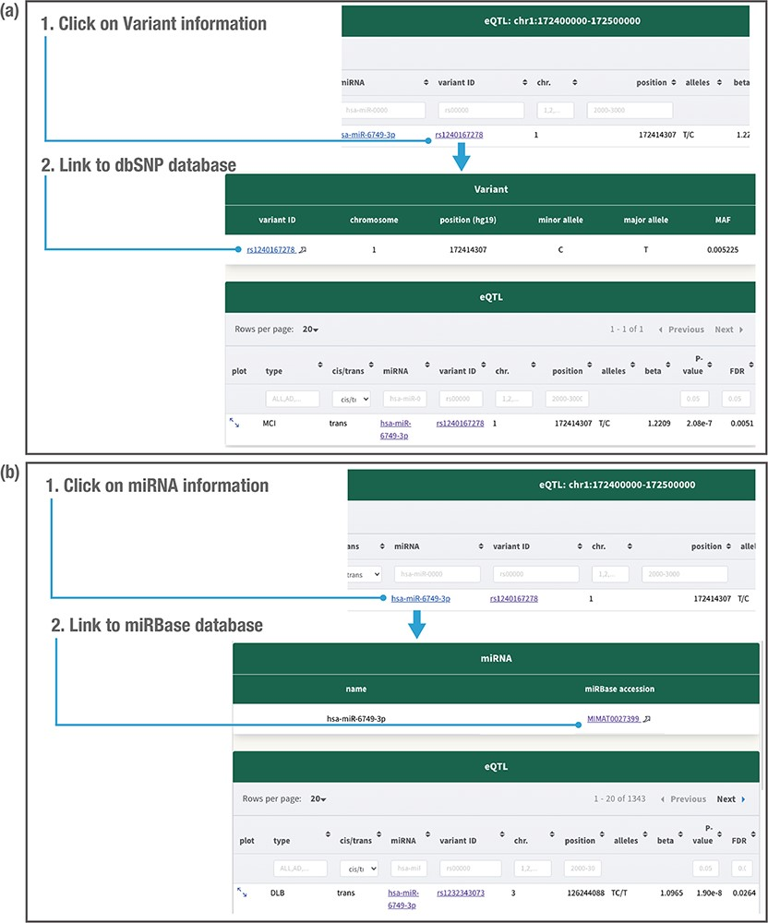
Figure 5. Detailed variant and miRNA information. Clicking on the variant related to the miR-eQTL provides the variant ...
Notes:
Figure 5. Detailed variant and miRNA information. Clicking on the variant related to the miR-eQTL provides the variant minor allele, major allele and minor allele frequency (MAF) in the JAMIR-eQTL database (a). Clicking on the miRNA provides the microRNA ID and accession number (b). The variant information further links to the public database dbSNP, whereas the miRNA information links to the public database miRbase.
Unless provided in the caption above, the following copyright applies to the content of this slide: © The Author(s) 2021. Published by Oxford University Press.This is an Open Access article distributed under the terms of the Creative Commons Attribution License (https://creativecommons.org/licenses/by/4.0/), which permits unrestricted reuse, distribution, and reproduction in any medium, provided the original work is properly cited.

