Slide 1
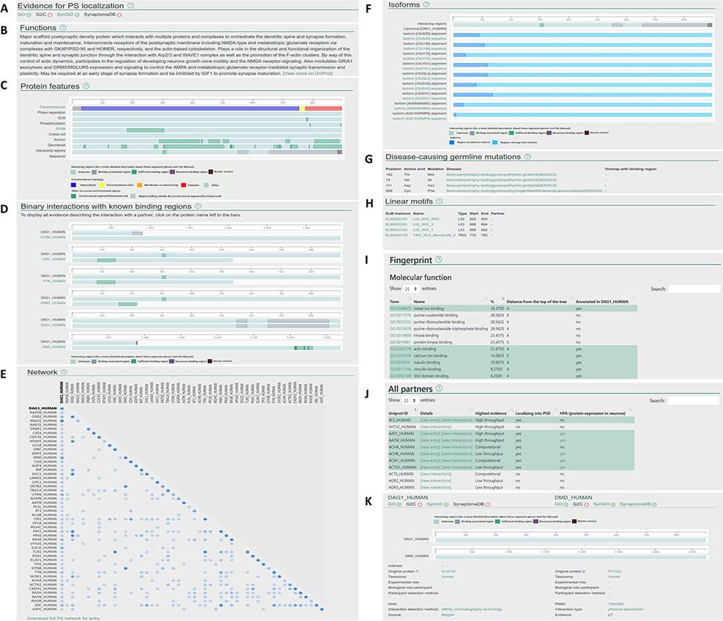
Figure 2. Layout of the individual entry pages (A–J) and the interaction pages (K) of PSINDB: Protein page: (A) ...
Notes:
Figure 2. Layout of the individual entry pages (A–J) and the interaction pages (K) of PSINDB: Protein page: (A) Evidence for PS localization, (B) function, (C) protein features, (D) binary partners with known interacting regions, (E) network, (F) isoforms, (G) disease-causing germline mutations, (H) short linear motifs, (I) fingerprint, (J) all partners. Interaction page: (K) details of the experiment.
Unless provided in the caption above, the following copyright applies to the content of this slide: © The Author(s) 2022. Published by Oxford University Press.This is an Open Access article distributed under the terms of the Creative Commons Attribution License (https://creativecommons.org/licenses/by/4.0/), which permits unrestricted reuse, distribution, and reproduction in any medium, provided the original work is properly cited.

