Slide 1
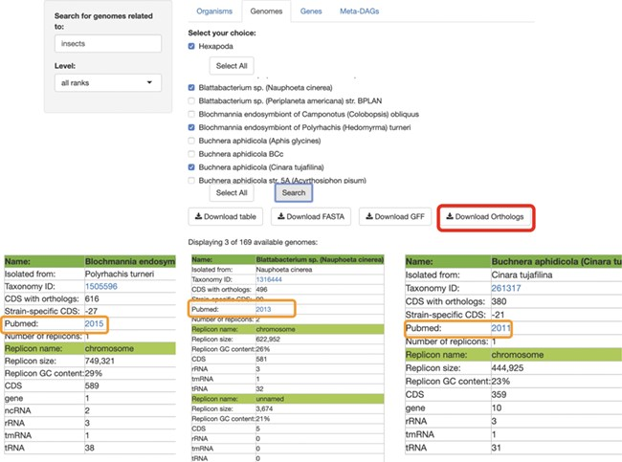
Figure 2 SymGenDB’s Genomes module. Continuing with the example on symbionts of insects, we searched for those genomes ...
Notes:
Figure 2 SymGenDB’s Genomes module. Continuing with the example on symbionts of insects, we searched for those genomes and selected 3 of the 169 available in SymGenDB’s. The resulting table (viewed horizontally for spacing purposes, although it is presented vertically in the database), consists of all the metadata of the genomes of our choice, with a link to the host’s taxonomy id from NCBI. It is important to show that one of the downloads available in this module is the orthology table of the chosen genomes (shown in red) which is very helpful for evolutionary research. Furthermore, the literature where this genome was first described is also made available to users (shown in orange).
Unless provided in the caption above, the following copyright applies to the content of this slide: © The Author(s) 2020. Published by Oxford University Press.This is an Open Access article distributed under the terms of the Creative Commons Attribution License (http://creativecommons.org/licenses/by/4.0/), which permits unrestricted reuse, distribution, and reproduction in any medium, provided the original work is properly cited.

