Slide 1
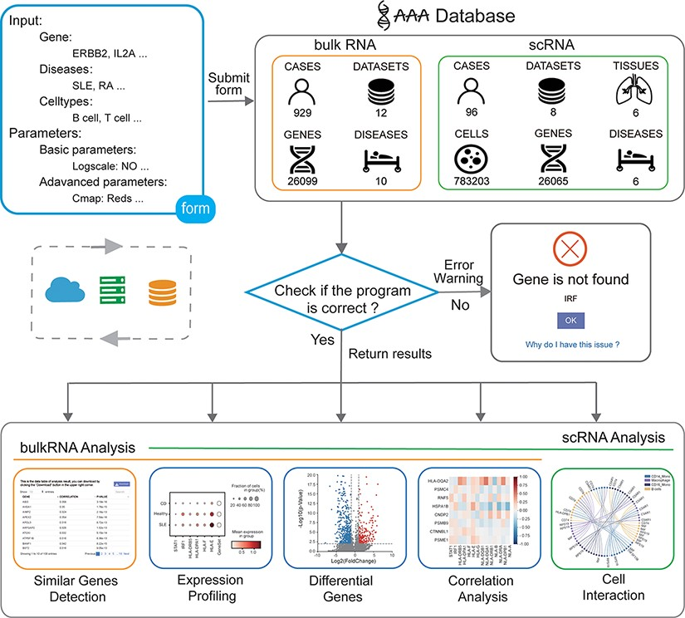
Figure 1. Overview of the IAAA database. The user can submit a custom form; the background obtains data from the ...
Notes:
Figure 1. Overview of the IAAA database. The user can submit a custom form; the background obtains data from the database according to the form and finally checks whether the program performs the analysis function correctly. Returns the result of the analysis upon success and returns an error warning in the event of failure.
Unless provided in the caption above, the following copyright applies to the content of this slide: © The Author(s) 2022. Published by Oxford University Press.This is an Open Access article distributed under the terms of the Creative Commons Attribution-NonCommercial License (https://creativecommons.org/licenses/by-nc/4.0/), which permits non-commercial re-use, distribution, and reproduction in any medium, provided the original work is properly cited. For commercial re-use, please contact journals.permissions@oup.com

Slide 2
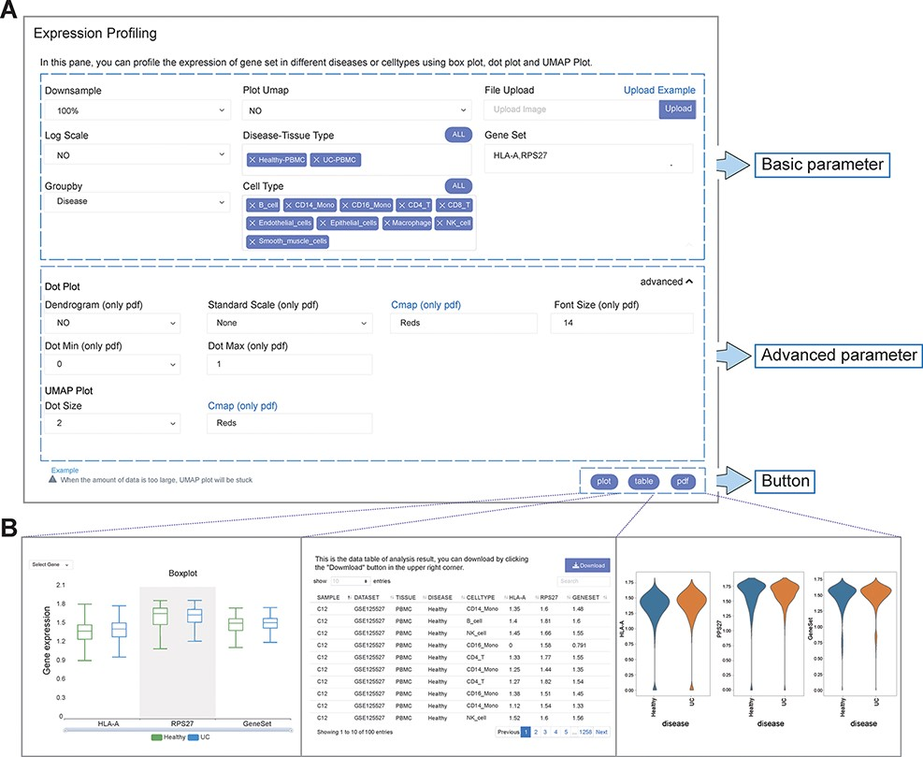
Figure 2. User-defined platform for functional analyses and output of analysis results. (A) The user-defined platform ...
Notes:
Figure 2. User-defined platform for functional analyses and output of analysis results. (A) The user-defined platform consists of three parts: basic parameters, advanced parameters and a button. The basic parameters include the parameters necessary for analysis, and the advanced parameters include several optional parameters. There are three buttons, corresponding to three types of results. (B) The ‘plot’ button returns the interactive analysis interface (left). The ‘table’ button returns the data table of the analysis results (middle). The ‘pdf’ button returns the PDF graph generated by the analysis results (right).
Unless provided in the caption above, the following copyright applies to the content of this slide: © The Author(s) 2022. Published by Oxford University Press.This is an Open Access article distributed under the terms of the Creative Commons Attribution-NonCommercial License (https://creativecommons.org/licenses/by-nc/4.0/), which permits non-commercial re-use, distribution, and reproduction in any medium, provided the original work is properly cited. For commercial re-use, please contact journals.permissions@oup.com

Slide 3
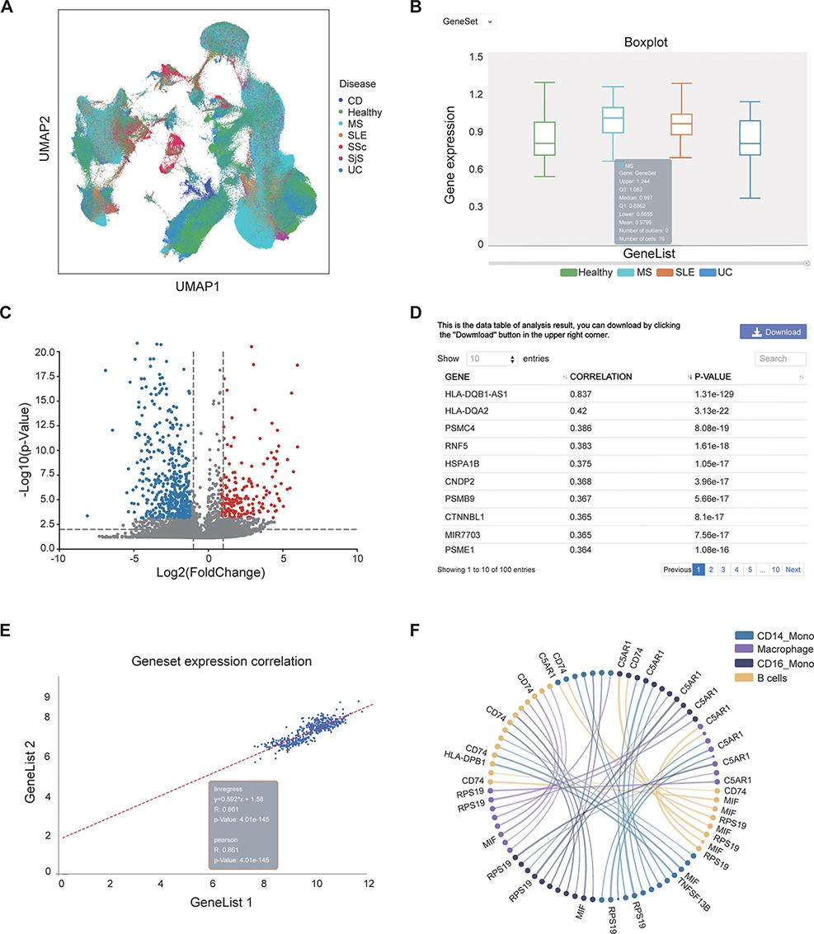
Figure 3. Examples of IAAA outputs. (A) UMAP plot showing the distribution of cells from healthy controls and several ...
Notes:
Figure 3. Examples of IAAA outputs. (A) UMAP plot showing the distribution of cells from healthy controls and several autoimmune diseases (i.e. CD, MS, SLE, SSc, SjS and UC) in scRNA-seq data. The UMAP plot is generated by the ‘general’ functions in IAAA. (B) Boxplot showing the expression of the type II interferon gene set (STAT1, IRF1, HLA-DRB5, HLA-DPA1, HLA-F, HLA-E, HLA-C, HLA-DQB1, HLA-DQA1, HLA-DRB1, HLA-B, HLA-DRA, HLA-DPB1 and HLA-A) in macrophages for scRNA-seq data from SLE, UC and MS patients. The boxplot is generated by ‘expression profiling’ functions in IAAA. (C) Volcano plot showing the differentially expressed genes between B cells and macrophages in MS patients for the scRNA-seq data. The volcano plot is generated by ‘differential analysis’ functions in IAAA. (D) The Pearson correlation of genes with the type II interferon gene set in bulk RNA-seq data generated by ‘similar gene detection’ functions in IAAA. (E) The Pearson correlation between two gene sets (type II interferon gene set and the high correlation gene set by similar gene detection functions) in bulk RNA-seq data by correlation analysis functions (scatter plot). (F) Circos plot showing the receptor–ligand pairs among B cells, CD14+ monocytes (CD14_Mono), CD16+ monocytes (CD16_Mono) and macrophages from PBMCs in SLE patients. The volcano plot is generated by ‘cell–cell interaction’ functions in IAAA. Mono, monocytes.
Unless provided in the caption above, the following copyright applies to the content of this slide: © The Author(s) 2022. Published by Oxford University Press.This is an Open Access article distributed under the terms of the Creative Commons Attribution-NonCommercial License (https://creativecommons.org/licenses/by-nc/4.0/), which permits non-commercial re-use, distribution, and reproduction in any medium, provided the original work is properly cited. For commercial re-use, please contact journals.permissions@oup.com

