Slide 1
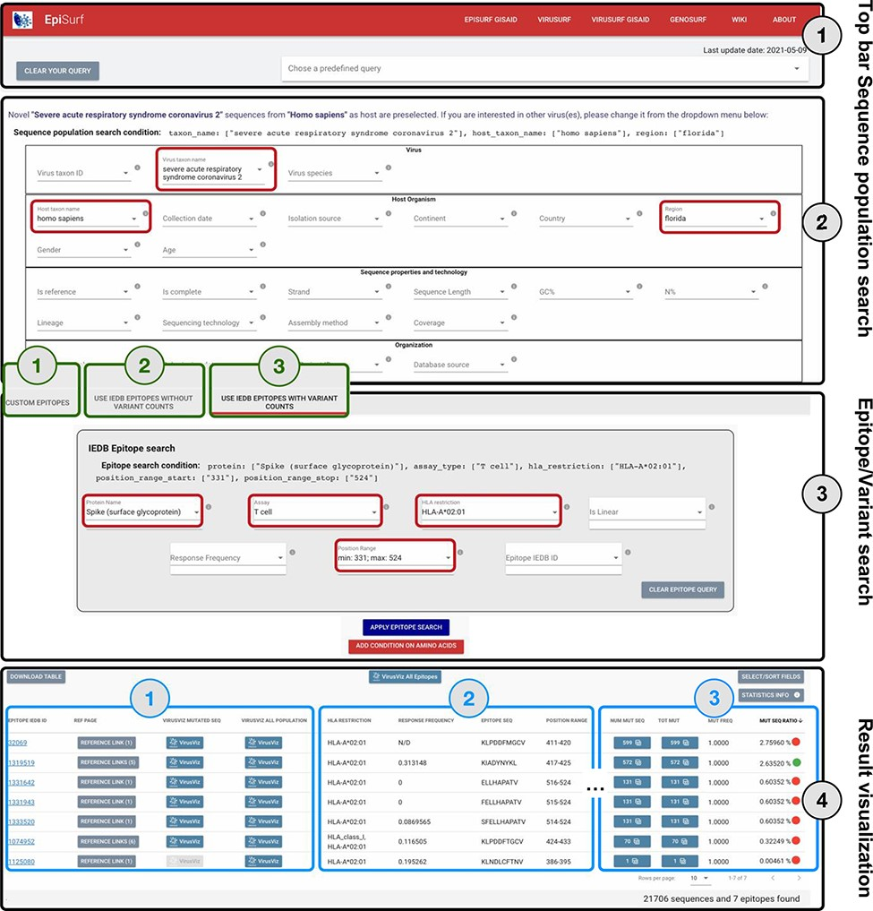
Figure 2. Overview of the EpiSurf interface, divided into four parts (see black rectangles). ‘Part 1’ (Top bar) allows ...
Notes:
Figure 2. Overview of the EpiSurf interface, divided into four parts (see black rectangles). ‘Part 1’ (Top bar) allows clearing all filters selected in the interface or selecting predefined example queries. ‘Part 2’ (Sequence population search) is used for selecting sequences of interest. SARS-CoV-2 and human host are pre-selected, whereas the ‘Florida’ location has been added as an example (see red rectangles). After metadata search, users select between three different modes (squared in green): (1) Custom epitopes (shown in detail in Figure 3); (2) Use IEDB epitopes without variant counts; (3) Use IEDB epitopes with variant counts. For Parts 3 and 4 of this figure, we assume the selection of Modes 2 or 3, whereas Figure 3 shows Parts 3 and 4 after selecting Mode 1. ‘Part 3’ (Epitope/Variant search) enables selecting epitopes from IEDB. The Spike protein is pre-selected (but users can easily change the choice of protein), whereas other conditions allow filtering the epitopes by using metadata available in IEDB. As an example, we show the selection of T cell assay, HLA-A*02:01 restriction and a position range covering the receptor binding domain (25)—see red rectangles. Finally, ‘Part 4’ (Result visualization) provides a table describing selected epitopes, further vertically decomposed into three areas (shown in blue): ‘Area 1’ includes a number of buttons to open the results within the IEDB page, VirusViz (considering only sequences mutated on the epitope range or all the ones in the population selected in Part 2); ‘Area 2’ includes sortable and adjustable metadata about epitopes; and ‘Area 3’ is present only in Mode 3 and includes counters that define the conservancy of the epitope in the population of interest. The columns of the table are customizable and the full table can be conveniently downloaded as a CSV file. The two most relevant counts in the search, i.e. the number of sequences and of epitopes, are provided at the bottom right corner of the web page.
Unless provided in the caption above, the following copyright applies to the content of this slide: © The Author(s) 2021. Published by Oxford University Press.This is an Open Access article distributed under the terms of the Creative Commons Attribution License (https://creativecommons.org/licenses/by/4.0/), which permits unrestricted reuse, distribution, and reproduction in any medium, provided the original work is properly cited.

