Slide 1
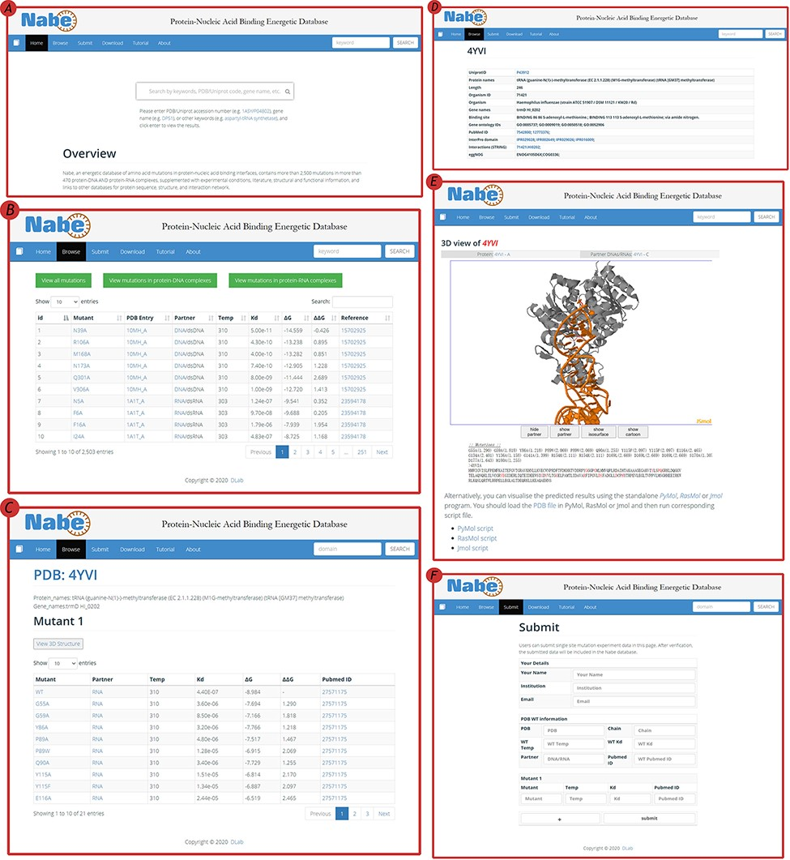
Figure 4. User interface of the Nabe database. (A) The Home page with a quick search box. (B) The Browse web page. (C) ...
Notes:
Figure 4. User interface of the Nabe database. (A) The Home page with a quick search box. (B) The Browse web page. (C) The mutants page of a protein–nucleic acid complex. (D) The detail page of a protein–nucleic acid complex. (E) The 3D model of a protein–nucleic acid complex. (F) The Submit web page.
Unless provided in the caption above, the following copyright applies to the content of this slide: © The Author(s) 2021. Published by Oxford University Press.This is an Open Access article distributed under the terms of the Creative Commons Attribution License (http://creativecommons.org/licenses/by/4.0/), which permits unrestricted reuse, distribution, and reproduction in any medium, provided the original work is properly cited.

Slide 2
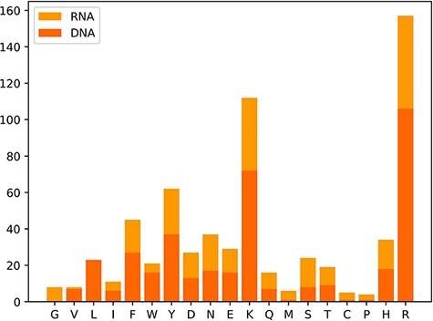
Figure 3. Distribution map of amino acid residues in hot spots.
Notes:
Figure 3. Distribution map of amino acid residues in hot spots.
Unless provided in the caption above, the following copyright applies to the content of this slide: © The Author(s) 2021. Published by Oxford University Press.This is an Open Access article distributed under the terms of the Creative Commons Attribution License (http://creativecommons.org/licenses/by/4.0/), which permits unrestricted reuse, distribution, and reproduction in any medium, provided the original work is properly cited.

Slide 3
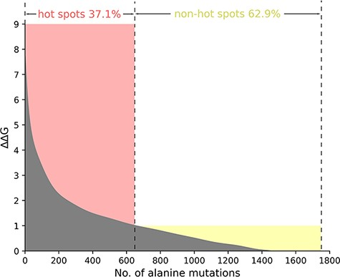
Figure 2. The ΔΔG range of hot spots (red, ΔΔG >1.0 kcal/mol) and non-hot spots (yellow, ΔΔG <1.0 kcal/mol) is ...
Notes:
Figure 2. The ΔΔG range of hot spots (red, ΔΔG >1.0 kcal/mol) and non-hot spots (yellow, ΔΔG <1.0 kcal/mol) is indicated. The section where ΔΔG is less than 0 is excluded in the picture.
Unless provided in the caption above, the following copyright applies to the content of this slide: © The Author(s) 2021. Published by Oxford University Press.This is an Open Access article distributed under the terms of the Creative Commons Attribution License (http://creativecommons.org/licenses/by/4.0/), which permits unrestricted reuse, distribution, and reproduction in any medium, provided the original work is properly cited.

Slide 4
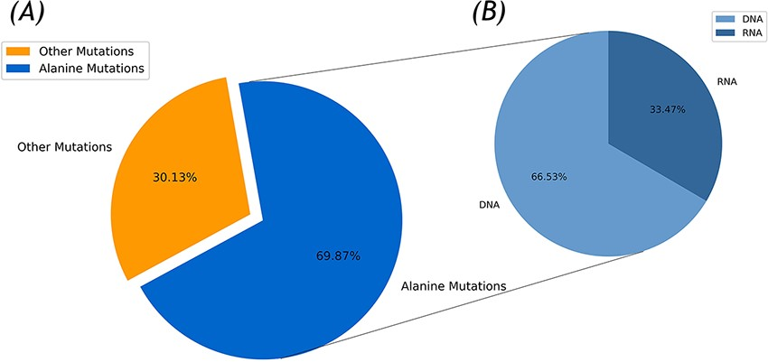
Figure 1. Statistics of the Nabe database. (A) Alanine mutation percentage chart. (B) The ratio of DNA to RNA in ...
Notes:
Figure 1. Statistics of the Nabe database. (A) Alanine mutation percentage chart. (B) The ratio of DNA to RNA in alanine mutation.
Unless provided in the caption above, the following copyright applies to the content of this slide: © The Author(s) 2021. Published by Oxford University Press.This is an Open Access article distributed under the terms of the Creative Commons Attribution License (http://creativecommons.org/licenses/by/4.0/), which permits unrestricted reuse, distribution, and reproduction in any medium, provided the original work is properly cited.

Slide 5
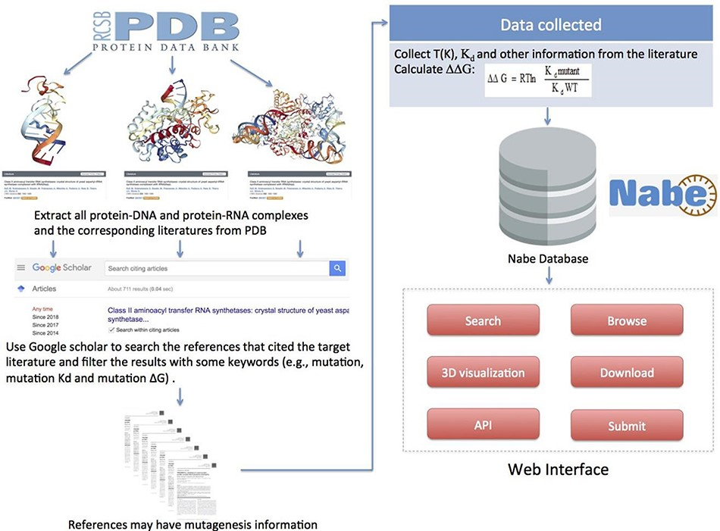
Figure 5. Flowchart describing data collection, workflow and applications of Nabe database.
Notes:
Figure 5. Flowchart describing data collection, workflow and applications of Nabe database.
Unless provided in the caption above, the following copyright applies to the content of this slide: © The Author(s) 2021. Published by Oxford University Press.This is an Open Access article distributed under the terms of the Creative Commons Attribution License (http://creativecommons.org/licenses/by/4.0/), which permits unrestricted reuse, distribution, and reproduction in any medium, provided the original work is properly cited.

