Slide 1
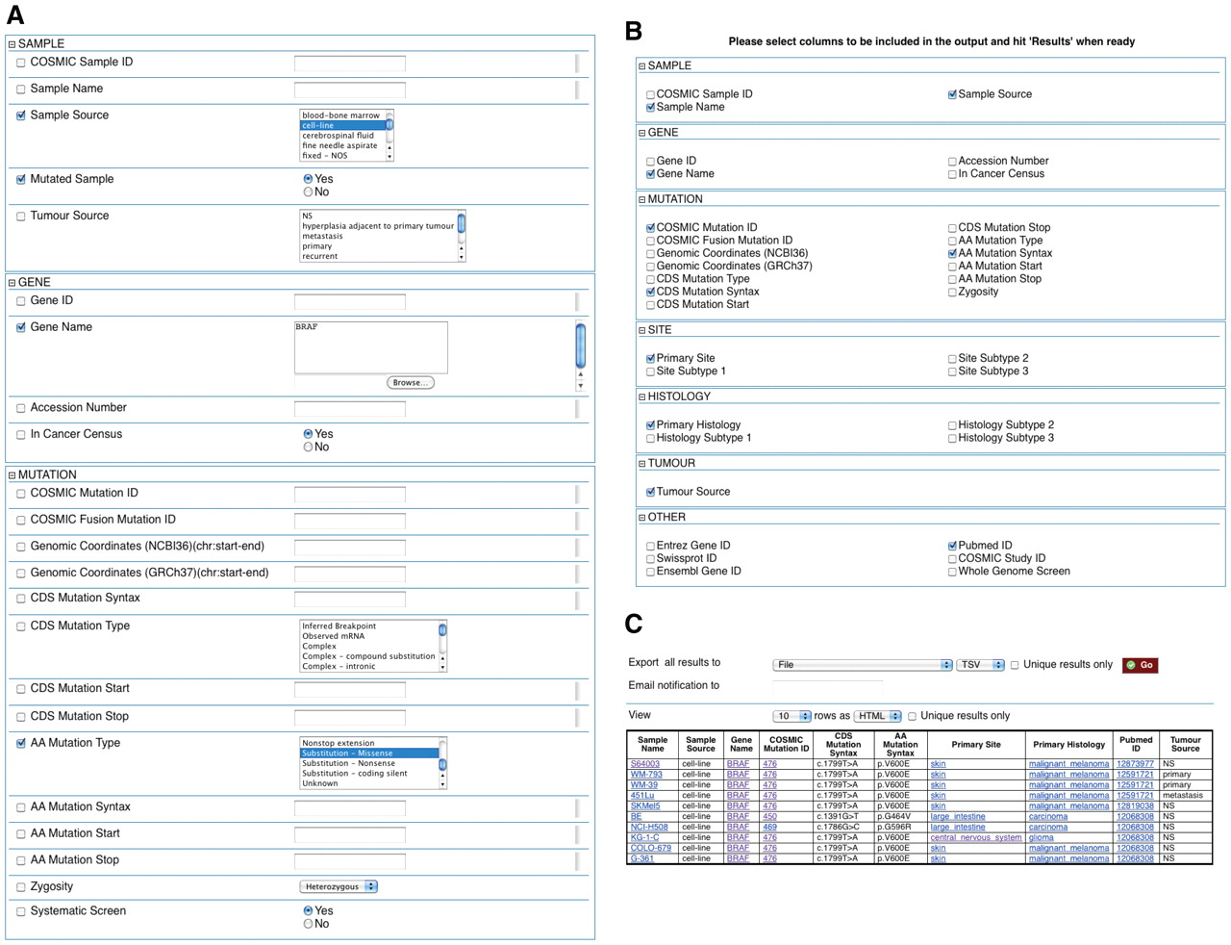
Figure 1. Example of how COSMICMart can be queried. This query searches for all cell lines with missense substitution ...
Notes:
Figure 1. Example of how COSMICMart can be queried. This query searches for all cell lines with missense substitution mutations in the BRAF gene (A). Attributes can be selected (B) to display in the results table (C).
Unless provided in the caption above, the following copyright applies to the content of this slide: © The Author(s) 2011. Published by Oxford University Press.This is Open Access article distributed under the terms of the Creative Commons Attribution Non-Commercial License (http://creativecommons.org/licenses/by-nc/2.5), which permits unrestricted non-commercial use, distribution, and reproduction in any medium, provided the original work is properly cited.

