Slide 1
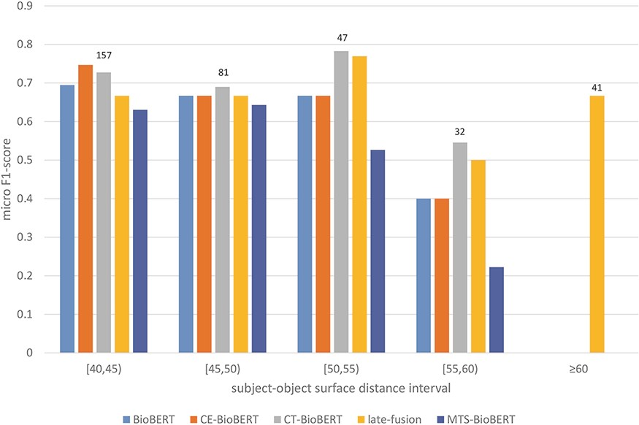
Figure 8. Stratified results on the DrugProt validation set (surface distance $ \ge $40): Examples in the validation ...
Notes:
Figure 8. Stratified results on the DrugProt validation set (surface distance $ \ge $40): Examples in the validation set are regrouped based on their subject–object surface distances. For each interval, the number of examples that fall in this interval is shown on top of the bars.
Unless provided in the caption above, the following copyright applies to the content of this slide: © The Author(s) 2022. Published by Oxford University Press.This is an Open Access article distributed under the terms of the Creative Commons Attribution-NonCommercial License (https://creativecommons.org/licenses/by-nc/4.0/), which permits non-commercial re-use, distribution, and reproduction in any medium, provided the original work is properly cited. For commercial re-use, please contact journals.permissions@oup.com

