Slide 1
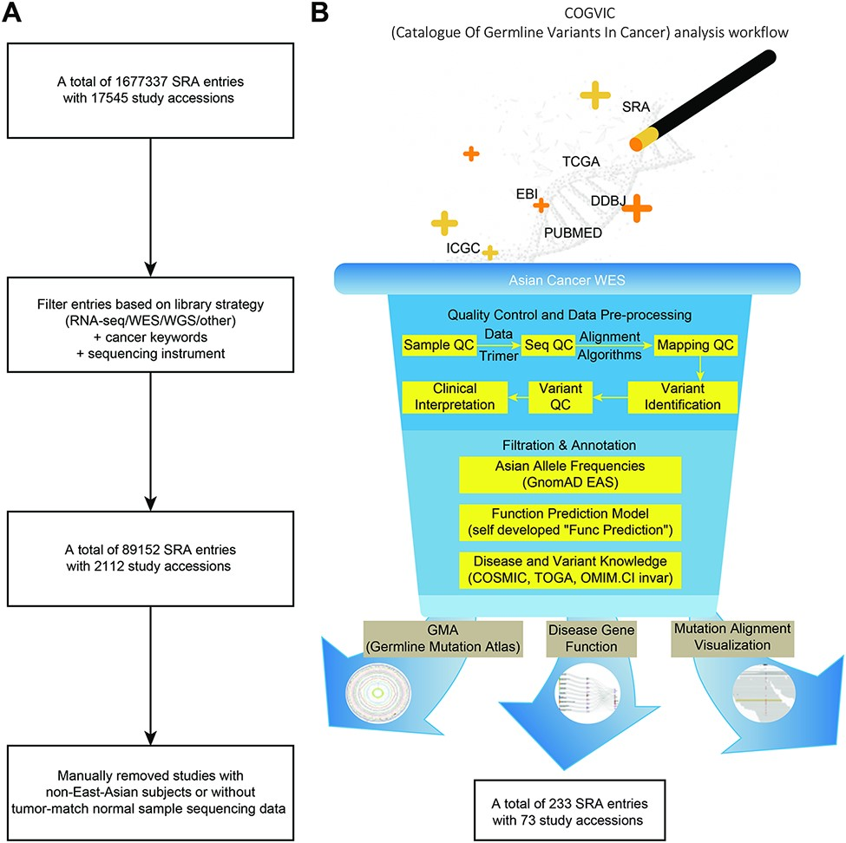
Figure 1. The COGVIC workflow of data selection and germline variant identification. (A) A total of 1 677 337 SRA ...
Notes:
Figure 1. The COGVIC workflow of data selection and germline variant identification. (A) A total of 1 677 337 SRA entries with 17 545 study accessions were filtered out based on the inclusion criteria. (B) The pipeline of the COGVIC germline variant identifier.
Unless provided in the caption above, the following copyright applies to the content of this slide: © The Author(s) 2021. Published by Oxford University Press.This is an Open Access article distributed under the terms of the Creative Commons Attribution License (https://creativecommons.org/licenses/by/4.0/), which permits unrestricted reuse, distribution, and reproduction in any medium, provided the original work is properly cited.

Slide 2
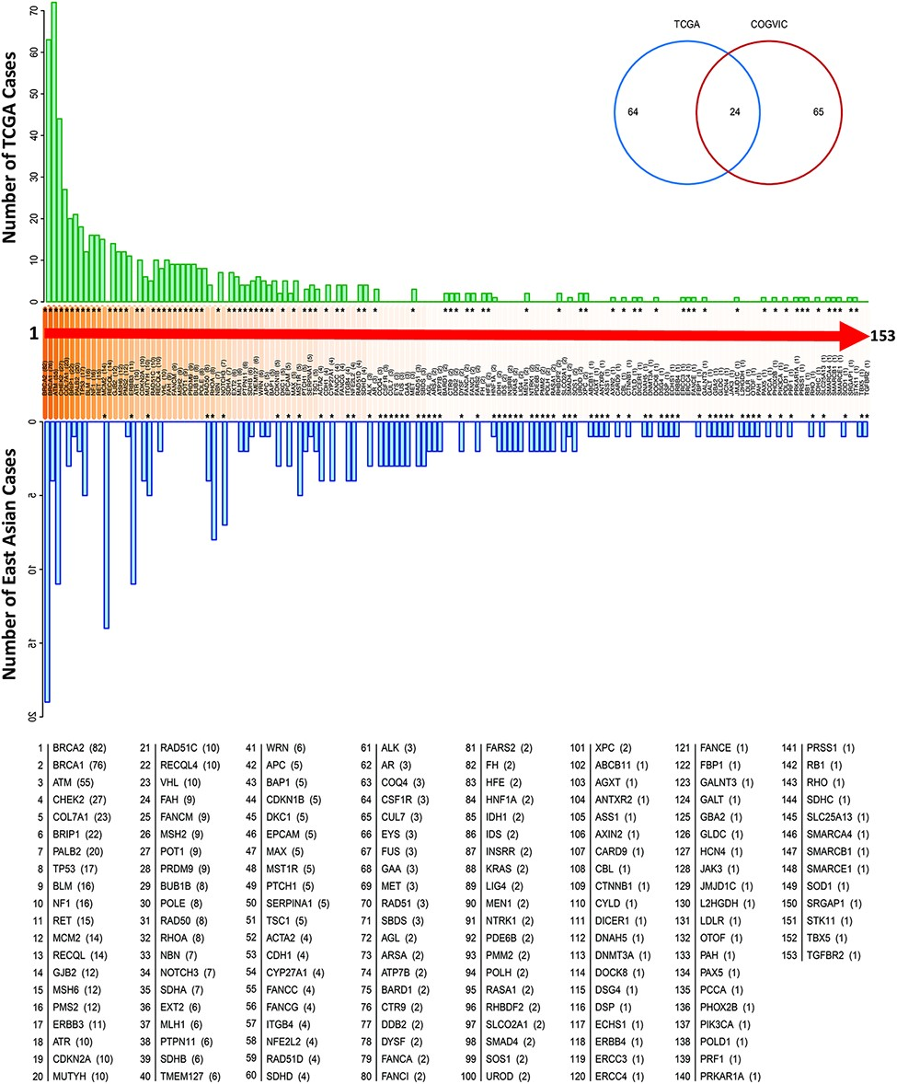
Figure 2. Genes with pathogenic variants identified in the COGVIC and TCGA cohorts. Distribution of the variants among ...
Notes:
Figure 2. Genes with pathogenic variants identified in the COGVIC and TCGA cohorts. Distribution of the variants among 153 genes in both cohorts. The number of cases with pathogenic variants by gene in the TCGA database (green upper bars) is compared with those in the East Asian population (blue lower bars). Differences between the databases are indicated by asterisks above the gene name (when the number of TCGA cases is greater) or below the gene name (when the number of cases for the gene in the East Asian population is greater). The numbers in brackets beside the gene name are consistent with this system, i.e. asterisks above the number in the bracket indicate the number of TCGA cases, while asterisks below it indicate the number of cases in the East Asian population. The Venn diagram shows 64 genes with mutations unique to TCGA, 65 genes with mutations unique to the East Asian population and 24 genes with mutations detected in the two populations.
Unless provided in the caption above, the following copyright applies to the content of this slide: © The Author(s) 2021. Published by Oxford University Press.This is an Open Access article distributed under the terms of the Creative Commons Attribution License (https://creativecommons.org/licenses/by/4.0/), which permits unrestricted reuse, distribution, and reproduction in any medium, provided the original work is properly cited.

Slide 3
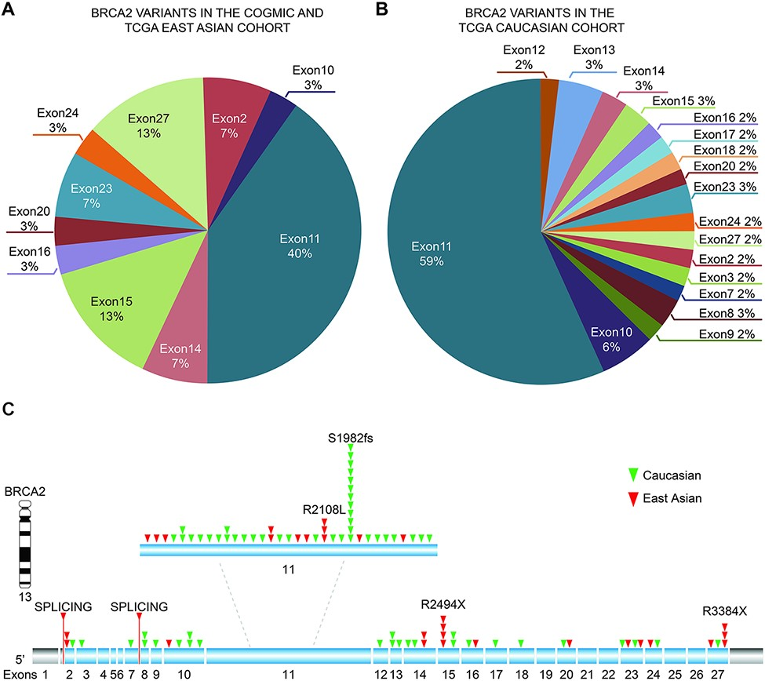
Figure 3. Distribution of identified pathogenic variants of BRCA2 around the world. (A) The proportion of BRCA2 ...
Notes:
Figure 3. Distribution of identified pathogenic variants of BRCA2 around the world. (A) The proportion of BRCA2 variants in different exons in Asian cases from the COGVIC and TCGA cohorts. The colors represent different exons, e.g. exon 1 and exon 2. (B) The proportion of BRCA2 variants in different exons in the TCGA Caucasian cohort. The colors are consistent with the exons shown in A. (C) All variants placed on the BRCA2 gene map. The numbers indicate the exon numbers. The detected variants are indicated by arrows. Red arrows represent the East Asian population, whereas the green arrows represent the Caucasian population. There are two splicing mutations, one between exons 1 and 2 and one between exons 7–8.
Unless provided in the caption above, the following copyright applies to the content of this slide: © The Author(s) 2021. Published by Oxford University Press.This is an Open Access article distributed under the terms of the Creative Commons Attribution License (https://creativecommons.org/licenses/by/4.0/), which permits unrestricted reuse, distribution, and reproduction in any medium, provided the original work is properly cited.

Slide 4
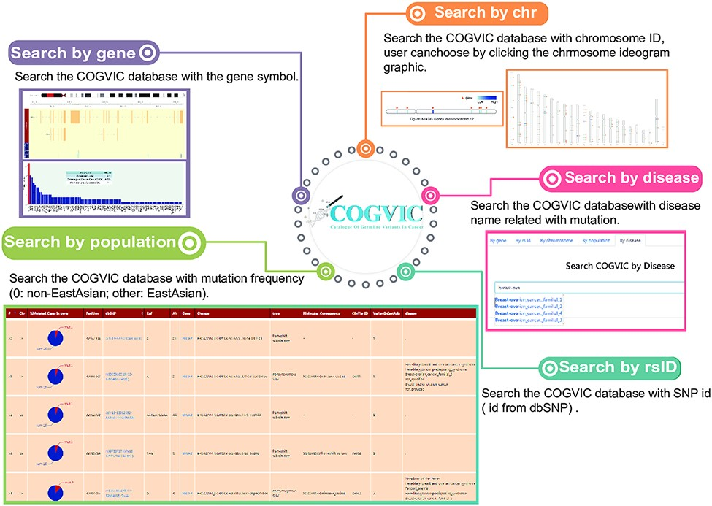
Figure 4. The main functions of the COGVIC database. This figure shows examples of outputs to specific search queries. ...
Notes:
Figure 4. The main functions of the COGVIC database. This figure shows examples of outputs to specific search queries. Search by gene: results of search by gene symbol; Search by chr: search by chromosome ID; Users can choose by clicking the chromosome ideogram graphic. Search by rsID: uses SNP rs# from dbSNP; Search by population: retrieves population-specific information mutation frequency (0: not Asian; other: Asian); Search by disease: search with disease names finds associated mutations.
Unless provided in the caption above, the following copyright applies to the content of this slide: © The Author(s) 2021. Published by Oxford University Press.This is an Open Access article distributed under the terms of the Creative Commons Attribution License (https://creativecommons.org/licenses/by/4.0/), which permits unrestricted reuse, distribution, and reproduction in any medium, provided the original work is properly cited.

