Slide 1
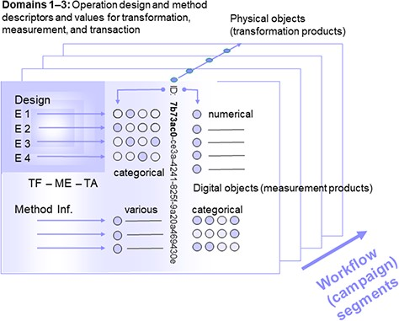
Figure 1 Segment of a (multi-segment) workflow or a (multi-segment) campaign with object identity (ID), operation ...
Notes:
Figure 1 Segment of a (multi-segment) workflow or a (multi-segment) campaign with object identity (ID), operation design elements and method information, as well as measurement values as assigned to physical (and digital) objects. Consecutive segments (indicated by the arrow at the lower right) are linked via parent identifier relations of the preceding physical objects or their digital representatives (parent identity relation). Operations are grouped according to the domains transformation, measurement and transaction (TF: transformation design, referring to domain 1, ME: method design, referring to domain 2, TA: transaction design, referring to domain 3), being assigned to (physical and digital) objects by declaration or selection of descriptor states (categorical, various). Measurement (or observation) values are primarily generated from physical objects (and secondarily from digital objects).
Unless provided in the caption above, the following copyright applies to the content of this slide: © The Author(s) 2020. Published by Oxford University Press.This is an Open Access article distributed under the terms of the Creative Commons Attribution License (http://creativecommons.org/licenses/by/4.0/), which permits unrestricted reuse, distribution, and reproduction in any medium, provided the original work is properly cited.

Slide 2
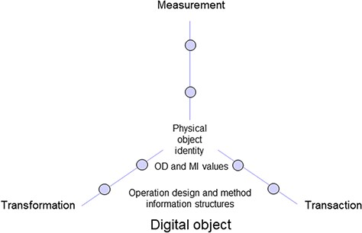
Figure 2 Digital object including information on physical object identity as well as operation design (OD) and method ...
Notes:
Figure 2 Digital object including information on physical object identity as well as operation design (OD) and method information (MI) structures and values of three elementary operation domains.
Unless provided in the caption above, the following copyright applies to the content of this slide: © The Author(s) 2020. Published by Oxford University Press.This is an Open Access article distributed under the terms of the Creative Commons Attribution License (http://creativecommons.org/licenses/by/4.0/), which permits unrestricted reuse, distribution, and reproduction in any medium, provided the original work is properly cited.

Slide 3
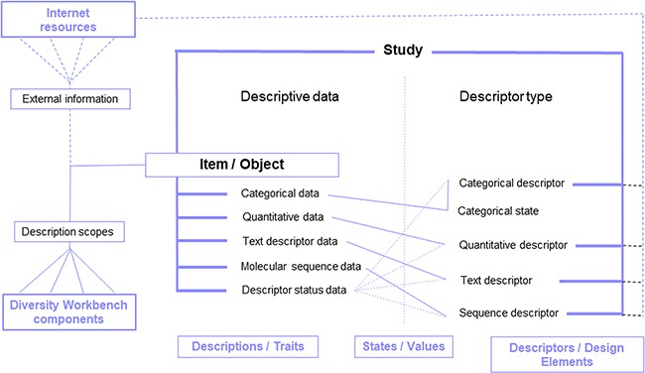
Figure 4 DiversityDescriptions enabling free definition of descriptors and descriptor states for the representation of ...
Notes:
Figure 4 DiversityDescriptions enabling free definition of descriptors and descriptor states for the representation of descriptive data of a study item based on various basic data types and enrichment via ‘description scopes’ by linking Diversity Workbench modules and external web resources.
Unless provided in the caption above, the following copyright applies to the content of this slide: © The Author(s) 2020. Published by Oxford University Press.This is an Open Access article distributed under the terms of the Creative Commons Attribution License (http://creativecommons.org/licenses/by/4.0/), which permits unrestricted reuse, distribution, and reproduction in any medium, provided the original work is properly cited.

Slide 4
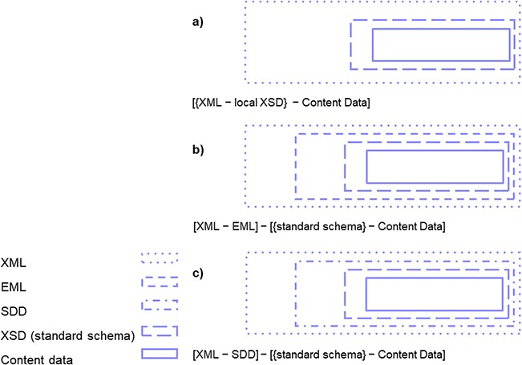
Figure 5 Research data export from DiversityDescriptions provided as XML files with content data with study ...
Notes:
Figure 5 Research data export from DiversityDescriptions provided as XML files with content data with study design-specific vocabulary provided in various formats: (a) as XML (with local XSD), (b) as XML-EML (and core elements mapped to any further domain standard schema) and (c) XML-SDD (and core elements mapped to any further domain standard schema).
Unless provided in the caption above, the following copyright applies to the content of this slide: © The Author(s) 2020. Published by Oxford University Press.This is an Open Access article distributed under the terms of the Creative Commons Attribution License (http://creativecommons.org/licenses/by/4.0/), which permits unrestricted reuse, distribution, and reproduction in any medium, provided the original work is properly cited.

Slide 5
Figure 3 Exemplary label with operation design code (ODC) and identifier (UUID) combined and both represented ...
Notes:
Figure 3 Exemplary label with operation design code (ODC) and identifier (UUID) combined and both represented additionally as QR code. For facilitating the handling during a workflow segment, creation of labels attached on physical object containers (boxes for environmental samples, tubes for laboratory intermediate objects and for storage) needs be achieved beforehand.
Unless provided in the caption above, the following copyright applies to the content of this slide: © The Author(s) 2020. Published by Oxford University Press.This is an Open Access article distributed under the terms of the Creative Commons Attribution License (http://creativecommons.org/licenses/by/4.0/), which permits unrestricted reuse, distribution, and reproduction in any medium, provided the original work is properly cited.

Slide 6
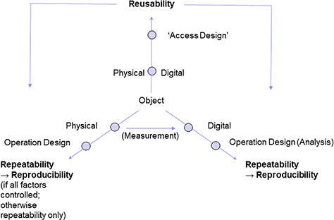
Figure 6 FAIR++: Reusability of physical and digital objects in a research setup is preconditional for the ...
Notes:
Figure 6 FAIR++: Reusability of physical and digital objects in a research setup is preconditional for the repeatability of operation designs on the respective object type. Analysis of digital objects (according to a certain design), entails the reproducibility of the operation results. Reproducibility of operations on physical objects, however, depends on whether or not environmental parameters are fully controlled. If not, a study setup can be repeated, but results may turn out to be different from the initial ones.
Unless provided in the caption above, the following copyright applies to the content of this slide: © The Author(s) 2020. Published by Oxford University Press.This is an Open Access article distributed under the terms of the Creative Commons Attribution License (http://creativecommons.org/licenses/by/4.0/), which permits unrestricted reuse, distribution, and reproduction in any medium, provided the original work is properly cited.

