Slide 1
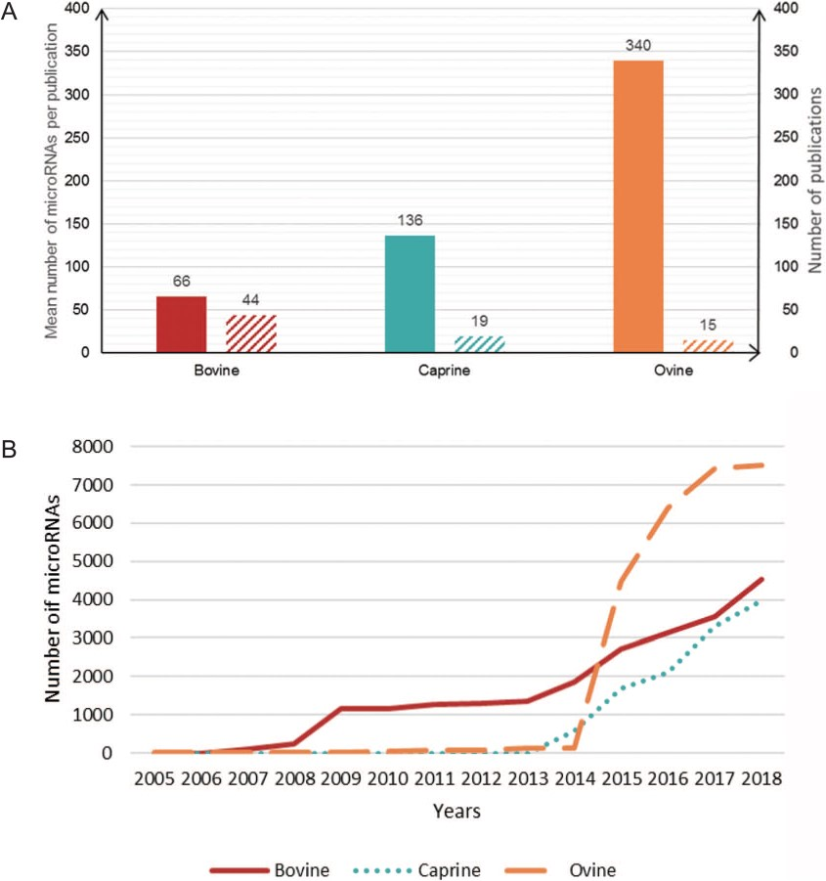
Figure 2 Number of microRNAs per publication. (A) Plain bars, average number of microRNAs described per publication ...
Notes:
Figure 2 Number of microRNAs per publication. (A) Plain bars, average number of microRNAs described per publication for each species. Hatched bars, the number of publications on each species. (B) Cumulative number of microRNAs described per year in each species.
Unless provided in the caption above, the following copyright applies to the content of this slide: © The Author(s) 2019. Published by Oxford University Press.This is an Open Access article distributed under the terms of the Creative Commons Attribution License (http://creativecommons.org/licenses/by/4.0/), which permits unrestricted reuse, distribution, and reproduction in any medium, provided the original work is properly cited.

