Slide 1
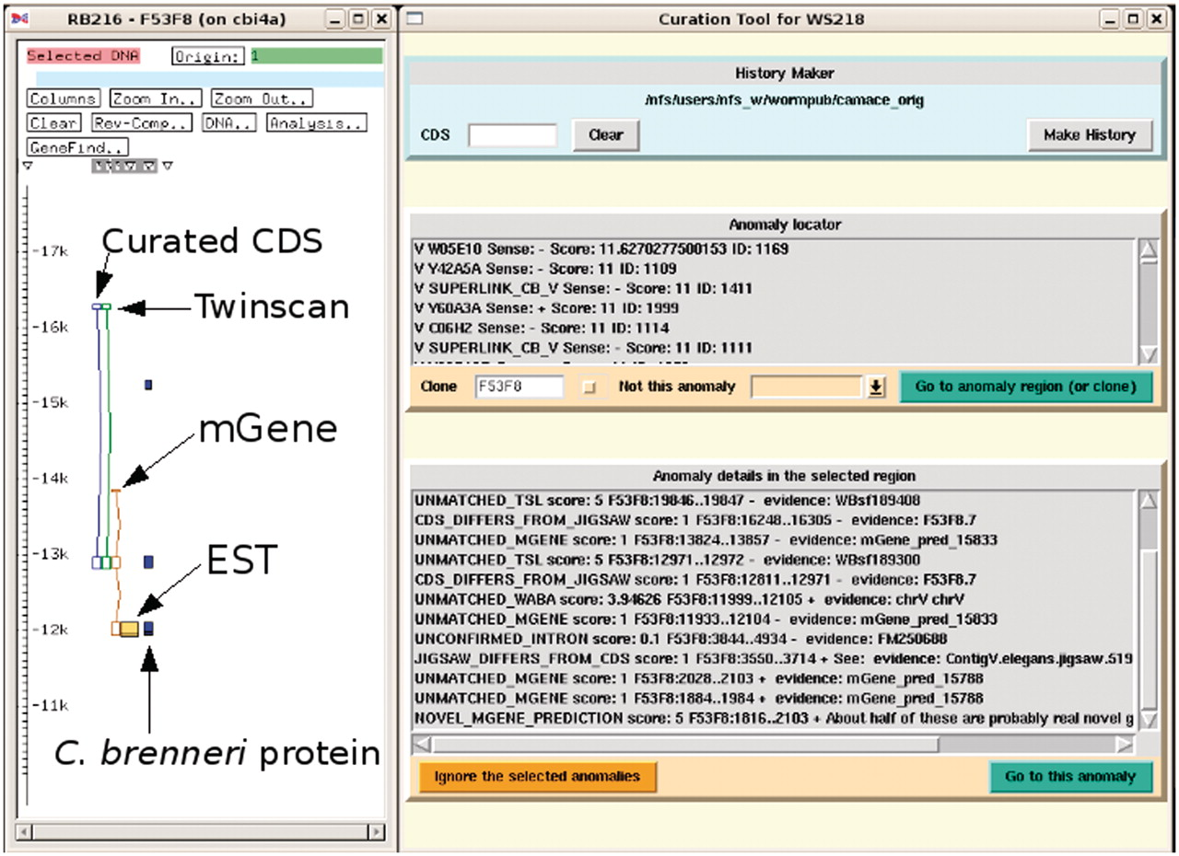
Figure 2. Screenshot of the curation system (to the right) in action with the ACeDB FMAP editor (to the left) ...
Notes:
Figure 2. Screenshot of the curation system (to the right) in action with the ACeDB FMAP editor (to the left) displaying a simplified and annotated view of a typical anomaly of a curated CDS structure together with the structures predicted by Twinscan and mGene. There is evidence from the mGene prediction, EST alignment and a weak C. brenneri protein homology for an extra exon at the 3′-end. The curation system has been set to find all the anomalies in the clone F53F8 and some of these can be seen in the list at the bottom. Many of these anomalies are currently outside of the current FMAP view, which is centred around the CDS F53F8.7.
Unless provided in the caption above, the following copyright applies to the content of this slide: © The Author(s) 2011. Published by Oxford University Press.This is Open Access article distributed under the terms of the Creative Commons Attribution Non-Commercial License (http://creativecommons.org/licenses/by-nc/2.5), which permits unrestricted non-commercial use, distribution, and reproduction in any medium, provided the original work is properly cited.

