Slide 1
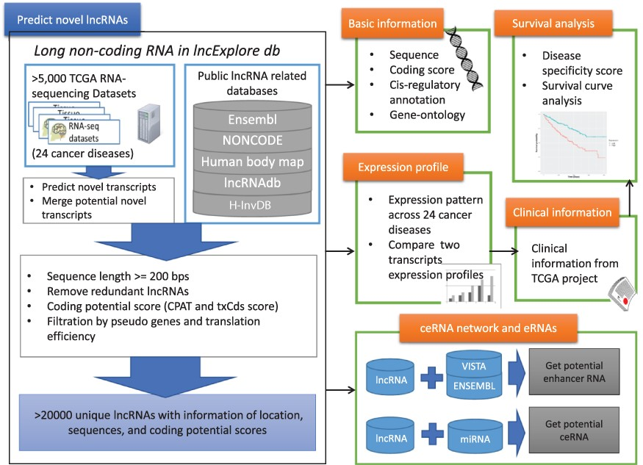
Figure 1. Schematic representation of lncExplore database. The available known lncRNA resources were collected from ...
Notes:
Figure 1. Schematic representation of lncExplore database. The available known lncRNA resources were collected from five public databases (Ensembl, Human body map, NONCODE, H-InvDB and lncRNAdb). We predicted the novel transcripts from RNA-seq datasets. To eliminated false-positive novel lncRNAs, we only collected the transcripts with following characteristics: sequences longer than 200 nucleotides, sequences with low coding potential probability, sequences without potential pseudogenes and sequences with similar translation efficiency as known lncRNAs. The elimination step reduced transcripts into >20 000 ‘unique lncRNA transcripts’ in our database. In lncExplore, the information about lncRNAs includes basic genomic information, gene expression profiles across cancers, predicted molecular annotations (GO, eRNA and ceRNA) and clinical-related information (disease specificity score and survival curve).
Unless provided in the caption above, the following copyright applies to the content of this slide: © The Author(s) 2021. Published by Oxford University Press.This is an Open Access article distributed under the terms of the Creative Commons Attribution License (https://creativecommons.org/licenses/by/4.0/), which permits unrestricted reuse, distribution, and reproduction in any medium, provided the original work is properly cited.

Slide 2
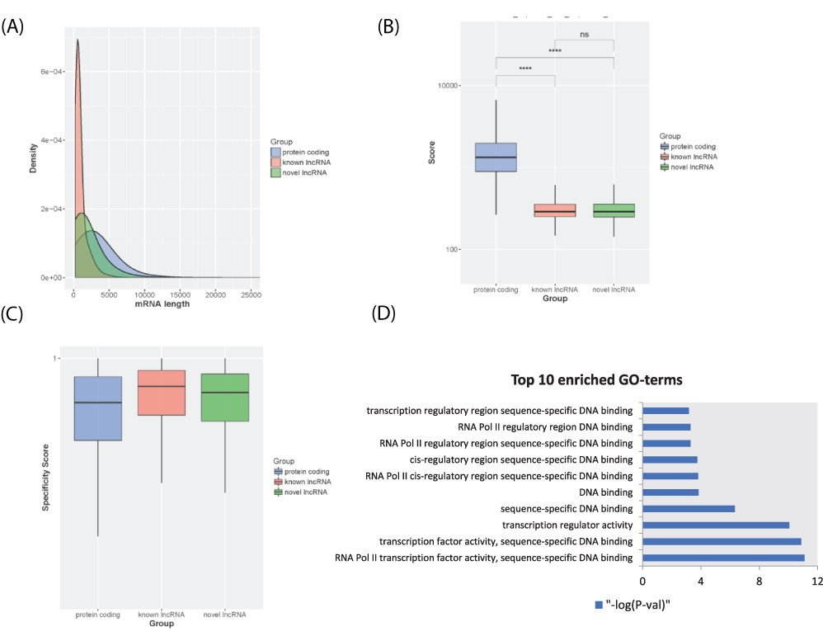
Figure 2. LncRNA transcript characterization. (A) Distribution of transcript lengths for known lncRNAs (red), novel ...
Notes:
Figure 2. LncRNA transcript characterization. (A) Distribution of transcript lengths for known lncRNAs (red), novel lncRNAs (green) and protein-coding genes (blue). (B) Boxplot of coding potential of transcripts by txCDS tool computed in three sets: known lncRNAs (red), novel lncRNAs (green) and protein-coding genes (blue). The statistical significance difference was calculated using Wilcoxon rank sum test. ‘ns’: non-significant, ‘****’: P-value < 0.001. (C) Boxplot of disease specificity score in three sets: known lncRNAs (red), novel lncRNAs (green) and protein-coding genes (blue). (D) Top 10 statistically significant enriched GO terms (molecular function category) for lncRNA HOTTIP 12 adjacent genes.
Unless provided in the caption above, the following copyright applies to the content of this slide: © The Author(s) 2021. Published by Oxford University Press.This is an Open Access article distributed under the terms of the Creative Commons Attribution License (https://creativecommons.org/licenses/by/4.0/), which permits unrestricted reuse, distribution, and reproduction in any medium, provided the original work is properly cited.

Slide 3
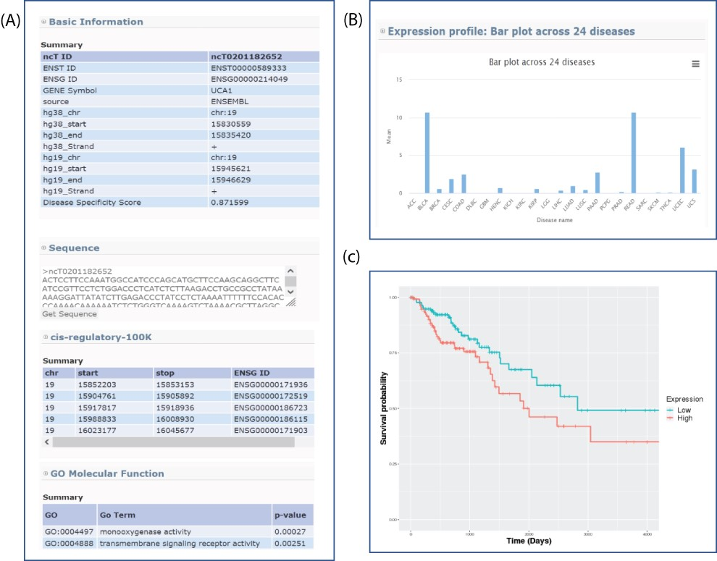
Figure 3. Sample output for searching lncRNA UCA1. (A) Basic genome information for each lncRNAs including genomic ...
Notes:
Figure 3. Sample output for searching lncRNA UCA1. (A) Basic genome information for each lncRNAs including genomic information, sequence, potential cis-regulatory elements and GO in the lncExplore database. (B) The average of expression values (FPKM) across 24 diseases were represented by bar charts. (C) Kaplan–Meier plot of lncRNA UCA1 in colon adenocarcinoma was displayed in different colors for two groups (high and low expression), respectively.
Unless provided in the caption above, the following copyright applies to the content of this slide: © The Author(s) 2021. Published by Oxford University Press.This is an Open Access article distributed under the terms of the Creative Commons Attribution License (https://creativecommons.org/licenses/by/4.0/), which permits unrestricted reuse, distribution, and reproduction in any medium, provided the original work is properly cited.

