Slide 1
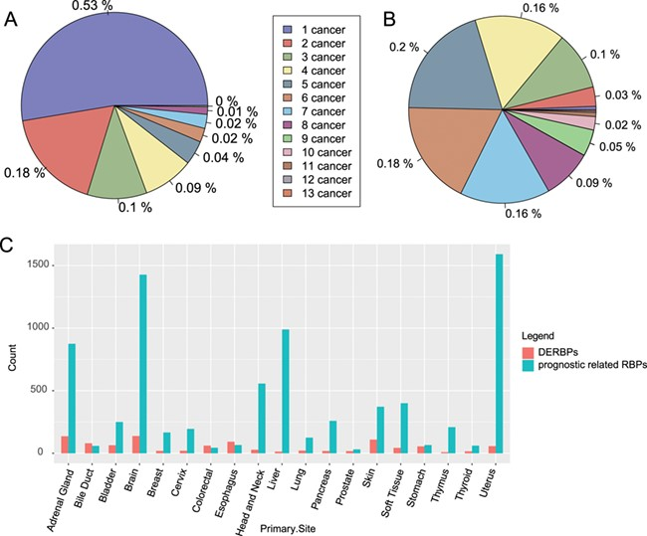
Figure 2 Distribution of RBPs among cancers. (A) Distribution of significantly differentially expressed RBPs among ...
Notes:
Figure 2 Distribution of RBPs among cancers. (A) Distribution of significantly differentially expressed RBPs among cancers. (B) Distribution of RBPs with significant prognostic value among caners. (C) Count of DERBPs and RBPs with prognostic values in cancers. The number ahead of cancer means the number of cancers with the same RBPs. DERBPs = differentially expressed RBPs.
Unless provided in the caption above, the following copyright applies to the content of this slide: © The Author(s) 2020. Published by Oxford University Press.This is an Open Access article distributed under the terms of the Creative Commons Attribution License (http://creativecommons.org/licenses/by/4.0/), which permits unrestricted reuse, distribution, and reproduction in any medium, provided the original work is properly cited.

