Slide 1
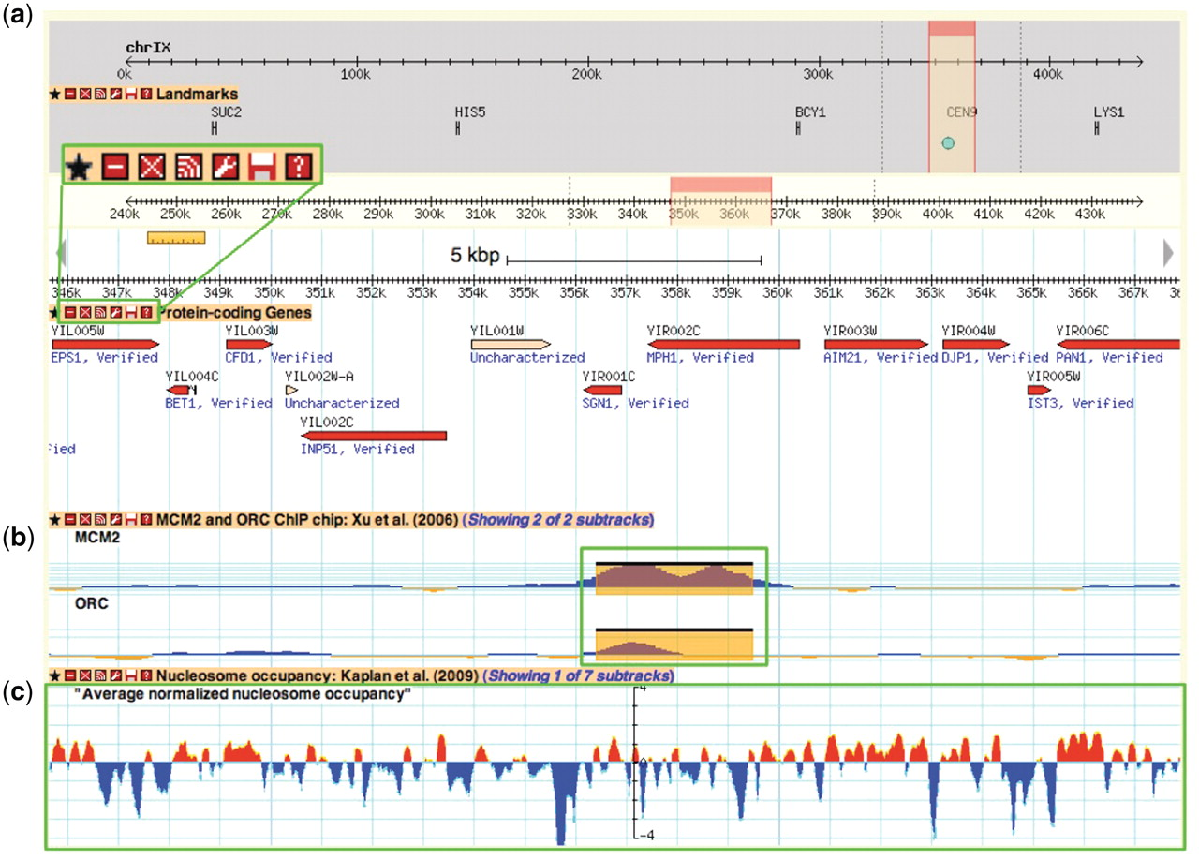
Figure 3. A Yeast Genome Map screenshot. Box (a) magnifies the tool bar present on each displayed data track. This tool ...
Notes:
Figure 3. A Yeast Genome Map screenshot. Box (a) magnifies the tool bar present on each displayed data track. This tool bar can be used to customize one's browsing experience. From left to right, the buttons are ‘favourite’, ‘minimize’, ‘close’, ‘share track’, ‘edit track display’, ‘save track’ and ‘about this track’. The ‘favourite’ button selects the track as a favourite for easy future access. The minimize’ and ‘close’ buttons perform those respective actions on the selected data track. The ‘share track’ button provides URL links that can be copy and pasted into the address bar of another web browser or other GBrowse instances. The ‘edit track display’ button allows one to change the track properties, including glyph shapes, colours and scale. The ‘save track’ button allows for the data track to be saved for the displayed region, the entire chromosome, or the entire dataset. Lastly, the ‘about this track’ button provides a pop-up box with information on the originating data, including the publication citation, the strain(s) used and links to supplementary data files and documentation on the SGD download page. Box (b) and (c) show examples of different glyph types that can be used to display different data types. In this instance, box b shows ORC and MCM2 ChIP-chip data from Xu et al. (47) using the ‘vista_plot’ glyph, which allows superimposition of segment data such as peak calls over continuous data values. Box (c) shows normalized nucleosome occupancy as determined by Kaplan et al. (48) using the ‘wiggle_whiskers’ glyph, which standardizes display of continuous data as z-scores about the mean (x-axis).
Unless provided in the caption above, the following copyright applies to the content of this slide: © The Author(s) 2012. Published by Oxford University Press.This is an Open Access article distributed under the terms of the Creative Commons Attribution Non-Commercial License (http://creativecommons.org/licenses/by-nc/3.0), which permits unrestricted non-commercial use, distribution, and reproduction in any medium, provided the original work is properly cited.

