Slide 1
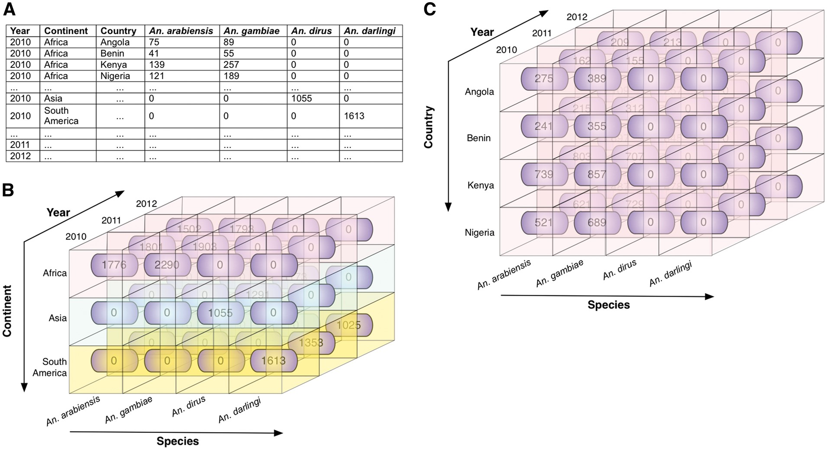
Figure 5. Illustrative example of roll up and roll down. These operations allow the user to navigate among levels of ...
Notes:
Figure 5. Illustrative example of roll up and roll down. These operations allow the user to navigate among levels of data ranging from the most summarized (up) level to the most detailed (down) level, along a specific dimension. (A) Illustrative data showing mosquito abundances for various locations (continents and countries), years, and Anopheles species. (B) The data cube, derived from the data in A, shows the mosquito abundance facts (numbers in rounded rectangles). The cube is associated with three dimensions: species, year, and continent, which are displayed along the three axes, with data labels coming from A. Fact cells with different values of the continent dimension are distinctly colour-coded for ease of visualization. (C) The roll down operation produces a more detailed view of data by rolling down one level along the hierarchical location (from continent to country). The mosquito abundances of continent Africa are rolled down to abundances for countries of Africa (Angola, Benin, Kenya, and Nigeria in this scenario). Note that when rolled up, the entire cube in C represents one row of data in B (in this case, the topmost row, representing Africa).
Unless provided in the caption above, the following copyright applies to the content of this slide: © The Author(s) 2017. Published by Oxford University Press.This is an Open Access article distributed under the terms of the Creative Commons Attribution License (http://creativecommons.org/licenses/by/4.0/), which permits unrestricted reuse, distribution, and reproduction in any medium, provided the original work is properly cited.

