Slide 1
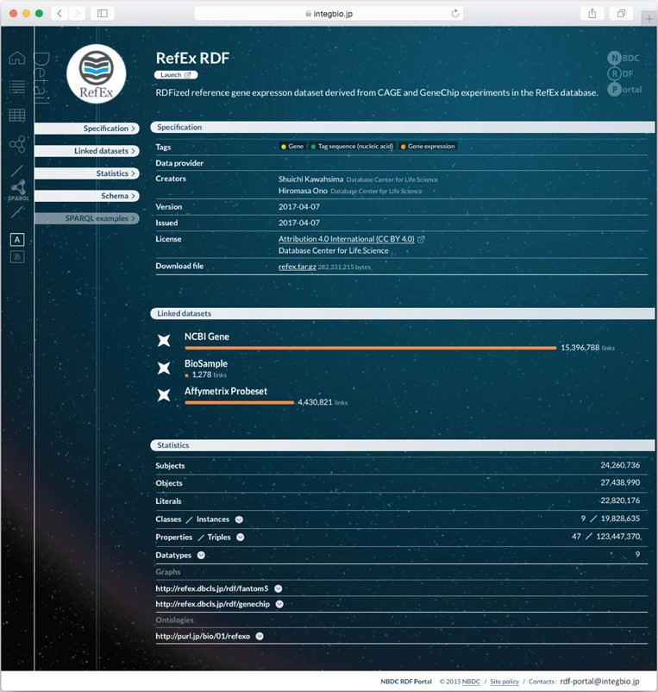
Figure 2 Example dataset page from the NBDC RDF portal. Each RDF dataset has its own page that provides metadata, ...
Notes:
Figure 2 Example dataset page from the NBDC RDF portal. Each RDF dataset has its own page that provides metadata, statistics, links to the RDF files, SPARQL query samples and a link to the SPARQL endpoint.
Unless provided in the caption above, the following copyright applies to the content of this slide: © The Author(s) 2018. Published by Oxford University Press. All rights reserved. For Permissions, please email: journals.permissions@oup.comThis article is published and distributed under the terms of the Oxford University Press, Standard Journals Publication Model (https://academic.oup.com/journals/pages/open_access/funder_policies/chorus/standard_publication_model)

