Slide 1
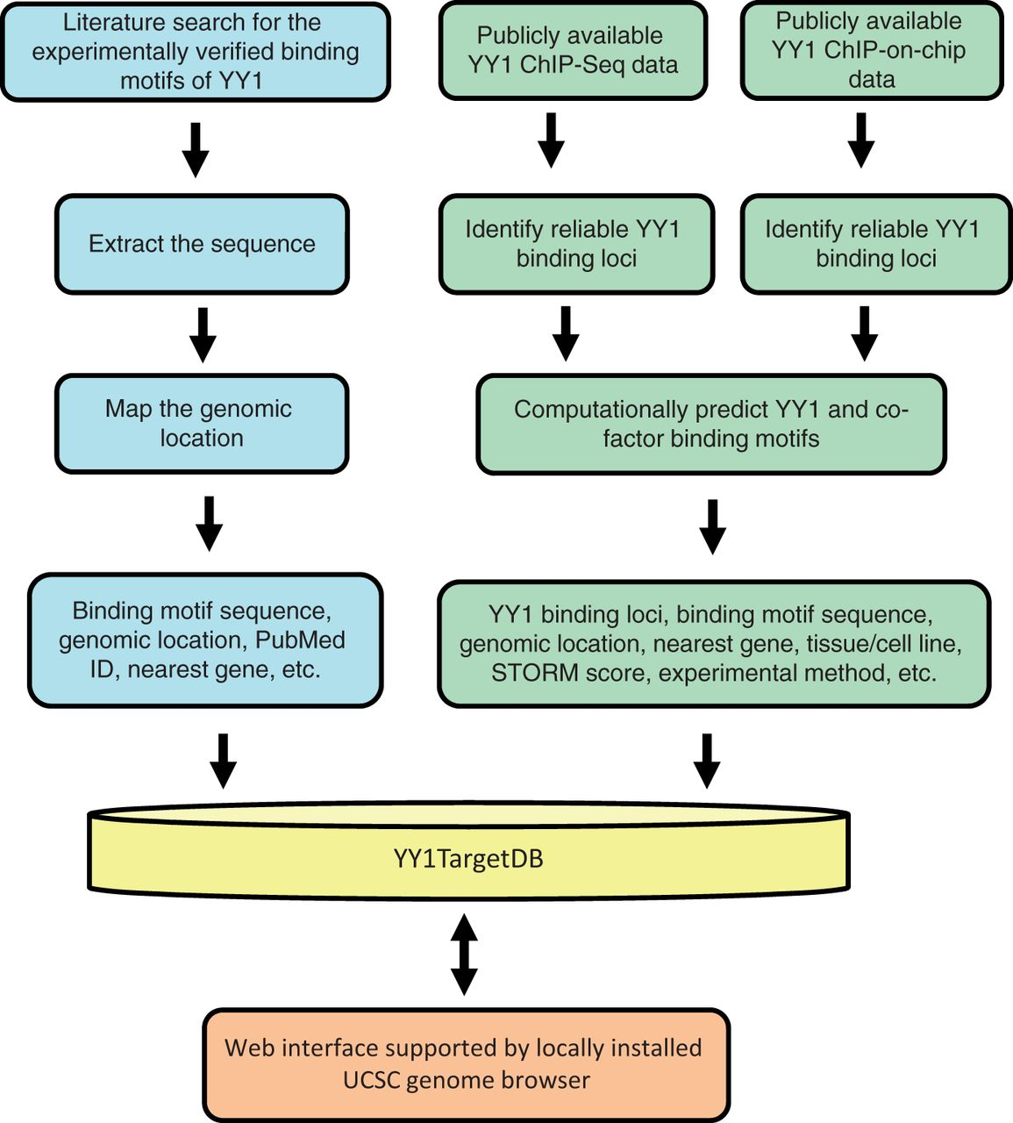
Figure 1 Schematic overview for YY1TargetDB data acquisition and database implementation. The experimentally verified ...
Notes:
Figure 1 Schematic overview for YY1TargetDB data acquisition and database implementation. The experimentally verified YY1-binding motifs were collected from literatrues, mapped to the reference genomes and stored in the database. High-throughput (ChIP-seq or ChIP-on-chip) experimental datasets were downloaded from NCBI GEO server and processed by our analysis and annotation pipeline. The identifed YY1-binding loci, computationally predicted YY1 and its cofactors binding motifs were deposited into YY1TargetDB. The database in integrated with locally installed UCSC genome browser to visualize YY1-binding loci and assoicated annotation information.
Unless provided in the caption above, the following copyright applies to the content of this slide: © The Author(s) 2013. Published by Oxford University Press.This is an Open Access article distributed under the terms of the Creative Commons Attribution Non-Commercial License (http://creativecommons.org/licenses/by-nc/3.0/), which permits unrestricted non-commercial use, distribution, and reproduction in any medium, provided the original work is properly cited.

Slide 2
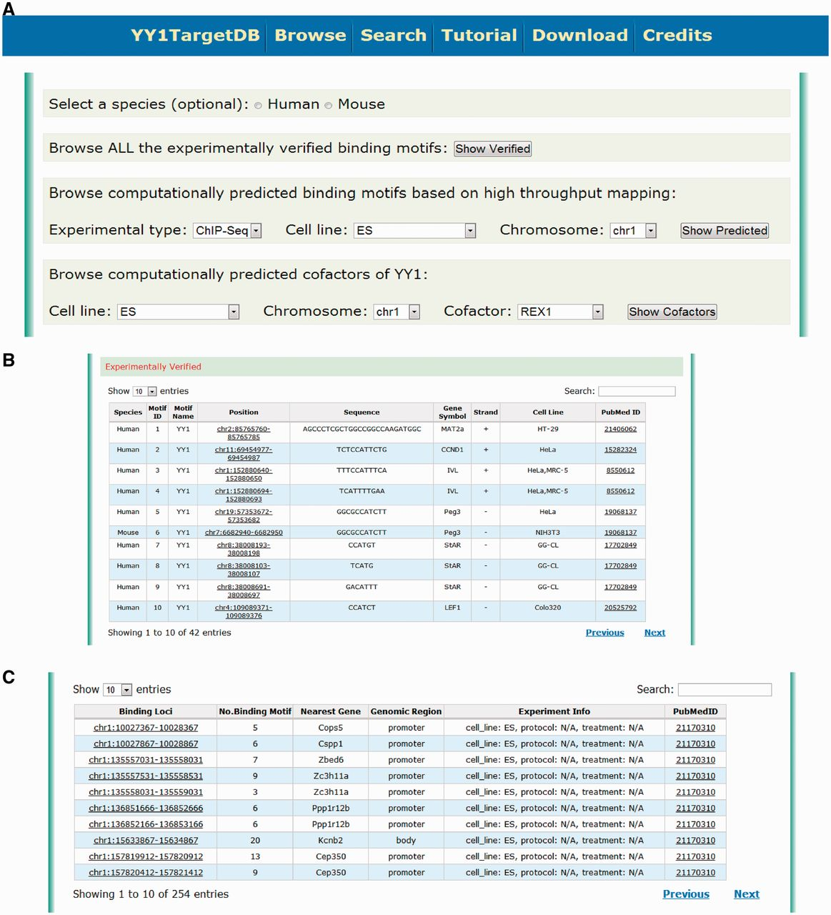
Figure 2 Screen shot depicting the browsing interface. (A) Web interface for browsing the experimentally verified or ...
Notes:
Figure 2 Screen shot depicting the browsing interface. (A) Web interface for browsing the experimentally verified or computationally predicted YY1-binding motif. (B) Tabulated presentation for experimentally verified YY1-binding motifs. A hyperlink was implemented for further data visualization. (C) Tabulated presentation for identified YY1-binding loci. A hyperlink was implemented for further visualization of computationally predicted YY1-binding motifs under each locus.
Unless provided in the caption above, the following copyright applies to the content of this slide: © The Author(s) 2013. Published by Oxford University Press.This is an Open Access article distributed under the terms of the Creative Commons Attribution Non-Commercial License (http://creativecommons.org/licenses/by-nc/3.0/), which permits unrestricted non-commercial use, distribution, and reproduction in any medium, provided the original work is properly cited.

Slide 3
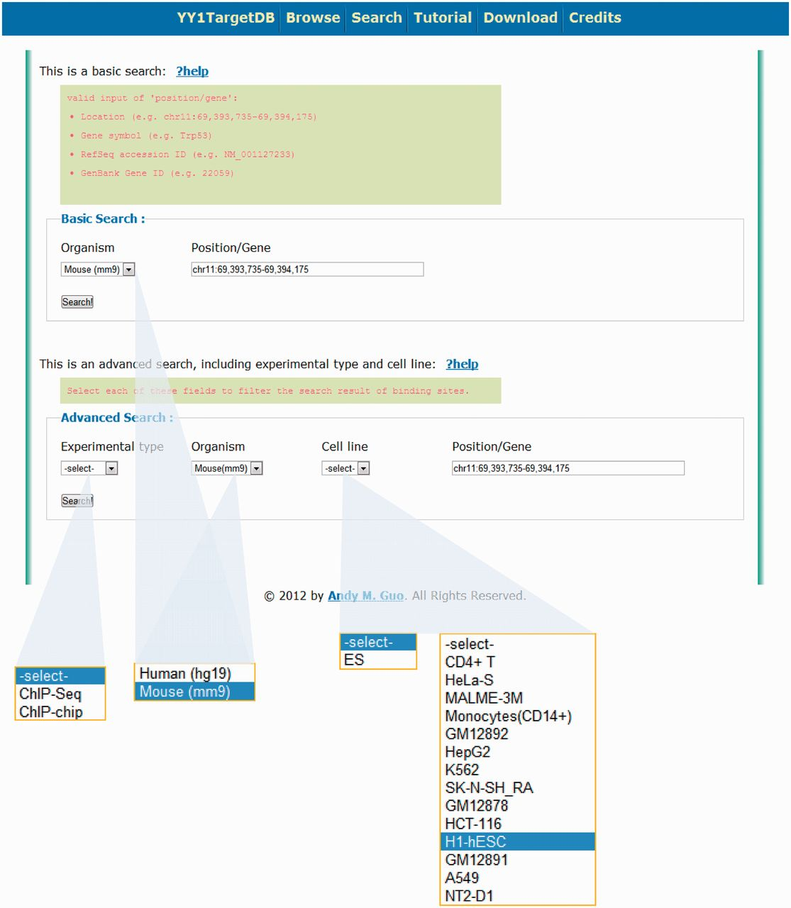
Figure 3 Search options for YY1 TargetDB. Users can perform basic search or advance search.
Notes:
Figure 3 Search options for YY1 TargetDB. Users can perform basic search or advance search.
Unless provided in the caption above, the following copyright applies to the content of this slide: © The Author(s) 2013. Published by Oxford University Press.This is an Open Access article distributed under the terms of the Creative Commons Attribution Non-Commercial License (http://creativecommons.org/licenses/by-nc/3.0/), which permits unrestricted non-commercial use, distribution, and reproduction in any medium, provided the original work is properly cited.

Slide 4
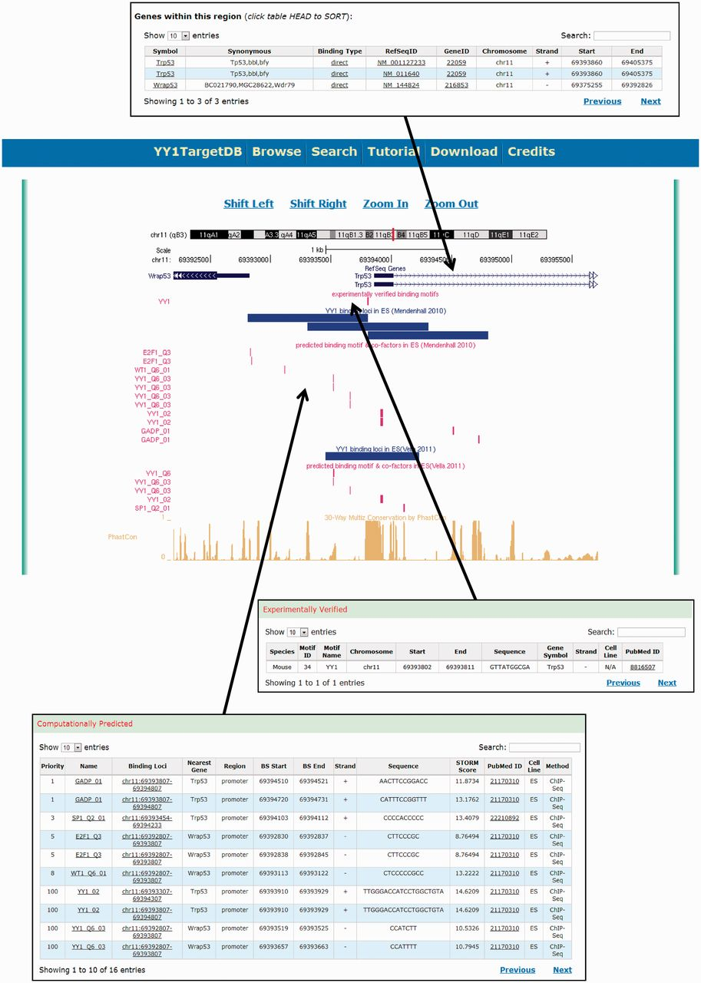
Figure 4 Screen shot depicting the data visualization using integrated UCSC genome browser and the tabulated ...
Notes:
Figure 4 Screen shot depicting the data visualization using integrated UCSC genome browser and the tabulated information.
Unless provided in the caption above, the following copyright applies to the content of this slide: © The Author(s) 2013. Published by Oxford University Press.This is an Open Access article distributed under the terms of the Creative Commons Attribution Non-Commercial License (http://creativecommons.org/licenses/by-nc/3.0/), which permits unrestricted non-commercial use, distribution, and reproduction in any medium, provided the original work is properly cited.

