Slide 1
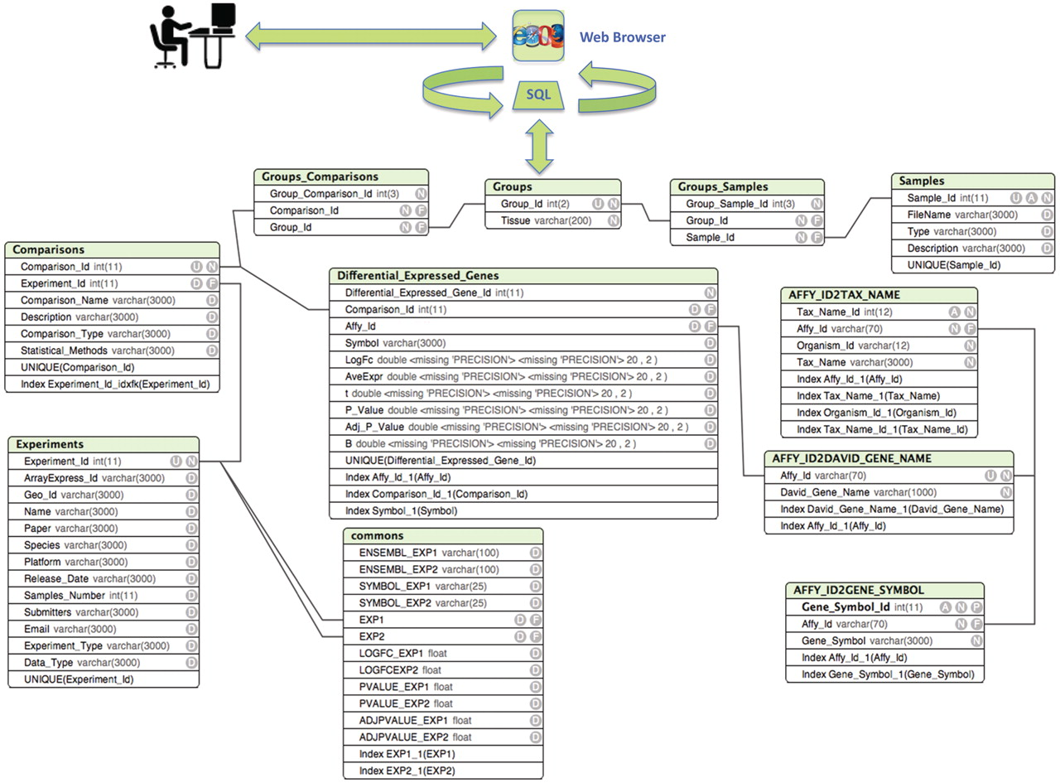
Figure 1. Entity relationship diagram of ParkDB. The scheme illustrates the tables created for data storage with the ...
Notes:
Figure 1. Entity relationship diagram of ParkDB. The scheme illustrates the tables created for data storage with the respective attributes and relations. The simple relations between the tables facilitate the possible expansion of the database to other genes involved in PD neurodegeneration and dopaminergic differentiation.
Unless provided in the caption above, the following copyright applies to the content of this slide: © The Author(s) 2011. Published by Oxford University Press.This is Open Access article distributed under the terms of the Creative Commons Attribution Non-Commercial License (http://creativecommons.org/licenses/by-nc/2.5), which permits unrestricted non-commercial use, distribution, and reproduction in any medium, provided the original work is properly cited.

