Slide 1
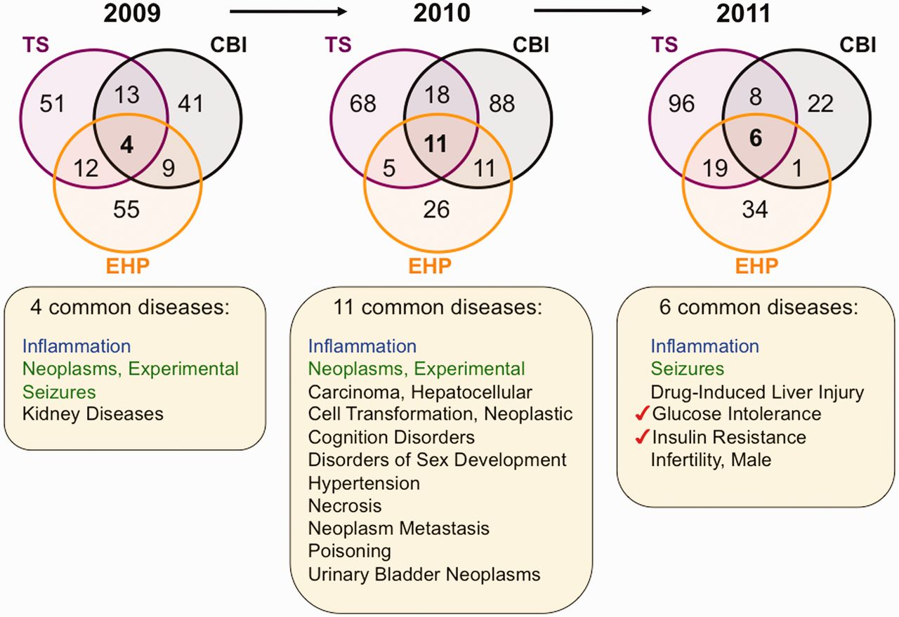
Figure 5 Environmental diseases from inter-journal comparison. Three Venn diagrams depict the overlapping datasets for ...
Notes:
Figure 5 Environmental diseases from inter-journal comparison. Three Venn diagrams depict the overlapping datasets for curated diseases shared by journals TS (purple circles), CBI (black circles) and EHP (orange circles) for years 2009–11. Inflammation (blue) is shared by all three journals for all 3 years, and experimental neoplasms and seizures (green) are shared in 2 of the 3 years. The other listed diseases (black) are shared by the three journals for that unique year. In 2011, two pre-diabetes markers (red checks) are shared among all three journals. All data are provided in the Supplementary Data, and readers can use CTD’s ‘MyVenn’ tool (http://ctdbase.org/tools/myVenn.go) to re-draw the Venn diagrams to explore all the sets.
Unless provided in the caption above, the following copyright applies to the content of this slide: © The Author(s) 2012. Published by Oxford University Press.This is an Open Access article distributed under the terms of the Creative Commons Attribution License (http://creativecommons.org/licenses/by-nc/3.0/), which permits non-commercial reuse, distribution, and reproduction in any medium, provided the original work is properly cited. For commercial re-use, please contact journals.permissions@oup.com.

