Slide 1
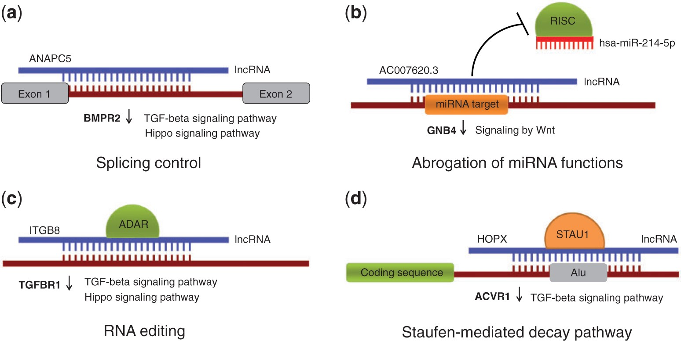
Figure 1. Possible roles of lncRNAs played in the context of RNA-RNA interactions. (a) Modulating alternative splicing ...
Notes:
Figure 1. Possible roles of lncRNAs played in the context of RNA-RNA interactions. (a) Modulating alternative splicing events through masking splice sites and other splicing signals (b) Abrogation of miRNA functions by blocking miRNA target sites; (c) Triggering RNA editing by creating dsRNA substrates for ADAR enzymes (d) Guiding protein-coding transcripts to degradation in a SMD pathway. Provided are examples of lncRNAs and differentially expressed genes predicted to be under their control. The genes belong to TGF-β, Hippo and Wnt-related signaling pathways and they all are downregulated in KTCN (marked with down arrows).
Unless provided in the caption above, the following copyright applies to the content of this slide: © The Author(s) 2017. Published by Oxford University Press.This is an Open Access article distributed under the terms of the Creative Commons Attribution License (http://creativecommons.org/licenses/by/4.0/), which permits unrestricted reuse, distribution, and reproduction in any medium, provided the original work is properly cited.

