Slide 1
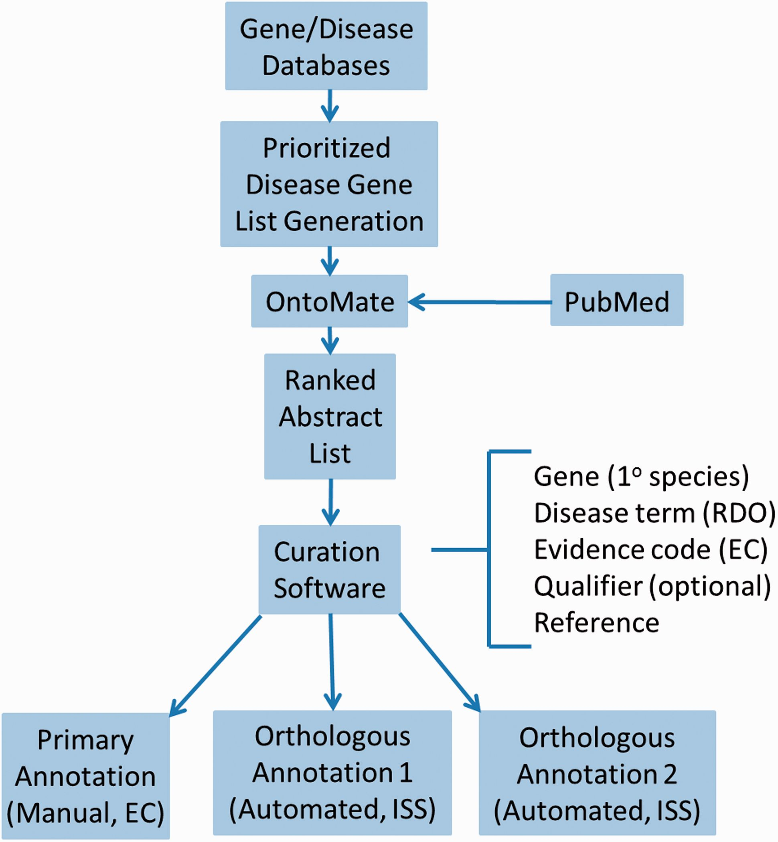
Figure 1. Disease curation flow diagram. Prioritized gene lists derived from disease databases are used to search ...
Notes:
Figure 1. Disease curation flow diagram. Prioritized gene lists derived from disease databases are used to search PubMed using the text mining tool OntoMate. The ranked abstract list obtained is manually curated to generate primary and orthologous annotations.
Unless provided in the caption above, the following copyright applies to the content of this slide: © The Author(s) 2016. Published by Oxford University Press. This is an Open Access article distributed under the terms of the Creative Commons Attribution License ( http://creativecommons.org/licenses/by/4.0/ ), which permits unrestricted reuse, distribution, and reproduction in any medium, provided the original work is properly cited.

