Slide 1
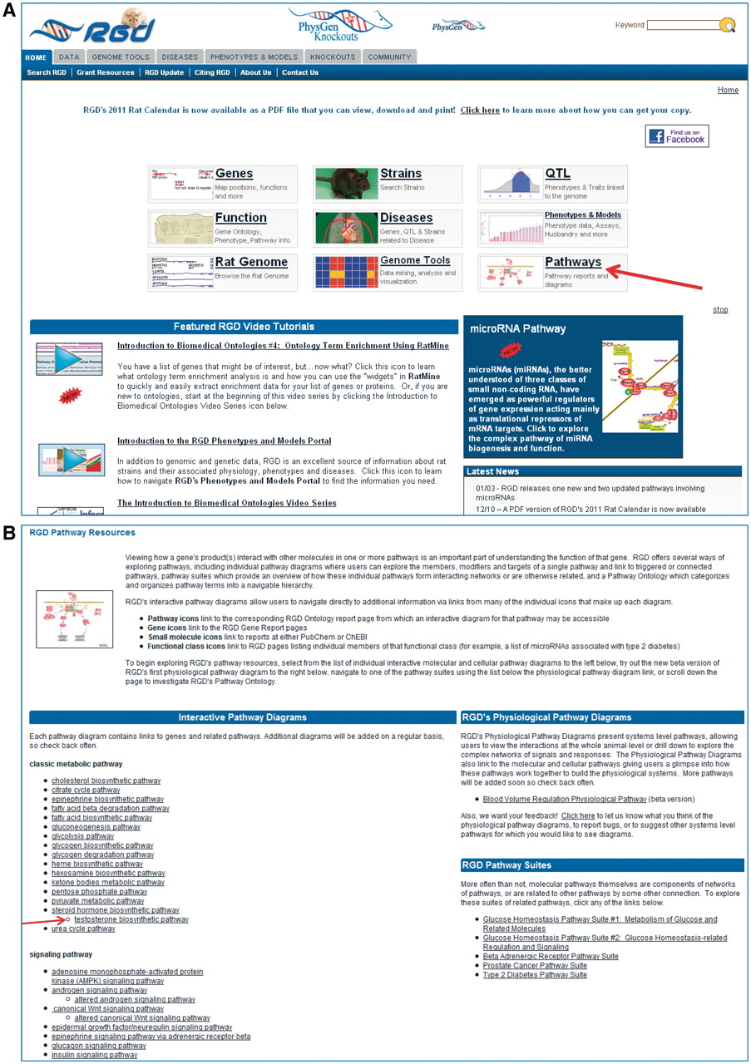
Figure 1. Shows a partial view of RGD's home page with the main entry points, video tutorials, rotating banner and the ...
Notes:
Figure 1. Shows a partial view of RGD's home page with the main entry points, video tutorials, rotating banner and the Latest News sections, with an arrow pointing to the Pathways entry (A) and the top portion of RGD's Pathway Resource page the Pathway entry brings, housing the interactive pathway diagram pages and pathway suites and physiological pathway diagrams with an arrow pointing to the ‘testosterone biosynthetic pathway’ (B).
Unless provided in the caption above, the following copyright applies to the content of this slide: © The Author(s) 2011. Published by Oxford University Press.This is Open Access article distributed under the terms of the Creative Commons Attribution Non-Commercial License (http://creativecommons.org/licenses/by-nc/2.5), which permits unrestricted non-commercial use, distribution, and reproduction in any medium, provided the original work is properly cited.

Slide 2
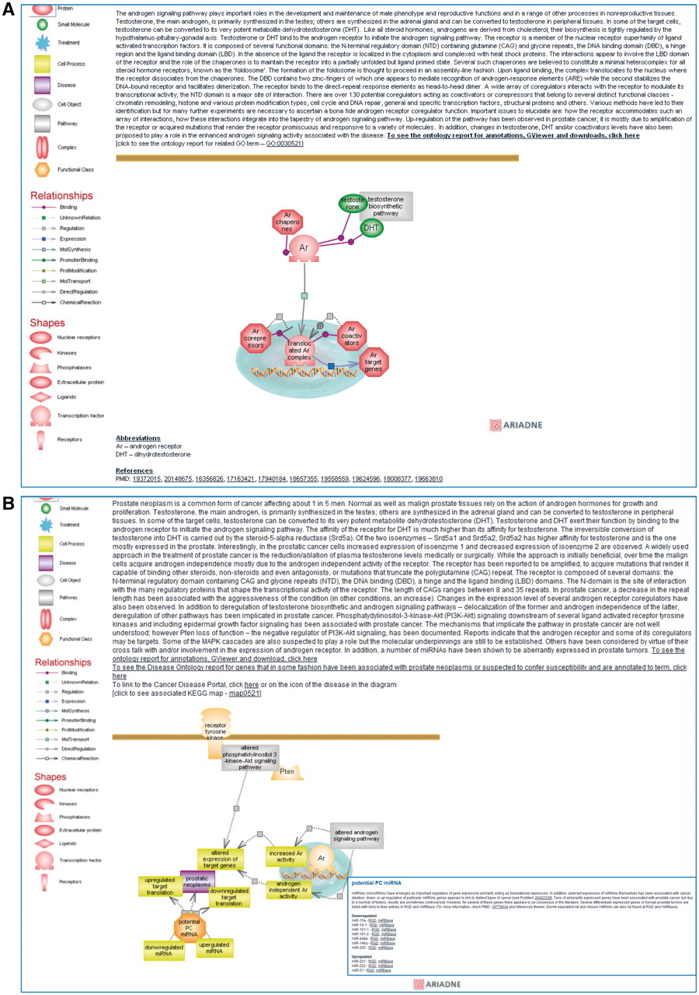
Figure 2. Shows a partial view of the interactive diagram page for the ‘androgen signaling pathway’ (A) and for the ...
Notes:
Figure 2. Shows a partial view of the interactive diagram page for the ‘androgen signaling pathway’ (A) and for the ‘prostate cancer pathway’ with the inset showing the list of miRNAs of potential interest in prostate cancer which can be accessed by clicking on the functional class icon (B).
Unless provided in the caption above, the following copyright applies to the content of this slide: © The Author(s) 2011. Published by Oxford University Press.This is Open Access article distributed under the terms of the Creative Commons Attribution Non-Commercial License (http://creativecommons.org/licenses/by-nc/2.5), which permits unrestricted non-commercial use, distribution, and reproduction in any medium, provided the original work is properly cited.

Slide 3
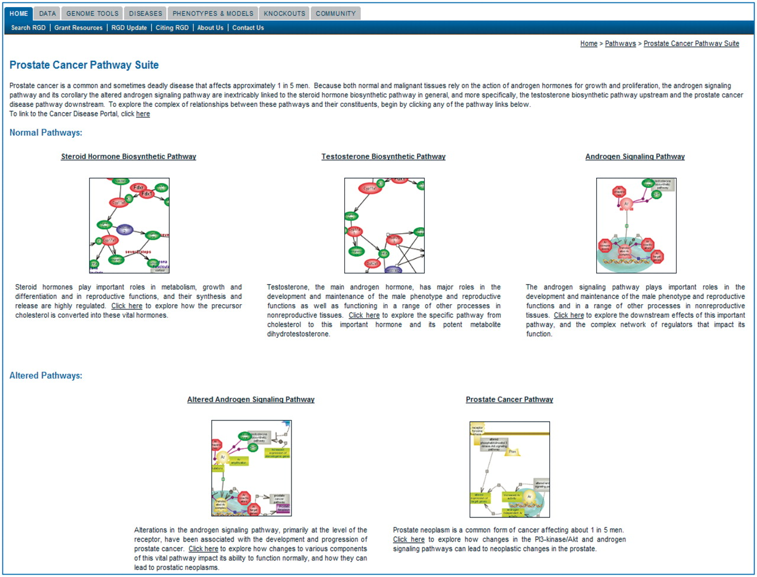
Figure 3. Shows the Prostate Cancer Pathway Suite.
Notes:
Figure 3. Shows the Prostate Cancer Pathway Suite.
Unless provided in the caption above, the following copyright applies to the content of this slide: © The Author(s) 2011. Published by Oxford University Press.This is Open Access article distributed under the terms of the Creative Commons Attribution Non-Commercial License (http://creativecommons.org/licenses/by-nc/2.5), which permits unrestricted non-commercial use, distribution, and reproduction in any medium, provided the original work is properly cited.

Slide 4
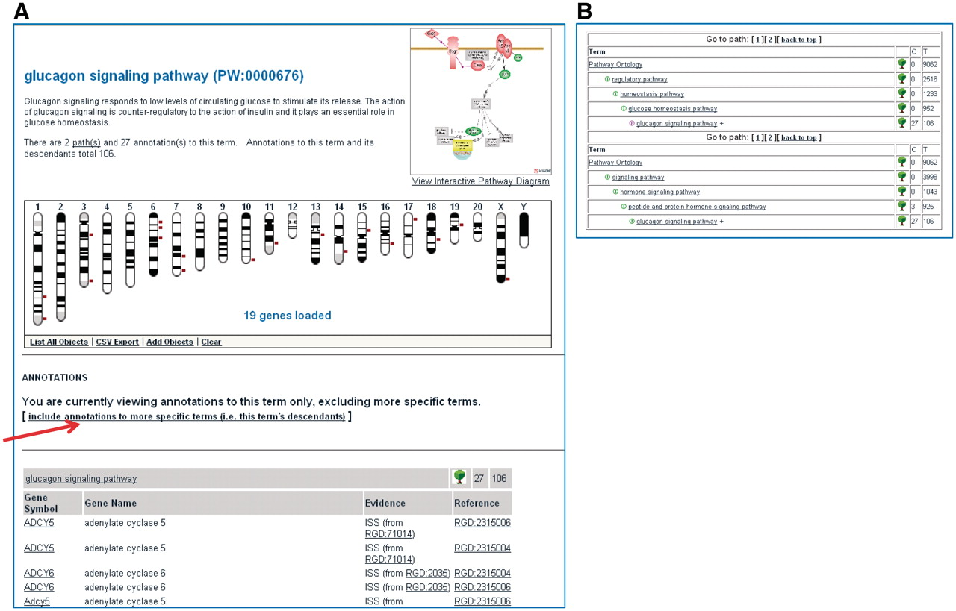
Figure 4. Shows a partial view of the Ontology Report page for the ‘glucagon signaling pathway’ (A) and the path(s) to ...
Notes:
Figure 4. Shows a partial view of the Ontology Report page for the ‘glucagon signaling pathway’ (A) and the path(s) to the ‘glucagon signaling pathway’ term within the ontology (B).
Unless provided in the caption above, the following copyright applies to the content of this slide: © The Author(s) 2011. Published by Oxford University Press.This is Open Access article distributed under the terms of the Creative Commons Attribution Non-Commercial License (http://creativecommons.org/licenses/by-nc/2.5), which permits unrestricted non-commercial use, distribution, and reproduction in any medium, provided the original work is properly cited.

