Slide 1
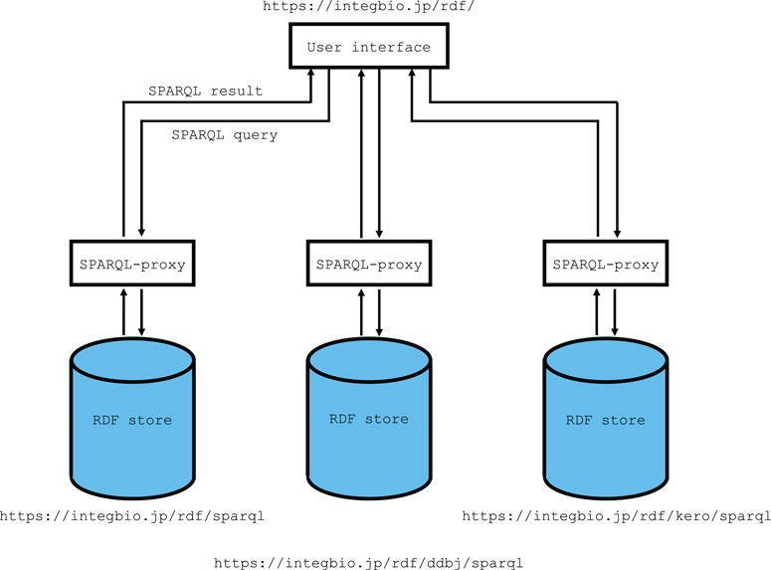
Figure 1 Overview of the system architecture. The RDF portal uses OpenLink Virtuoso as its RDF store. The SPARQL ...
Notes:
Figure 1 Overview of the system architecture. The RDF portal uses OpenLink Virtuoso as its RDF store. The SPARQL endpoint uses the SPARQL-proxy software for its front end. Currently, there are three virtuoso instances for the primary instance, the DDBJ RDF and the DBKERO RDF.
Unless provided in the caption above, the following copyright applies to the content of this slide: © The Author(s) 2018. Published by Oxford University Press. All rights reserved. For Permissions, please email: journals.permissions@oup.comThis article is published and distributed under the terms of the Oxford University Press, Standard Journals Publication Model (https://academic.oup.com/journals/pages/open_access/funder_policies/chorus/standard_publication_model)

