Slide 1
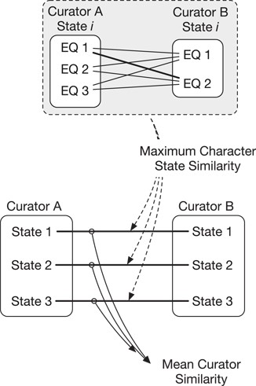
Figure 1 Similarity of annotations between two curators is calculated across multiple character states (e.g. states ...
Notes:
Figure 1 Similarity of annotations between two curators is calculated across multiple character states (e.g. states 1–3, bottom). First, the maximum character state similarity is calculated at the level of a single character state and is the best match (maximum score) in pairwise comparisons across that state’s EQ annotations. Mean curator similarity is then calculated as the mean of the maximum similarities across all character state pairs.
Unless provided in the caption above, the following copyright applies to the content of this slide: © The Author(s) 2018. Published by Oxford University Press.This is an Open Access article distributed under the terms of the Creative Commons Attribution License (http://creativecommons.org/licenses/by/4.0/), which permits unrestricted reuse, distribution, and reproduction in any medium, provided the original work is properly cited.

Slide 2
Figure 2 EQ annotations are split into E, Q and RE components and also transformed into an OWL class expression. ...
Notes:
Figure 2 EQ annotations are split into E, Q and RE components and also transformed into an OWL class expression. Superclasses of E, Q and RE and the class expression are queried via ELK. E, Q and RE superclasses are combined in the form E–Q–RE. These E–Q–RE superclasses along with the class expression’s superclasses form the subsumers of the EQ annotation for computation of semantic similarity.
Unless provided in the caption above, the following copyright applies to the content of this slide: © The Author(s) 2018. Published by Oxford University Press.This is an Open Access article distributed under the terms of the Creative Commons Attribution License (http://creativecommons.org/licenses/by/4.0/), which permits unrestricted reuse, distribution, and reproduction in any medium, provided the original work is properly cited.

Slide 3
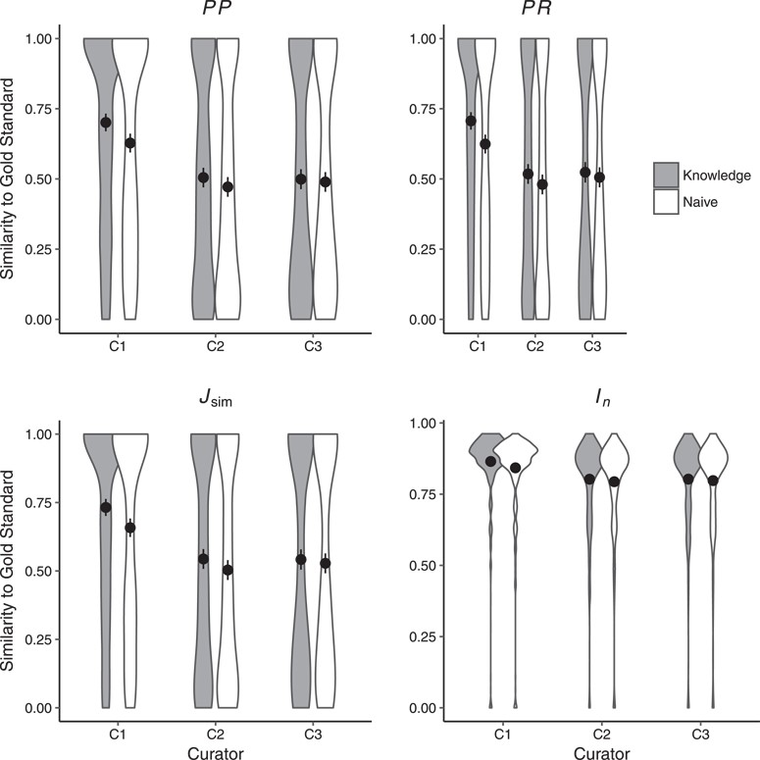
Figure 3 Similarity of human annotations to the gold standard in Naïve and Knowledge rounds. Shown are means across ...
Notes:
Figure 3 Similarity of human annotations to the gold standard in Naïve and Knowledge rounds. Shown are means across all 463 character states. Error bars represent two standard errors of the mean. Curators C1 (as per PP, PR, $J_{\mbox{sim}}$ and $I_n$) and C2 (as per PR, $J_{\mbox{sim}}$) were significantly closer to the gold standard in the Knowledge round as compared to the Naïve round. Detailed results are shown in Supplementary Materials, Table 2.
Unless provided in the caption above, the following copyright applies to the content of this slide: © The Author(s) 2018. Published by Oxford University Press.This is an Open Access article distributed under the terms of the Creative Commons Attribution License (http://creativecommons.org/licenses/by/4.0/), which permits unrestricted reuse, distribution, and reproduction in any medium, provided the original work is properly cited.

Slide 4
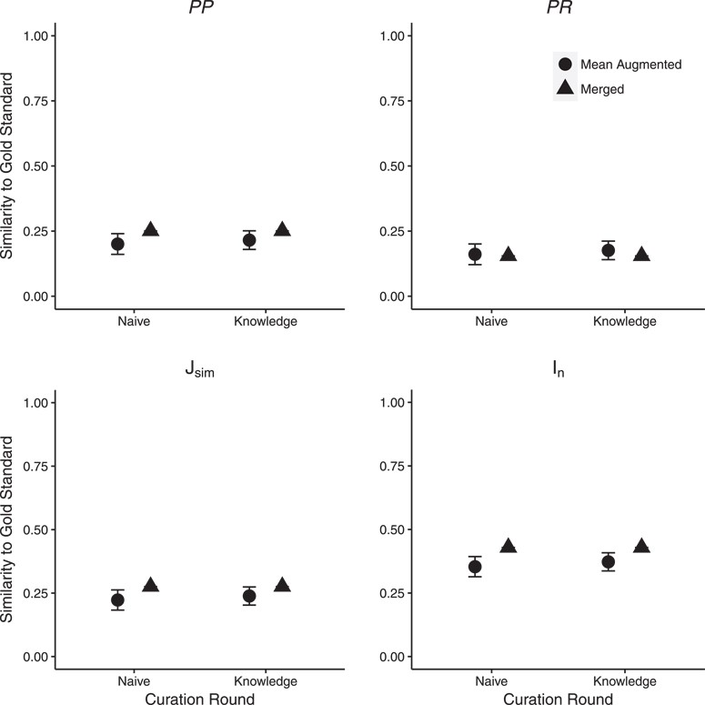
Figure 4 Effect of ontology completeness on SCP performance as measured by similarity to the gold standard. ‘Mean ...
Notes:
Figure 4 Effect of ontology completeness on SCP performance as measured by similarity to the gold standard. ‘Mean Augmented’ is the mean of similarity scores from the three curator augmented ontologies; error bars show two standard errors of the mean. Significant differences in similarity between SCP and the gold standard were found for the majority of statistics across the two rounds. Detailed results are shown in Supplementary Materials, Table 2.
Unless provided in the caption above, the following copyright applies to the content of this slide: © The Author(s) 2018. Published by Oxford University Press.This is an Open Access article distributed under the terms of the Creative Commons Attribution License (http://creativecommons.org/licenses/by/4.0/), which permits unrestricted reuse, distribution, and reproduction in any medium, provided the original work is properly cited.

Slide 5
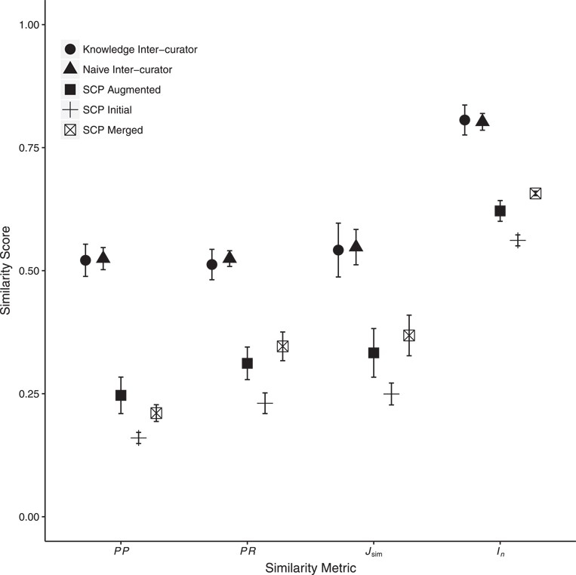
Figure 5 Mean inter-curator consistency and mean similarity between human- and machine (SCP)-generated annotations. ...
Notes:
Figure 5 Mean inter-curator consistency and mean similarity between human- and machine (SCP)-generated annotations. Error bars show two standard errors of the mean. Inter-curator consistency results are shown for both the Naïve and Knowledge annotation rounds. SCP runs used either the Initial, C1, C2 or C3 Augmented or the Merged ontologies. Only SCP similarity to human-generated annotations from the Knowledge round are shown. Consistency between SCP annotations to human annotations was significantly lower than human inter-curator consistency. Across all metrics, SCP annotation similarity to human annotations increased significantly between the use of Initial to Augmented ontologies and again from Augmented to Merged ontologies except for PP (decreased from Augmented to Merged). Detailed results are in Supplementary Materials, Tables 4 and 5.
Unless provided in the caption above, the following copyright applies to the content of this slide: © The Author(s) 2018. Published by Oxford University Press.This is an Open Access article distributed under the terms of the Creative Commons Attribution License (http://creativecommons.org/licenses/by/4.0/), which permits unrestricted reuse, distribution, and reproduction in any medium, provided the original work is properly cited.

