Slide 1
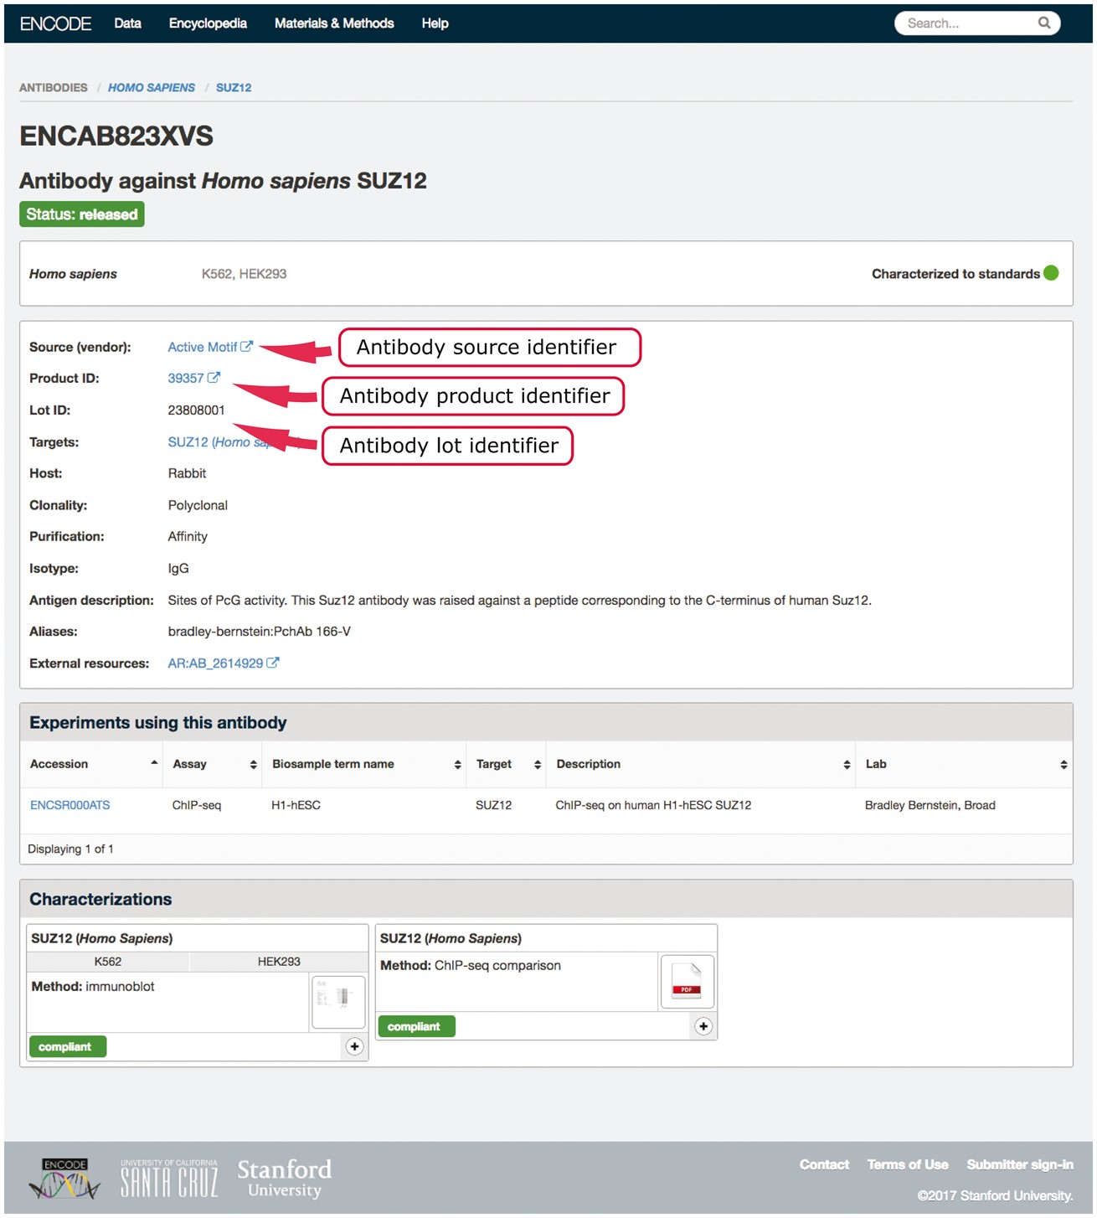
Figure 2. Example of an antibody page for antibody lot (ENCAB823XVS). Various aspects of metadata are displayed on the ...
Notes:
Figure 2. Example of an antibody page for antibody lot (ENCAB823XVS). Various aspects of metadata are displayed on the antibody page, including the properties that are used for antibody uniqueness validation. The set includes the lot identifier, product identifier and the source (vendor) name.
Unless provided in the caption above, the following copyright applies to the content of this slide: © The Author(s) 2018. Published by Oxford University Press.This is an Open Access article distributed under the terms of the Creative Commons Attribution License (http://creativecommons.org/licenses/by/4.0/), which permits unrestricted reuse, distribution, and reproduction in any medium, provided the original work is properly cited.

