Slide 1
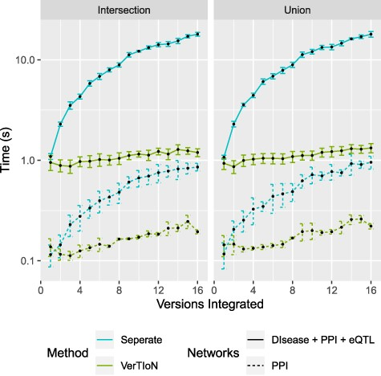
Fig. 8 Processing time for integrating versions. Shows a run-time comparison between loading and integrating ...
Notes:
Fig. 8 Processing time for integrating versions. Shows a run-time comparison between loading and integrating tissue-specific networks when stored separately as CSR matrices and the VerTIoN structure. Each point represents 10 iterations of randomly chosen sets of network versions.
Unless provided in the caption above, the following copyright applies to the content of this slide: © The Author(s) 2020. Published by Oxford University Press.This is an Open Access article distributed under the terms of the Creative Commons Attribution License (http://creativecommons.org/licenses/by/4.0/), which permits unrestricted reuse, distribution, and reproduction in any medium, provided the original work is properly cited.

