Slide 1
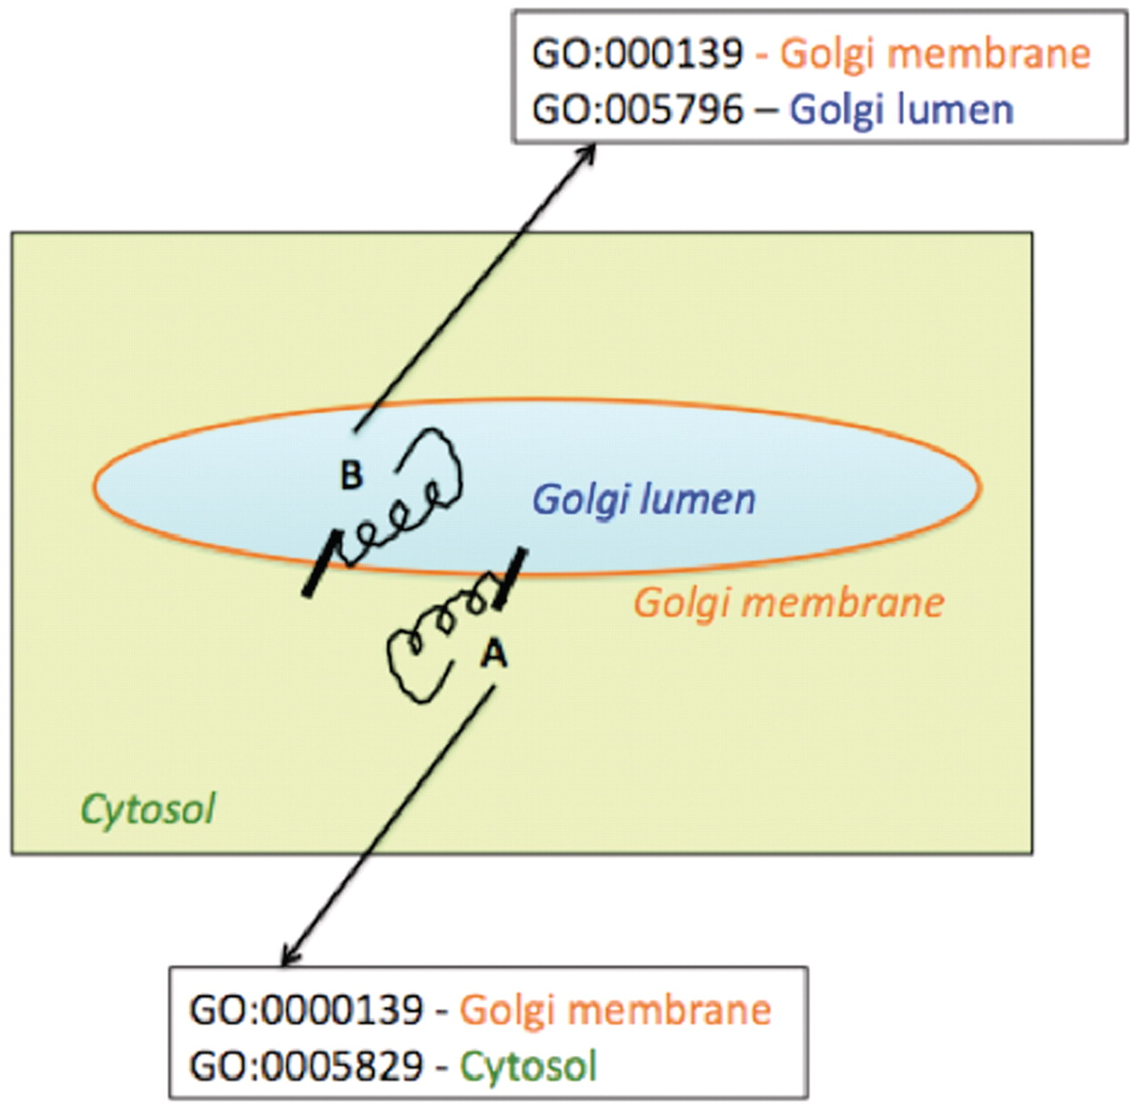
Figure 7. Schematic representation of association of multiple Cellular Component Gene Ontology terms with two ...
Notes:
Figure 7. Schematic representation of association of multiple Cellular Component Gene Ontology terms with two differentially oriented Golgi membrane enzymes.
Unless provided in the caption above, the following copyright applies to the content of this slide: © The Author(s) 2012. Published by Oxford University Press.This is an Open Access article distributed under the terms of the Creative Commons Attribution Non-Commercial License (http://creativecommons.org/licenses/by-nc/3.0), which permits unrestricted non-commercial use, distribution, and reproduction in any medium, provided the original work is properly cited.

