Slide 1
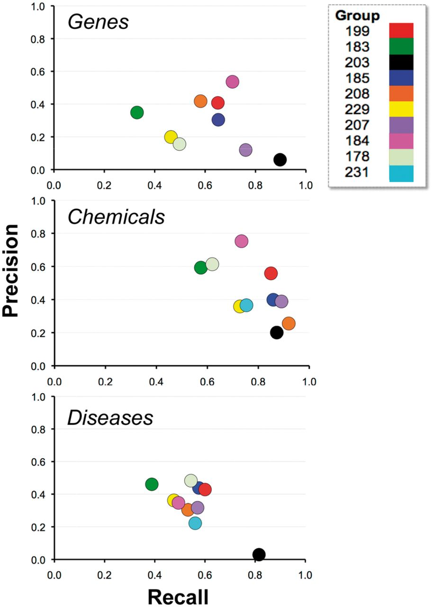
Figure 10. Recall and precision. Combined average recall (x-axis) and precision (y-axis) results are shown for each ...
Notes:
Figure 10. Recall and precision. Combined average recall (x-axis) and precision (y-axis) results are shown for each participating group (color-coded by group number) within major NER category. For some groups there appeared to be a clear trade-off between recall and precision (e.g. 203), whereas for other groups trade-offs were less apparent (e.g. 184 and 199).
Unless provided in the caption above, the following copyright applies to the content of this slide: © The Author(s) 2014. Published by Oxford University Press.This is an Open Access article distributed under the terms of the Creative Commons Attribution License (http://creativecommons.org/licenses/by/3.0/), which permits unrestricted reuse, distribution, and reproduction in any medium, provided the original work is properly cited.

