Slide 1
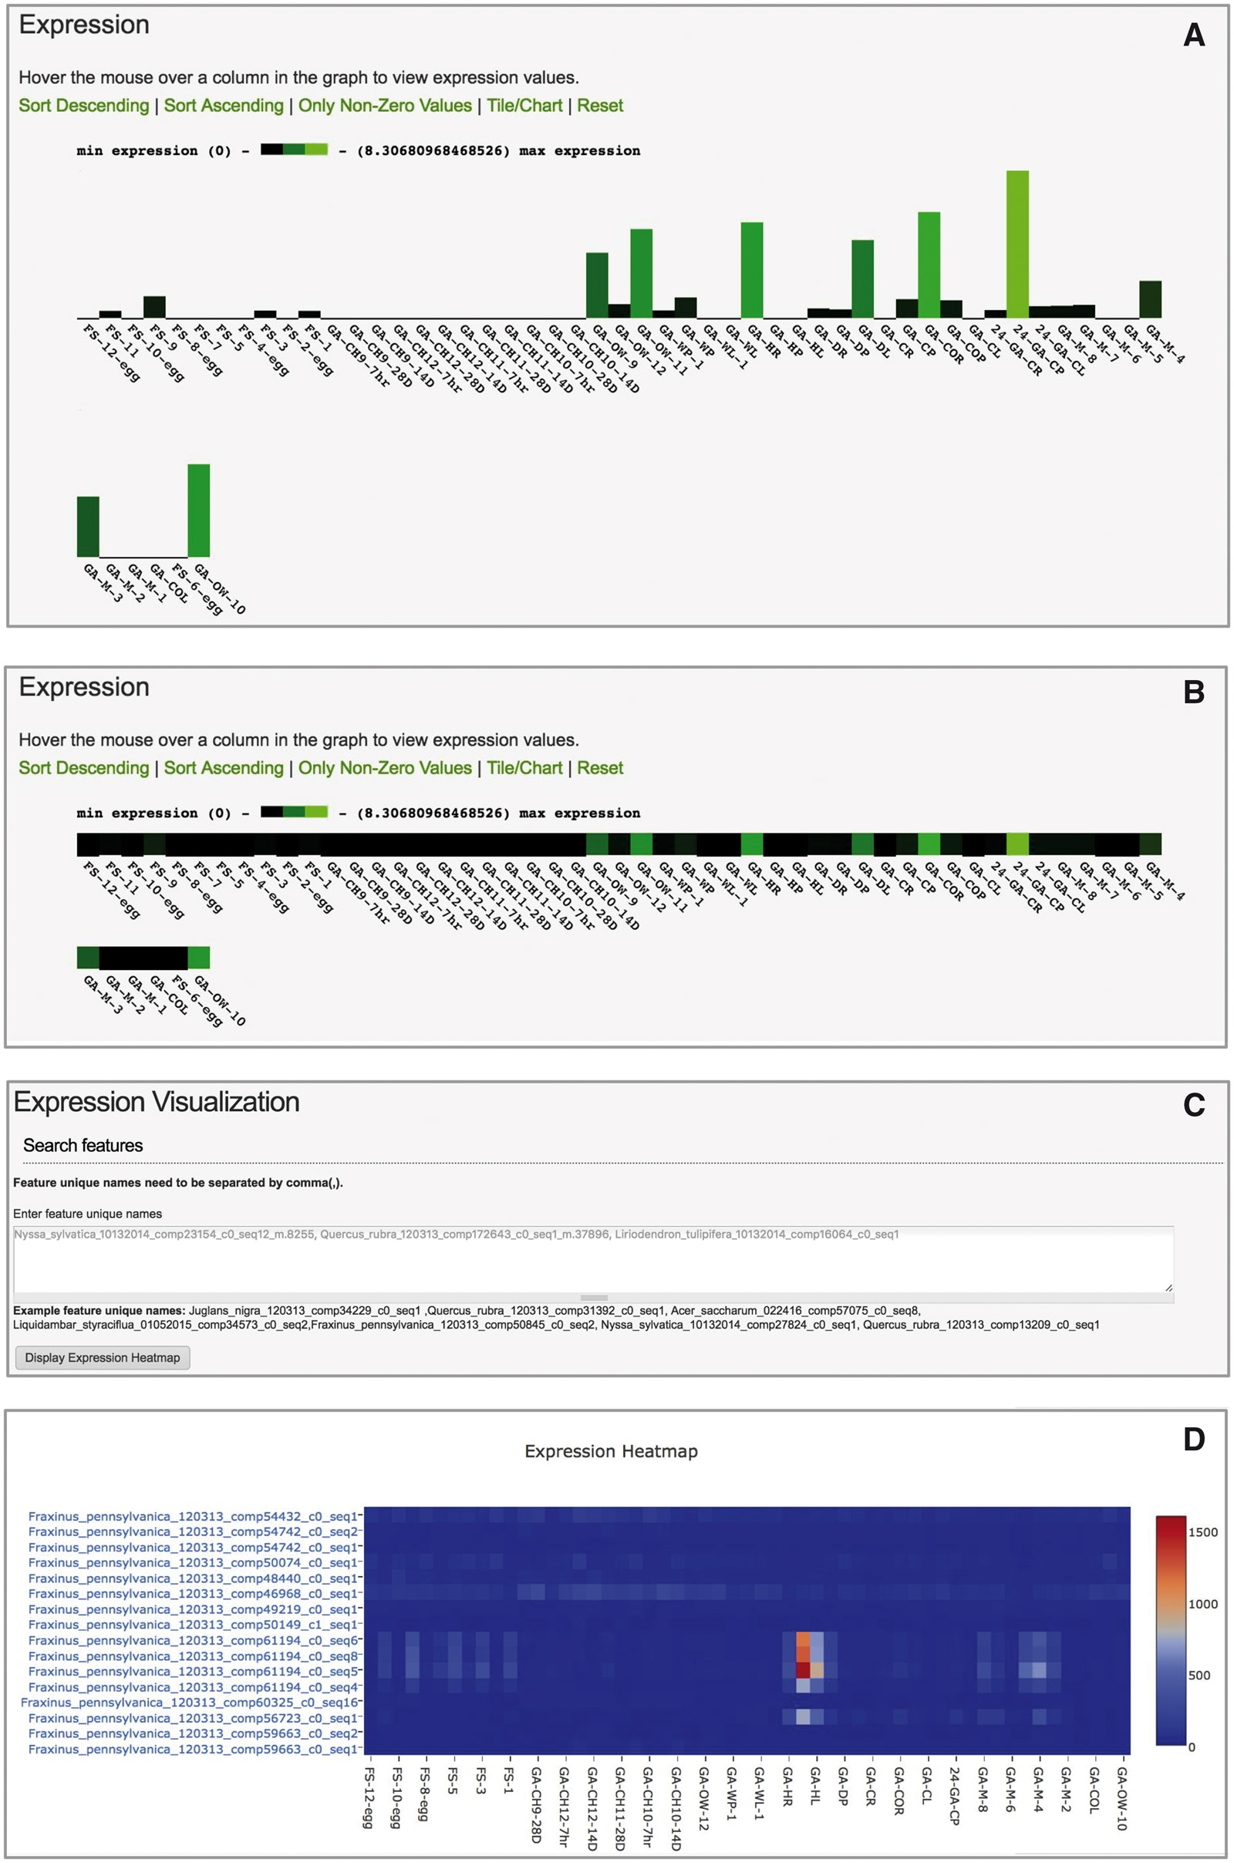
Figure 6. User interface of Tripal Analysis Expression module. (A) The feature page initially displays expression ...
Notes:
Figure 6. User interface of Tripal Analysis Expression module. (A) The feature page initially displays expression values as a bar chart. (B) Users may toggle the the barchart to a one-dimensional heatmap. (C) An interactive tool allows users to paste in a list of feature ids of interest. (D) The tool will create a two dimensional heatmap of the feature expression values across all available biomaterials. This heatmap displays ubiquitin transcripts (top eight rows) vs. heat-shock transcripts (bottom eight rows) from Fraxinus pennsylvanica (green ash). Hovering over the boxes with red and orange color in the online heatmap reveals that they are derived from petioles and leaves exposed to heat stress (40 °C for 24 h).
Unless provided in the caption above, the following copyright applies to the content of this slide: © The Author(s) 2017. Published by Oxford University Press.This is an Open Access article distributed under the terms of the Creative Commons Attribution License (http://creativecommons.org/licenses/by/4.0/), which permits unrestricted reuse, distribution, and reproduction in any medium, provided the original work is properly cited.

