Slide 1
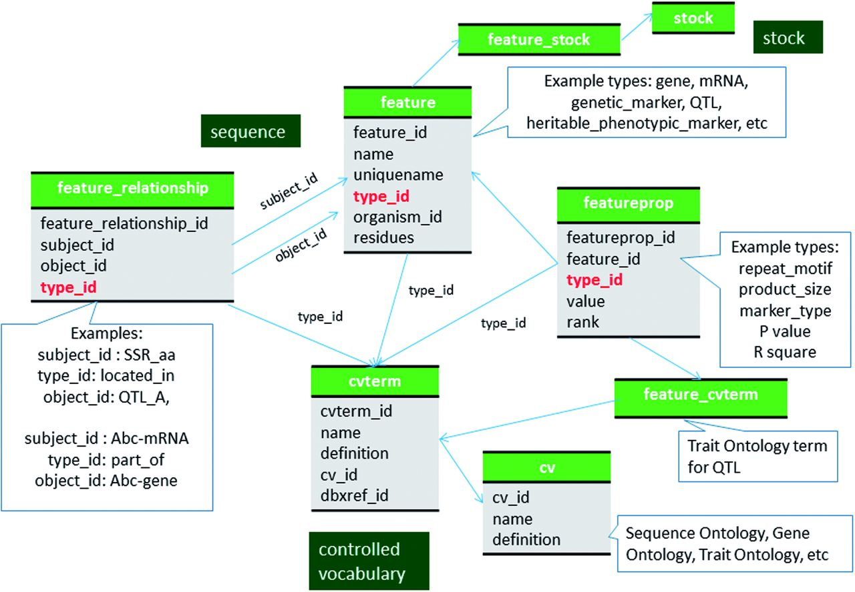
Figure 1 Schematic diagram of how genomic features are stored in Chado using ontology. The bold red fields represent ...
Notes:
Figure 1 Schematic diagram of how genomic features are stored in Chado using ontology. The bold red fields represent foreign keys to the cvterm table which houses vocabulary terms. Boxes in dark green represents the modules of Chado represented in this diagram.
Unless provided in the caption above, the following copyright applies to the content of this slide: © The Author(s) 2016. Published by Oxford University Press.This is an Open Access article distributed under the terms of the Creative Commons Attribution License (http://creativecommons.org/licenses/by/4.0/), which permits unrestricted reuse, distribution, and reproduction in any medium, provided the original work is properly cited.

Slide 2
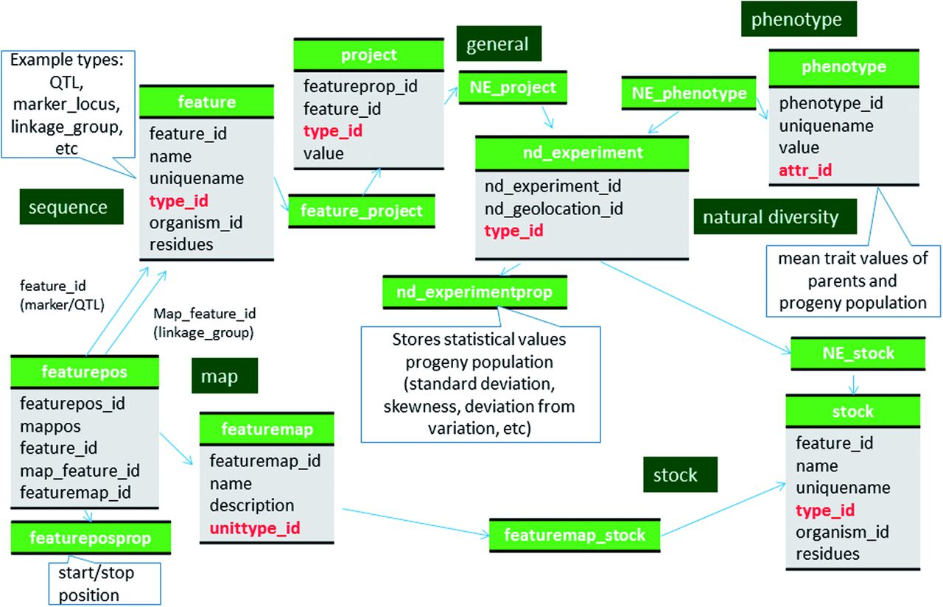
Figure 2 Schematic diagram of how the genetic map data of molecular markers and QTL are stored in Chado. The bold red ...
Notes:
Figure 2 Schematic diagram of how the genetic map data of molecular markers and QTL are stored in Chado. The bold red fields represent foreign keys to the cvterm table which houses vocabulary terms. Boxes in dark green represents the modules of Chado represented in this diagram.
Unless provided in the caption above, the following copyright applies to the content of this slide: © The Author(s) 2016. Published by Oxford University Press.This is an Open Access article distributed under the terms of the Creative Commons Attribution License (http://creativecommons.org/licenses/by/4.0/), which permits unrestricted reuse, distribution, and reproduction in any medium, provided the original work is properly cited.

Slide 3
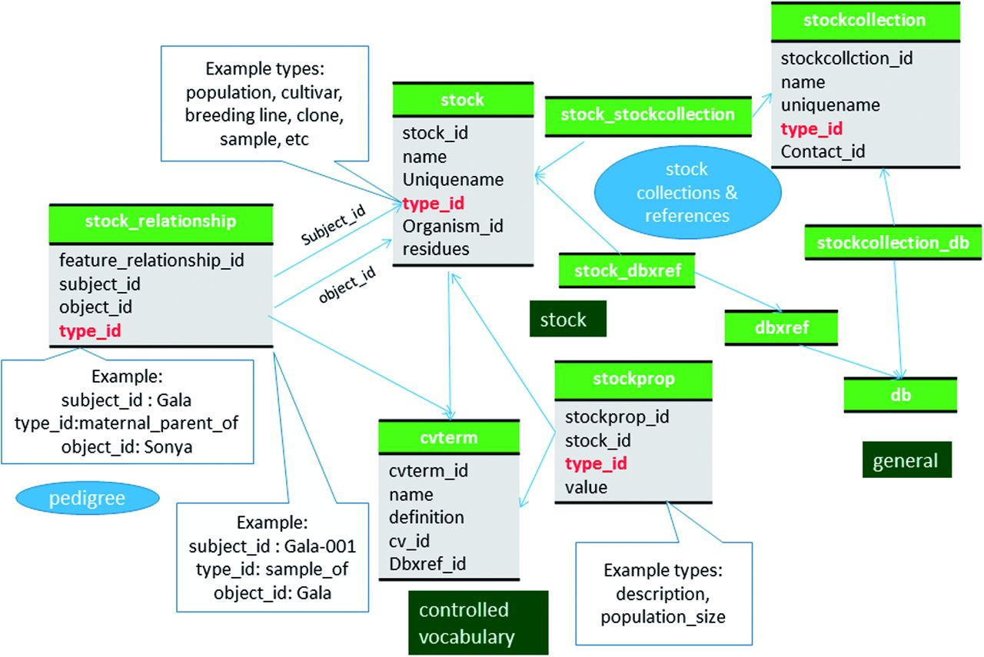
Figure 3 Schematic diagram of how stocks are stored in Chado. Hierarchical stocks, from samples, cultivars to ...
Notes:
Figure 3 Schematic diagram of how stocks are stored in Chado. Hierarchical stocks, from samples, cultivars to population are stored in samples and their relationship including pedigree are stored in stock_relationship table. The bold red fields represent foreign keys to the cvterm table which houses vocabulary terms. Boxes in dark green represents the modules of Chado represented in this diagram.
Unless provided in the caption above, the following copyright applies to the content of this slide: © The Author(s) 2016. Published by Oxford University Press.This is an Open Access article distributed under the terms of the Creative Commons Attribution License (http://creativecommons.org/licenses/by/4.0/), which permits unrestricted reuse, distribution, and reproduction in any medium, provided the original work is properly cited.

Slide 4
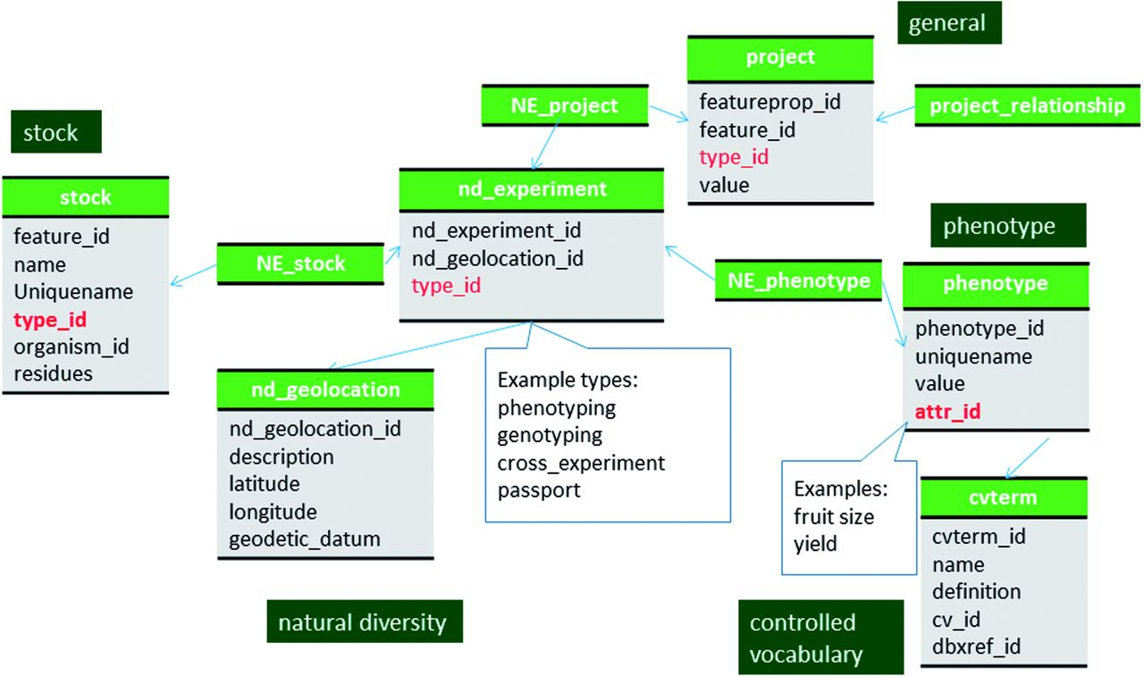
Figure 4 Schematic diagram of how phenotypic data are stored in Chado. Datasets, such as passport data and cross data, ...
Notes:
Figure 4 Schematic diagram of how phenotypic data are stored in Chado. Datasets, such as passport data and cross data, which do not have associated phenotypic or genotypic data can also be stored in the nd_experiment table and linked to the stock table. The bold red fields represent foreign keys to the cvterm table which houses vocabulary terms. Boxes in dark green represents the modules of Chado represented in this diagram.
Unless provided in the caption above, the following copyright applies to the content of this slide: © The Author(s) 2016. Published by Oxford University Press.This is an Open Access article distributed under the terms of the Creative Commons Attribution License (http://creativecommons.org/licenses/by/4.0/), which permits unrestricted reuse, distribution, and reproduction in any medium, provided the original work is properly cited.

Slide 5
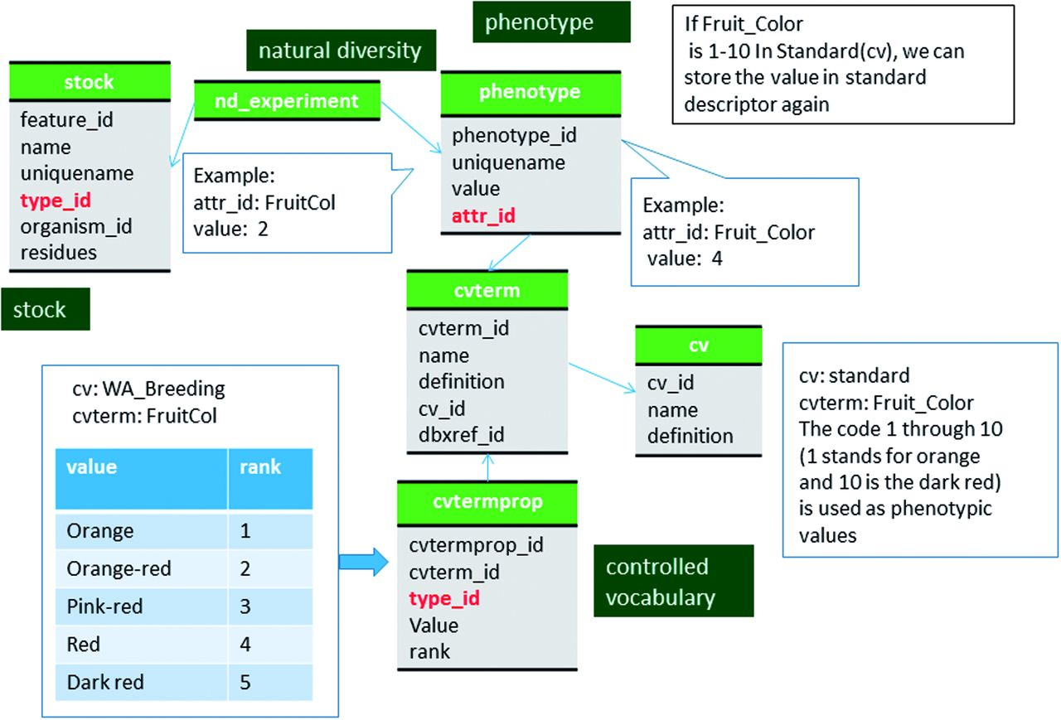
Figure 5 Schematic diagram of how coded phenotypic values are stored in Chado. The same data can be stored in two ...
Notes:
Figure 5 Schematic diagram of how coded phenotypic values are stored in Chado. The same data can be stored in two different code system to enable comparison among datasets. The bold red fields represent foreign keys to the cvterm table which houses vocabulary terms. Boxes in dark green represents the modules of Chado represented in this diagram.
Unless provided in the caption above, the following copyright applies to the content of this slide: © The Author(s) 2016. Published by Oxford University Press.This is an Open Access article distributed under the terms of the Creative Commons Attribution License (http://creativecommons.org/licenses/by/4.0/), which permits unrestricted reuse, distribution, and reproduction in any medium, provided the original work is properly cited.

Slide 6
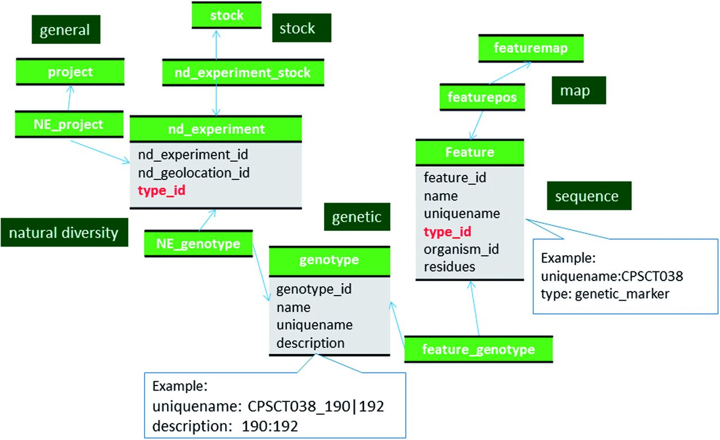
Figure 6 Schematic diagram of how genotypic data are stored in Chado. The bold red fields represent foreign keys to ...
Notes:
Figure 6 Schematic diagram of how genotypic data are stored in Chado. The bold red fields represent foreign keys to the cvterm table which houses vocabulary terms. Boxes in dark green represents the modules of Chado represented in this diagram.
Unless provided in the caption above, the following copyright applies to the content of this slide: © The Author(s) 2016. Published by Oxford University Press.This is an Open Access article distributed under the terms of the Creative Commons Attribution License (http://creativecommons.org/licenses/by/4.0/), which permits unrestricted reuse, distribution, and reproduction in any medium, provided the original work is properly cited.

Slide 7
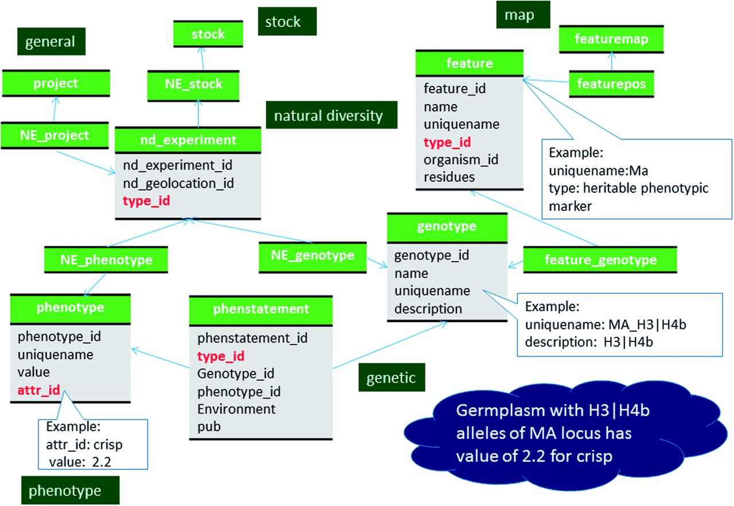
Figure 7 Schematic diagram of how relationship between genotype and phenotype is stored in Chado. The bold red fields ...
Notes:
Figure 7 Schematic diagram of how relationship between genotype and phenotype is stored in Chado. The bold red fields represent foreign keys to the cvterm table which houses vocabulary terms. Boxes in dark green represents the modules of Chado represented in this diagram.
Unless provided in the caption above, the following copyright applies to the content of this slide: © The Author(s) 2016. Published by Oxford University Press.This is an Open Access article distributed under the terms of the Creative Commons Attribution License (http://creativecommons.org/licenses/by/4.0/), which permits unrestricted reuse, distribution, and reproduction in any medium, provided the original work is properly cited.

