Slide 1
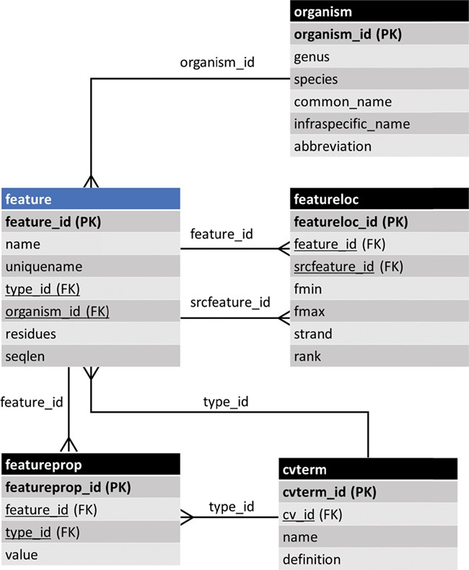
Figure 1 The entity–relationship (ER) diagram of the feature table of Chado and some of its linked tables (some table ...
Notes:
Figure 1 The entity–relationship (ER) diagram of the feature table of Chado and some of its linked tables (some table columns removed). The feature table stores genomic features and ancillary data is housed in linked tables.
Unless provided in the caption above, the following copyright applies to the content of this slide: © The Author(s) 2019. Published by Oxford University Press.This is an Open Access article distributed under the terms of the Creative Commons Attribution License (http://creativecommons.org/licenses/by/4.0/), which permits unrestricted reuse, distribution, and reproduction in any medium, provided the original work is properly cited.

