Slide 1
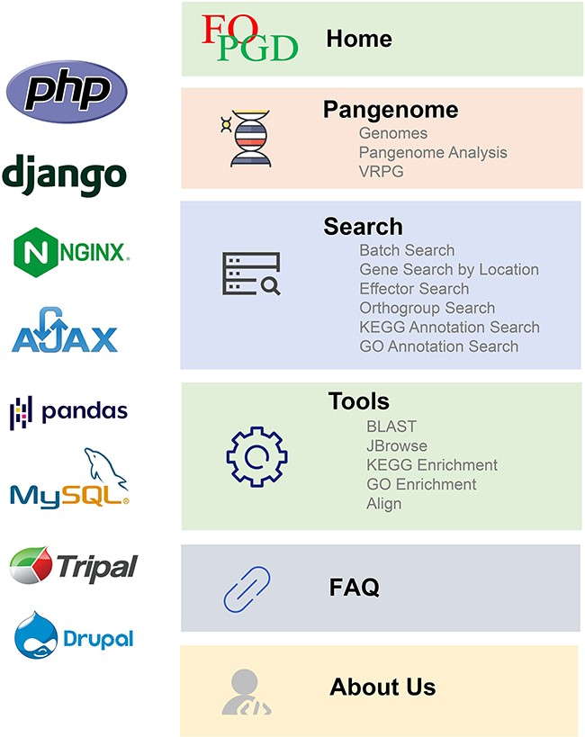
Figure 1. The framework, core system and programming language of FOPGDB.
Notes:
Figure 1. The framework, core system and programming language of FOPGDB.
Unless provided in the caption above, the following copyright applies to the content of this slide: © The Author(s) 2024. Published by Oxford University Press.This is an Open Access article distributed under the terms of the Creative Commons Attribution License (https://creativecommons.org/licenses/by/4.0/), which permits unrestricted reuse, distribution, and reproduction in any medium, provided the original work is properly cited.

Slide 2
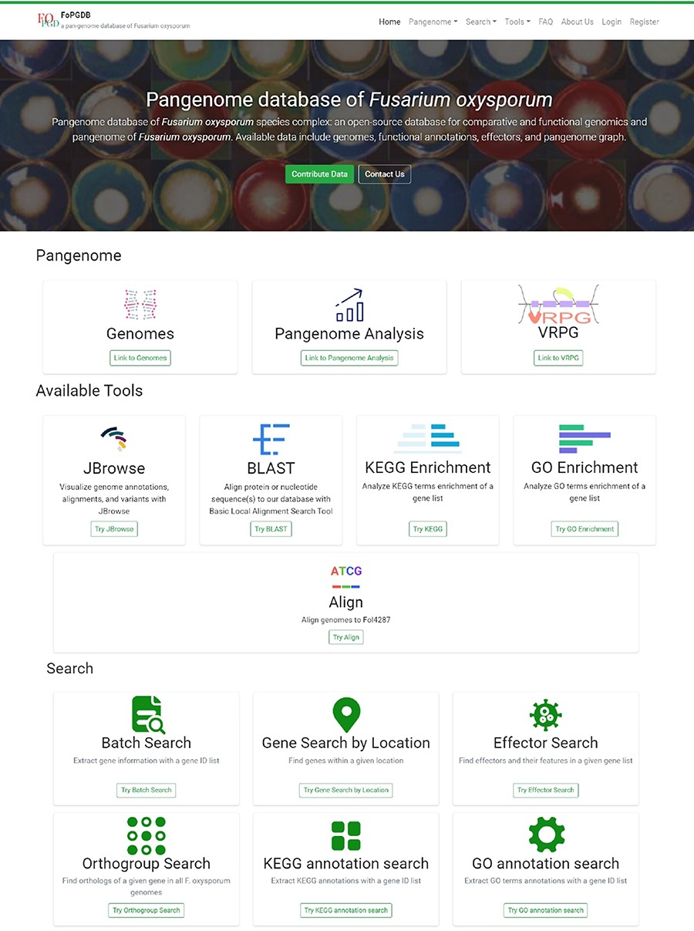
Figure 2. The homepage of FoPGDB.
Notes:
Figure 2. The homepage of FoPGDB.
Unless provided in the caption above, the following copyright applies to the content of this slide: © The Author(s) 2024. Published by Oxford University Press.This is an Open Access article distributed under the terms of the Creative Commons Attribution License (https://creativecommons.org/licenses/by/4.0/), which permits unrestricted reuse, distribution, and reproduction in any medium, provided the original work is properly cited.

Slide 3
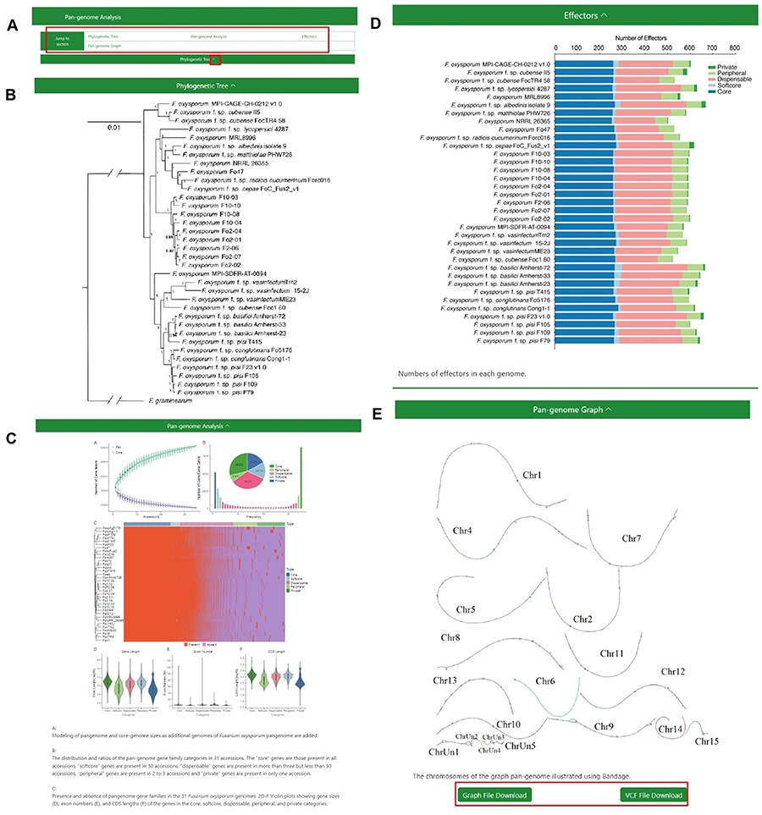
Figure 3. The Pangenome Analysis section under the Pangenome module. (A) Quick access links. (B) Maximum-likelihood ...
Notes:
Figure 3. The Pangenome Analysis section under the Pangenome module. (A) Quick access links. (B) Maximum-likelihood tree using single-copy orthologous protein sequences in 35 Fusarium oxysporum genomes. Fusarium graminearum was used as an outgroup. (C) (Top left) Modeling of pangenome and core-genome sizes as additional genomes of F. oxysporum pangenome are added. (Top right) The distribution and ratios of the pangenome gene family categories in 35 accessions. The ‘core’ genes are those present in all accessions, ‘softcore’ genes are present in 34 accessions, ‘dispensable’ genes are present in more than 3 but less than 34 accessions, ‘peripheral’ genes are present in 2 to 3 accessions and ‘private’ genes are present in only 1 accession. (Center) Presence and absence of pangenome gene families in the 35 F. oxysporum genomes. (Bottom) Violin plots showing gene sizes (left), exon numbers (middle) and CDS lengths (right) of the genes in the core, soft-core, dispensable, peripheral and private categories. (D) Numbers of effectors in each genome. (E) Visualization of the chromosomes in the graph genome with Bandage.
Unless provided in the caption above, the following copyright applies to the content of this slide: © The Author(s) 2024. Published by Oxford University Press.This is an Open Access article distributed under the terms of the Creative Commons Attribution License (https://creativecommons.org/licenses/by/4.0/), which permits unrestricted reuse, distribution, and reproduction in any medium, provided the original work is properly cited.

Slide 4
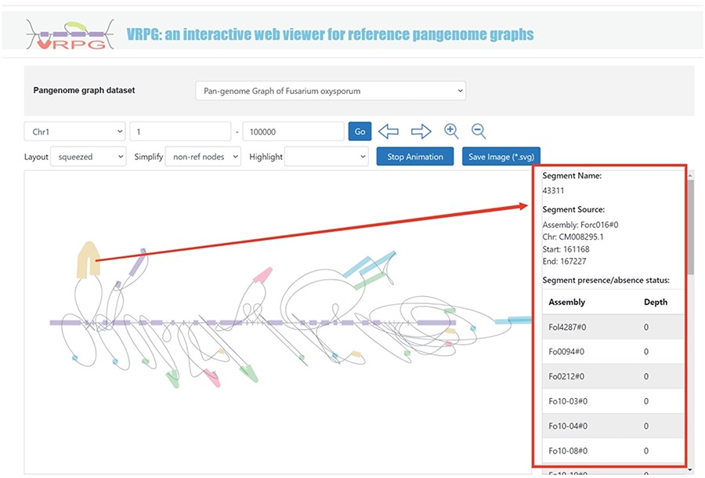
Figure 4. VRPG section under the Pangenome module shows a section in the graph pangenome.
Notes:
Figure 4. VRPG section under the Pangenome module shows a section in the graph pangenome.
Unless provided in the caption above, the following copyright applies to the content of this slide: © The Author(s) 2024. Published by Oxford University Press.This is an Open Access article distributed under the terms of the Creative Commons Attribution License (https://creativecommons.org/licenses/by/4.0/), which permits unrestricted reuse, distribution, and reproduction in any medium, provided the original work is properly cited.

Slide 5
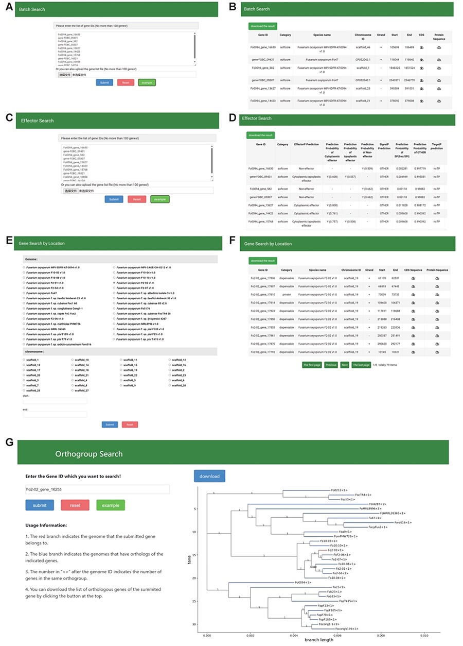
Figure 5. The Search module sections. (A, B) Search page and result page of Batch Search, (C, D) Search page and result ...
Notes:
Figure 5. The Search module sections. (A, B) Search page and result page of Batch Search, (C, D) Search page and result page of effector search, (E, F) Search page and result page of Gene Search By Location, (G) Search page and result page of Orthogroup search.
Unless provided in the caption above, the following copyright applies to the content of this slide: © The Author(s) 2024. Published by Oxford University Press.This is an Open Access article distributed under the terms of the Creative Commons Attribution License (https://creativecommons.org/licenses/by/4.0/), which permits unrestricted reuse, distribution, and reproduction in any medium, provided the original work is properly cited.

Slide 6
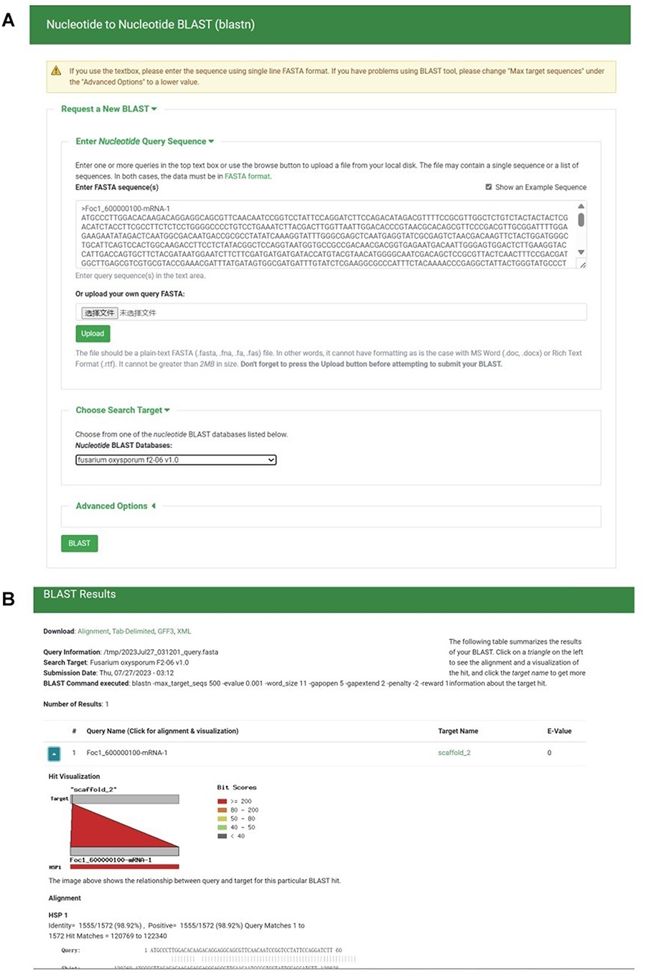
Figure 6. BLAST section under the Tools module. (A) BLAST search page. (B) BLAST result page.
Notes:
Figure 6. BLAST section under the Tools module. (A) BLAST search page. (B) BLAST result page.
Unless provided in the caption above, the following copyright applies to the content of this slide: © The Author(s) 2024. Published by Oxford University Press.This is an Open Access article distributed under the terms of the Creative Commons Attribution License (https://creativecommons.org/licenses/by/4.0/), which permits unrestricted reuse, distribution, and reproduction in any medium, provided the original work is properly cited.

Slide 7
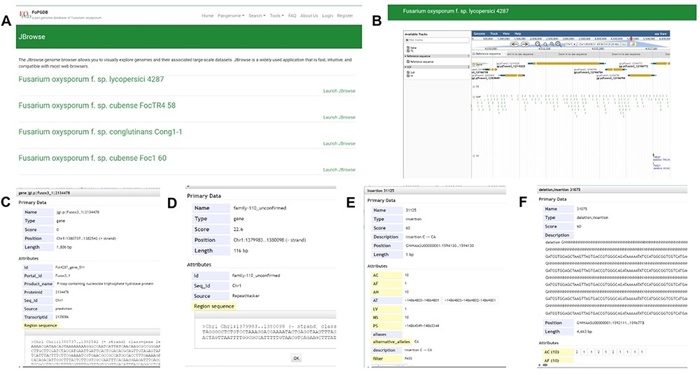
Figure 7. JBrowse section under the Tools module. (A) Page of genome browser index, (B) available tracks for different ...
Notes:
Figure 7. JBrowse section under the Tools module. (A) Page of genome browser index, (B) available tracks for different types of genomic features, (C) a window showing detailed information of the target gene model, (D) TE information, (E) SNPs and INDELs information for 35 Fusarium oxysporum accessions, (F) SVs’ information for 35 F. oxysporum accessions.
Unless provided in the caption above, the following copyright applies to the content of this slide: © The Author(s) 2024. Published by Oxford University Press.This is an Open Access article distributed under the terms of the Creative Commons Attribution License (https://creativecommons.org/licenses/by/4.0/), which permits unrestricted reuse, distribution, and reproduction in any medium, provided the original work is properly cited.

Slide 8
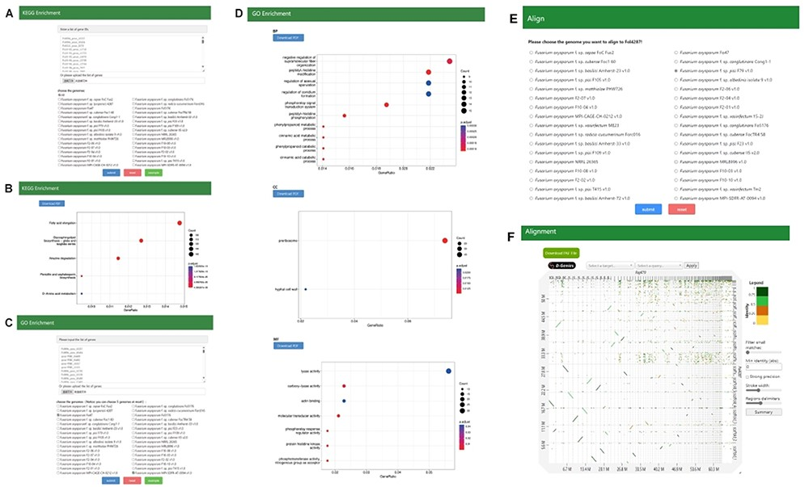
Figure 8. (A, B) Search page and result page of KEGG enrichment, (C, D) Search page and result page of GO Enrichment, ...
Notes:
Figure 8. (A, B) Search page and result page of KEGG enrichment, (C, D) Search page and result page of GO Enrichment, (E, F) Search page and result page of Alignment.
Unless provided in the caption above, the following copyright applies to the content of this slide: © The Author(s) 2024. Published by Oxford University Press.This is an Open Access article distributed under the terms of the Creative Commons Attribution License (https://creativecommons.org/licenses/by/4.0/), which permits unrestricted reuse, distribution, and reproduction in any medium, provided the original work is properly cited.

