Slide 1
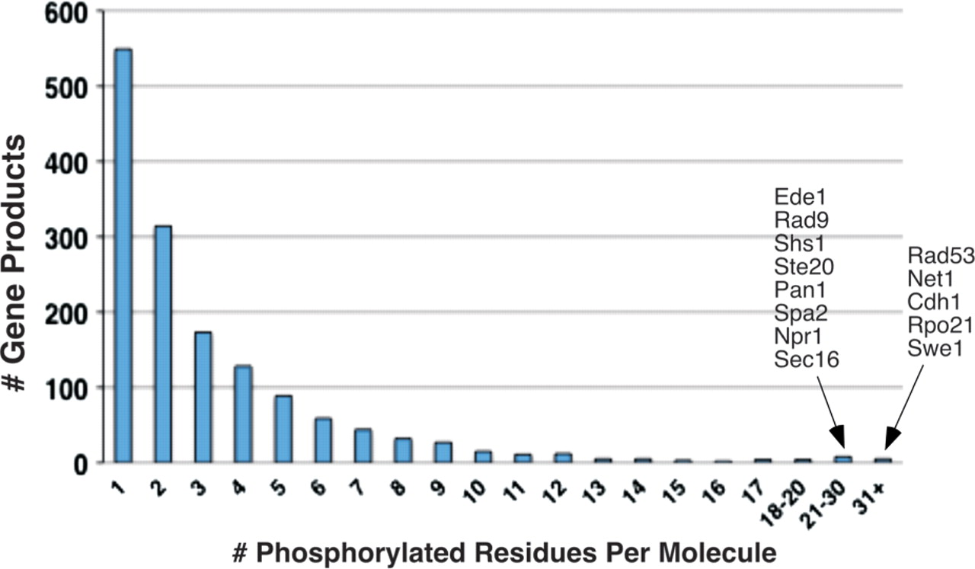
Figure 4. Distribution of multiply phosphorylated proteins in PhosphoGRID. The number of proteins with the indicated ...
Notes:
Figure 4. Distribution of multiply phosphorylated proteins in PhosphoGRID. The number of proteins with the indicated phosphorylated residues in PhosphoGRID are shown. The identity of gene products with 21 or greater identified phosphorylations are indicated to the right.
Unless provided in the caption above, the following copyright applies to the content of this slide: © The Author(s) 2010. Published by Oxford University Press.This is Open Access article distributed under the terms of the Creative Commons Attribution Non-Commercial License (http://creativecommons.org/licenses/by-nc/2.5), which permits unrestricted non-commercial use, distribution, and reproduction in any medium, provided the original work is properly cited.

