Slide 1
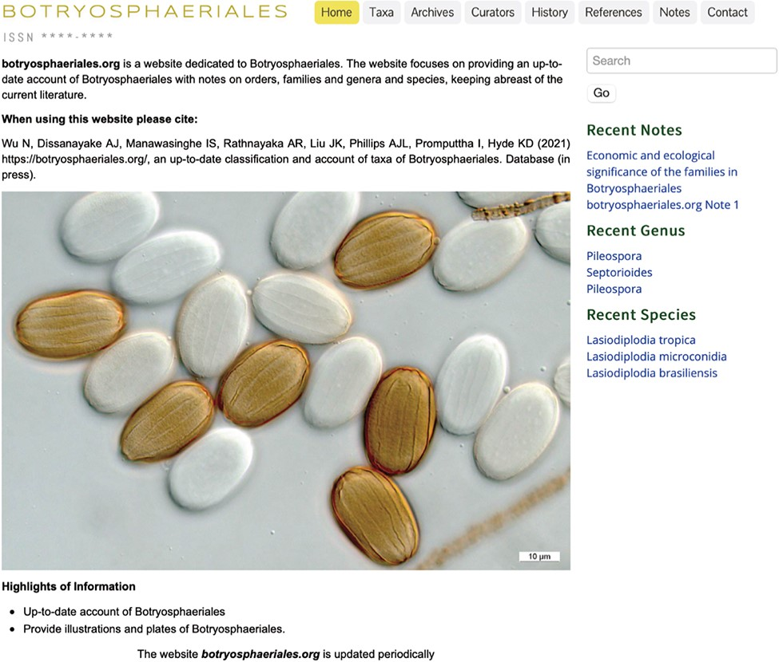
Figure 1. The homepage of Botryosphaeriales webpage.
Notes:
Figure 1. The homepage of Botryosphaeriales webpage.
Unless provided in the caption above, the following copyright applies to the content of this slide: © The Author(s) 2021. Published by Oxford University Press.This is an Open Access article distributed under the terms of the Creative Commons Attribution License (https://creativecommons.org/licenses/by/4.0/), which permits unrestricted reuse, distribution, and reproduction in any medium, provided the original work is properly cited.

Slide 2
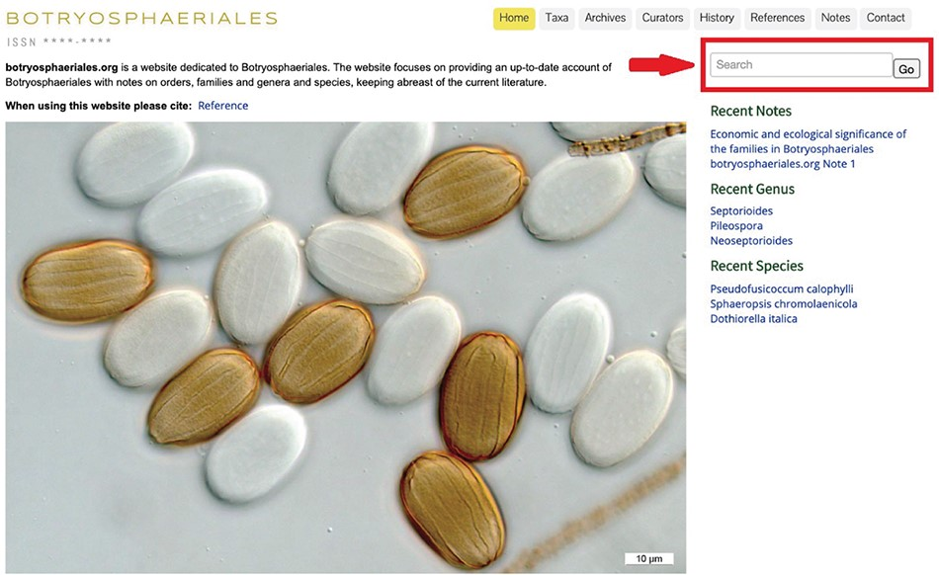
Figure 2. Red arrow indicates search tool to enter the taxon name.
Notes:
Figure 2. Red arrow indicates search tool to enter the taxon name.
Unless provided in the caption above, the following copyright applies to the content of this slide: © The Author(s) 2021. Published by Oxford University Press.This is an Open Access article distributed under the terms of the Creative Commons Attribution License (https://creativecommons.org/licenses/by/4.0/), which permits unrestricted reuse, distribution, and reproduction in any medium, provided the original work is properly cited.

Slide 3
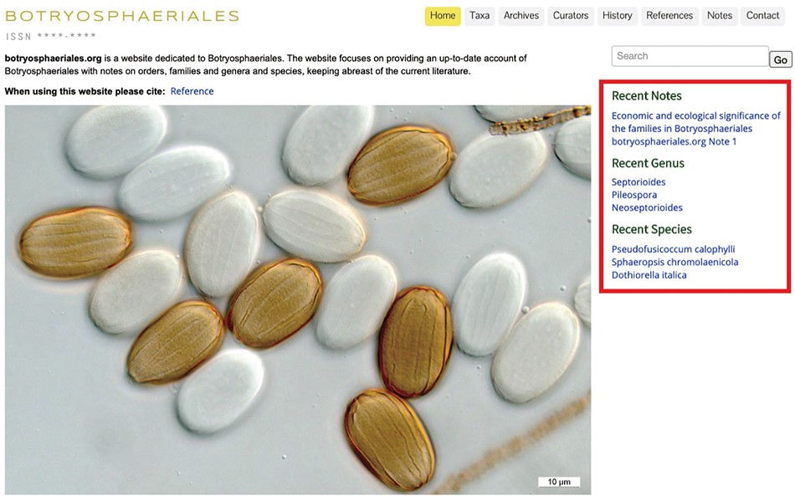
Figure 3. The recent notes, genus and species to enable easy access.
Notes:
Figure 3. The recent notes, genus and species to enable easy access.
Unless provided in the caption above, the following copyright applies to the content of this slide: © The Author(s) 2021. Published by Oxford University Press.This is an Open Access article distributed under the terms of the Creative Commons Attribution License (https://creativecommons.org/licenses/by/4.0/), which permits unrestricted reuse, distribution, and reproduction in any medium, provided the original work is properly cited.

Slide 4
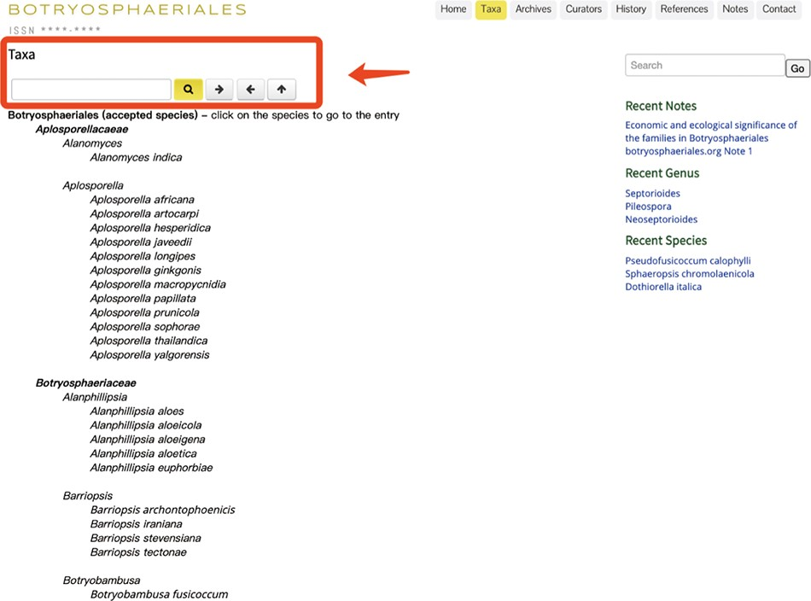
Figure 4. The ‘Taxa’ view of the Botryosphaeriales webpage.
Notes:
Figure 4. The ‘Taxa’ view of the Botryosphaeriales webpage.
Unless provided in the caption above, the following copyright applies to the content of this slide: © The Author(s) 2021. Published by Oxford University Press.This is an Open Access article distributed under the terms of the Creative Commons Attribution License (https://creativecommons.org/licenses/by/4.0/), which permits unrestricted reuse, distribution, and reproduction in any medium, provided the original work is properly cited.

Slide 5
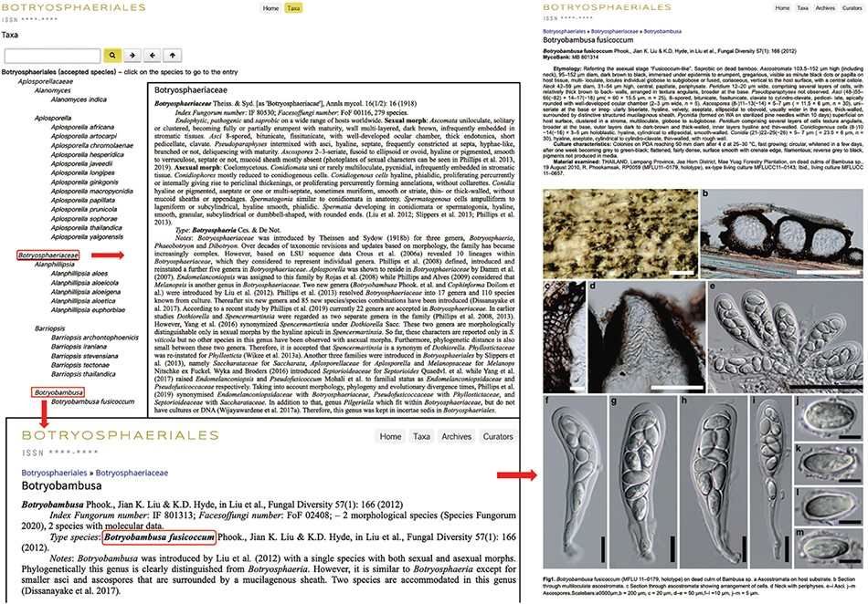
Figure 5. Details of the genus Botryobambusa.
Notes:
Figure 5. Details of the genus Botryobambusa.
Unless provided in the caption above, the following copyright applies to the content of this slide: © The Author(s) 2021. Published by Oxford University Press.This is an Open Access article distributed under the terms of the Creative Commons Attribution License (https://creativecommons.org/licenses/by/4.0/), which permits unrestricted reuse, distribution, and reproduction in any medium, provided the original work is properly cited.

Slide 6
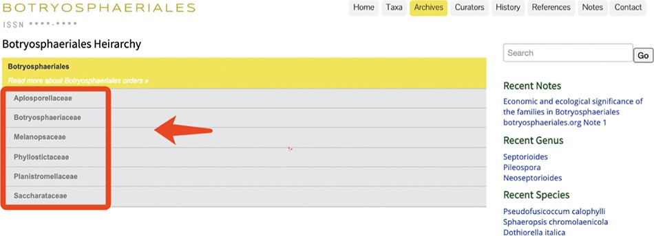
Figure 6. Appearance of the ‘Archives’ section in Botryosphaeriales webpage.
Notes:
Figure 6. Appearance of the ‘Archives’ section in Botryosphaeriales webpage.
Unless provided in the caption above, the following copyright applies to the content of this slide: © The Author(s) 2021. Published by Oxford University Press.This is an Open Access article distributed under the terms of the Creative Commons Attribution License (https://creativecommons.org/licenses/by/4.0/), which permits unrestricted reuse, distribution, and reproduction in any medium, provided the original work is properly cited.

Slide 7
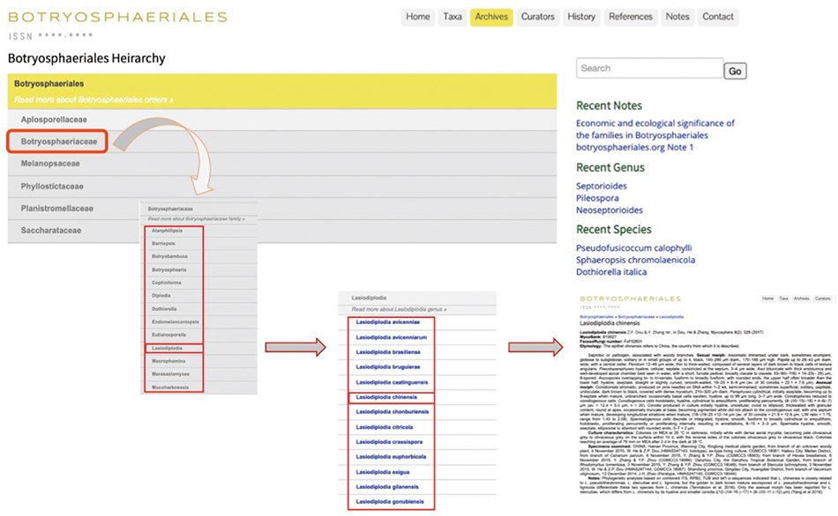
Figure 7. User-friendly interface of the ‘Archives’ section in Botryosphaeriales webpage.
Notes:
Figure 7. User-friendly interface of the ‘Archives’ section in Botryosphaeriales webpage.
Unless provided in the caption above, the following copyright applies to the content of this slide: © The Author(s) 2021. Published by Oxford University Press.This is an Open Access article distributed under the terms of the Creative Commons Attribution License (https://creativecommons.org/licenses/by/4.0/), which permits unrestricted reuse, distribution, and reproduction in any medium, provided the original work is properly cited.

Slide 8
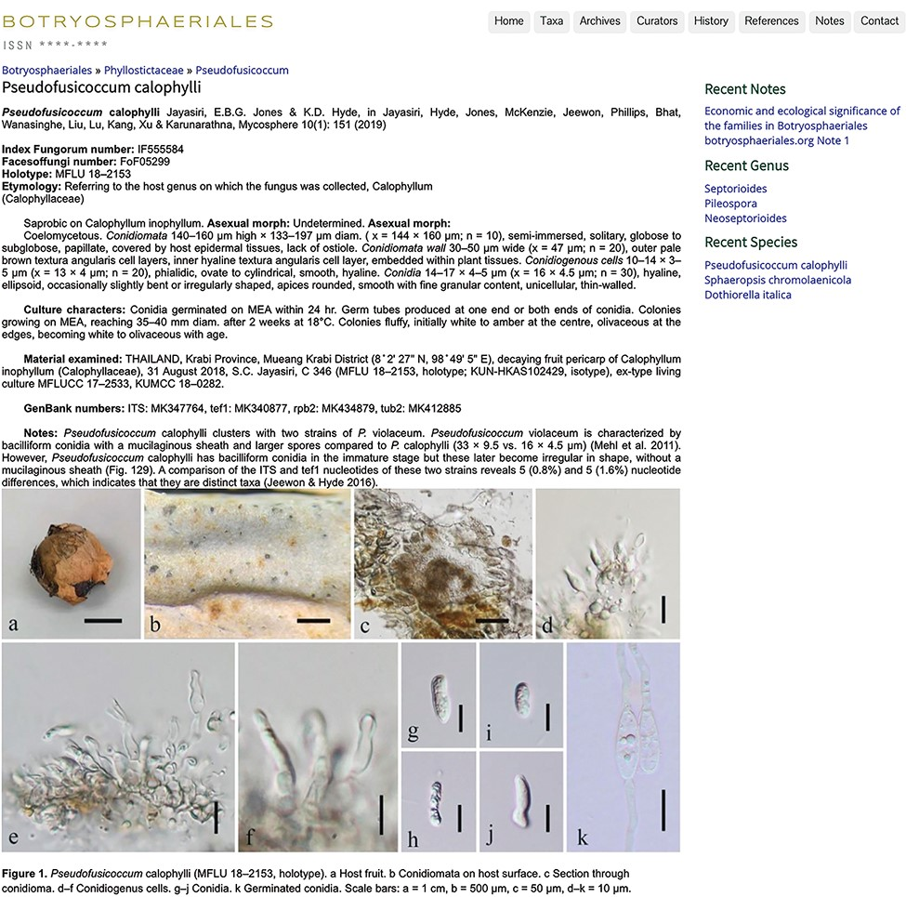
Figure 8. An entry with description, notes and plate (15).
Notes:
Figure 8. An entry with description, notes and plate (15).
Unless provided in the caption above, the following copyright applies to the content of this slide: © The Author(s) 2021. Published by Oxford University Press.This is an Open Access article distributed under the terms of the Creative Commons Attribution License (https://creativecommons.org/licenses/by/4.0/), which permits unrestricted reuse, distribution, and reproduction in any medium, provided the original work is properly cited.

Slide 9
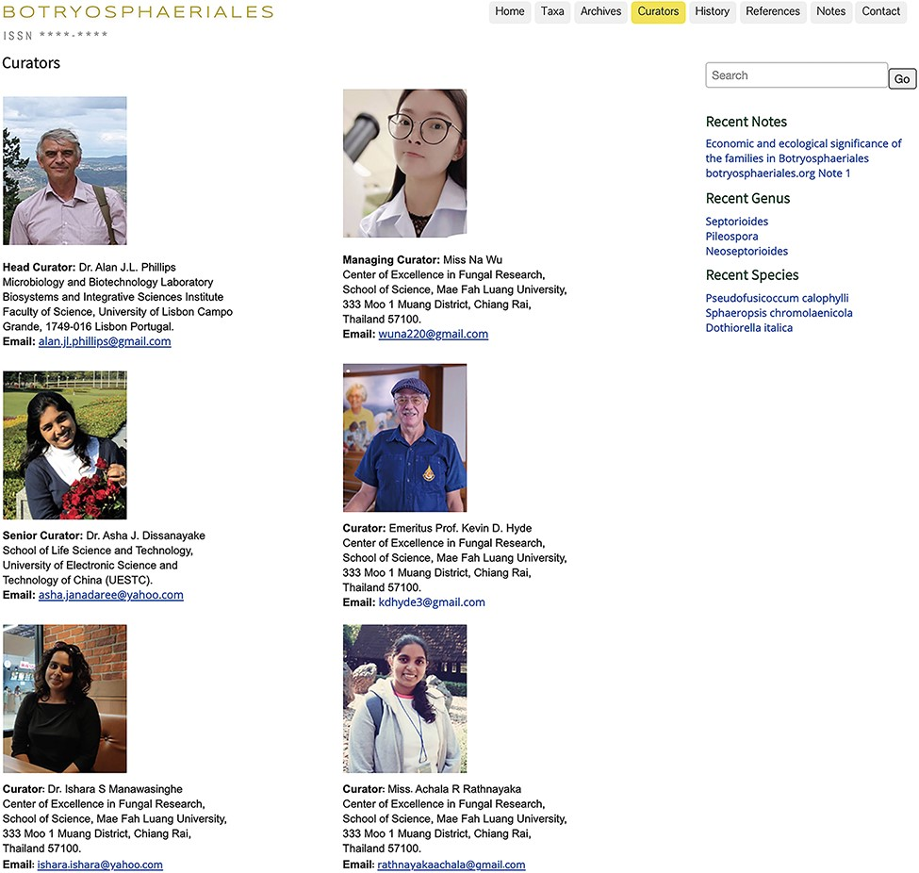
Figure 9. Curators of the Botryosphaeriales webpage.
Notes:
Figure 9. Curators of the Botryosphaeriales webpage.
Unless provided in the caption above, the following copyright applies to the content of this slide: © The Author(s) 2021. Published by Oxford University Press.This is an Open Access article distributed under the terms of the Creative Commons Attribution License (https://creativecommons.org/licenses/by/4.0/), which permits unrestricted reuse, distribution, and reproduction in any medium, provided the original work is properly cited.

