Slide 1
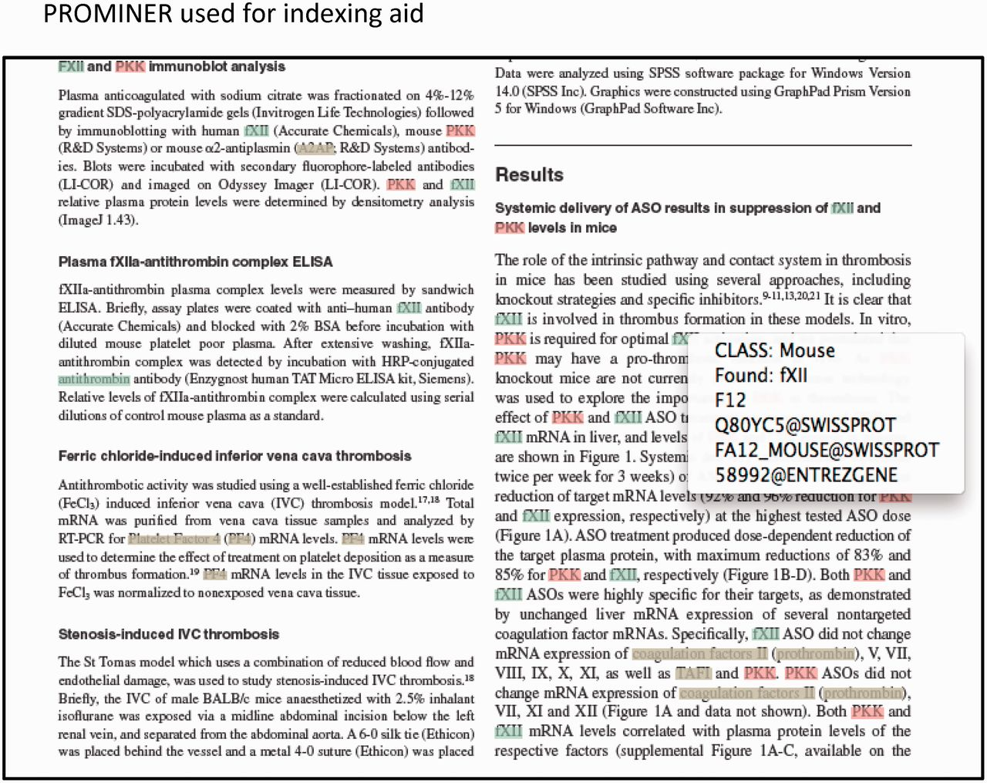
Figure 4. Output from PROMINER: PROMINER is used to assist in the gene indexing process. Utilizing official ...
Notes:
Figure 4. Output from PROMINER: PROMINER is used to assist in the gene indexing process. Utilizing official nomenclatures and synonym lists for mouse/rat/human gene names and gene symbols, PROMINER marks up papers for review by a curator, who then associates genes-to-papers in the MGI EI.
Unless provided in the caption above, the following copyright applies to the content of this slide: © The Author(s) 2012. Published by Oxford University Press.This is an Open Access article distributed under the terms of the Creative Commons Attribution License (http://creativecommons.org/licenses/by-nc/3.0/), which permits non-commercial reuse, distribution, and reproduction in any medium, provided the original work is properly cited. For commercial re-use, please contact journals.permissions@oup.com.

