Slide 1
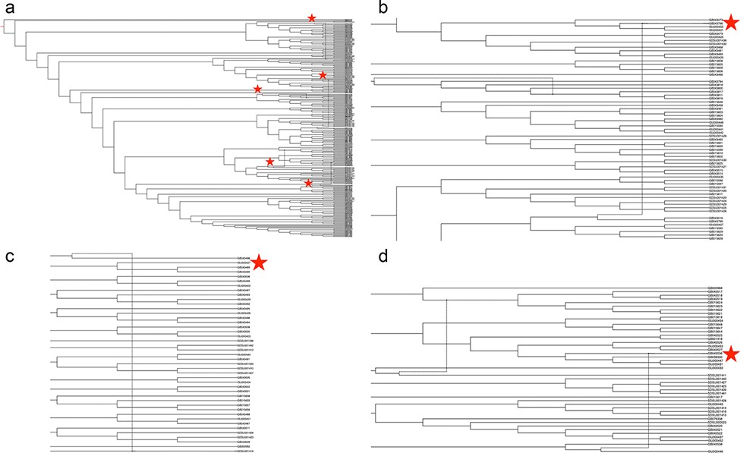
Figure 4. Phylogenetic network of porcine reproductive and respiratory syndrome virus collected in the Midwest of the ...
Notes:
Figure 4. Phylogenetic network of porcine reproductive and respiratory syndrome virus collected in the Midwest of the USA from 2014 to present (a) Putative recombination events are indicated by verticle lines within the network, annotated by red stars. Panel (b) strain IA30788-R (GB043798), Panel (c) strain 23199-S4-L001 (GB043498) and Panel (d) strain 7705R-S1 (GB043536) are visualized separately to demonstrate evolutionary relationships and recombination nodes. Phylogenetic network with tip labels, recombination layers 1 through 20 and gene tree embeddings is provided at https://github.com/us-spd/.
Unless provided in the caption above, the following copyright applies to the content of this slide: Published by Oxford University Press 2021. This work is written by (a) US Government employee(s) and is in the public domain in the US.This work is written by (a) US Government employee(s) and is in the public domain in the US.

