Slide 1
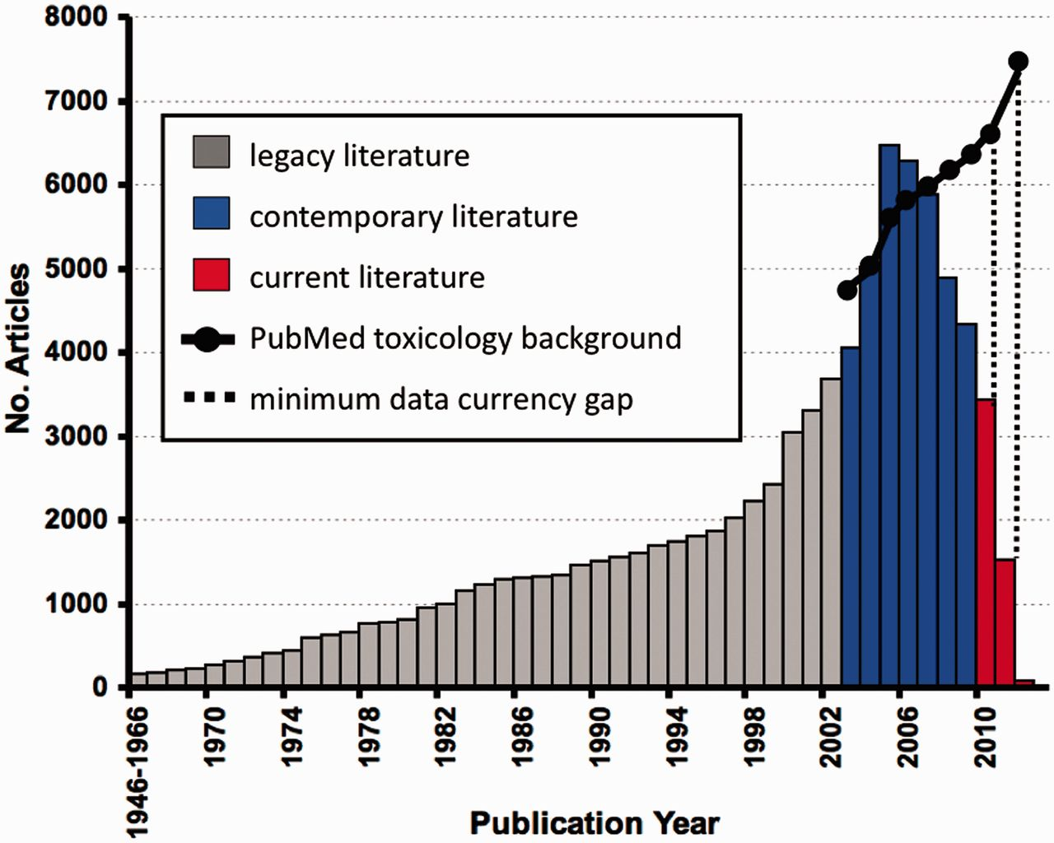
Figure 1 Data currency at CTD. In March 2012, CTD contained 88 035 articles published between 1946 and 2012, including ...
Notes:
Figure 1 Data currency at CTD. In March 2012, CTD contained 88 035 articles published between 1946 and 2012, including 46 113 (52%) legacy articles (grey), 36 900 (42%) contemporary articles (blue) and 5022 (6%) current articles (red); for simplicity, the number of articles for publication years 1946–66 were condensed into a single bar. When the number of curated articles in CTD is compared against an approximate number of available toxicogenomic articles from PubMed (solid black line), a noticeable hypothetical minimum gap in data currency is seen, especially for years 2010–11 (dashed lines). To approximate the number of hypothetical toxicogenomic articles for each year, PubMed was queried with the generic string: (toxicology OR toxicogenomics) OR [chemical AND (gene OR mRNA OR transcript)] NOT review[pt] AND ("YYYY/01/01"[PPDAT]:"YYYY/12/31"[PPDAT]), where YYYY = year of interest. The retrieved background is clearly an underrepresentation of the possible available literature (perhaps by as much as 2-fold; (1)); thus, the gap in data currency is a described as a ‘minimum gap’.
Unless provided in the caption above, the following copyright applies to the content of this slide: © The Author(s) 2012. Published by Oxford University Press.This is an Open Access article distributed under the terms of the Creative Commons Attribution License (http://creativecommons.org/licenses/by-nc/3.0/), which permits non-commercial reuse, distribution, and reproduction in any medium, provided the original work is properly cited. For commercial re-use, please contact journals.permissions@oup.com.

