Slide 1
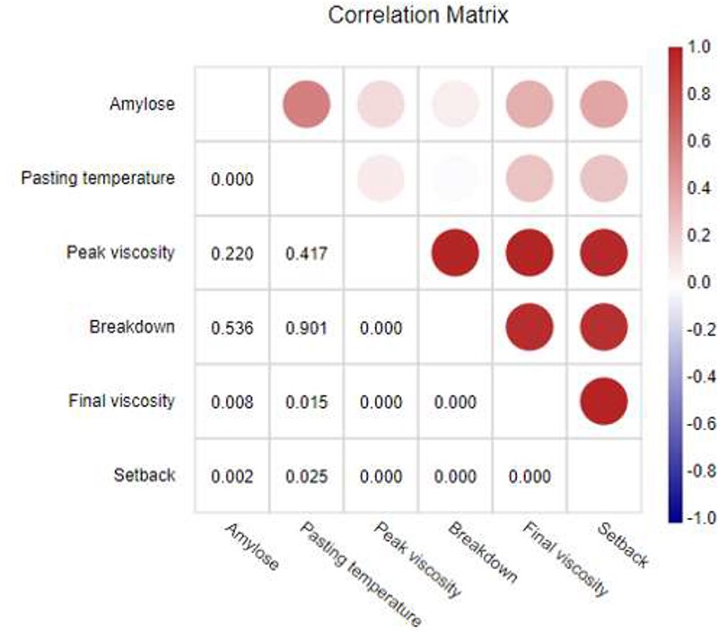
Figure 3. Correlation matrix between six starch parameters of Thai rice cultivars. The upper triangular matrix ...
Notes:
Figure 3. Correlation matrix between six starch parameters of Thai rice cultivars. The upper triangular matrix illustrates the correlation coefficients represented by a color on a continuous scale. The red color indicates a positive correlation, and blue color defines a negative correlation. The lower triangular matrix shows the P-values.
Unless provided in the caption above, the following copyright applies to the content of this slide: © The Author(s) 2020. Published by Oxford University Press.This is an Open Access article distributed under the terms of the Creative Commons Attribution License (http://creativecommons.org/licenses/by/4.0/), which permits unrestricted reuse, distribution, and reproduction in any medium, provided the original work is properly cited.

