Slide 1
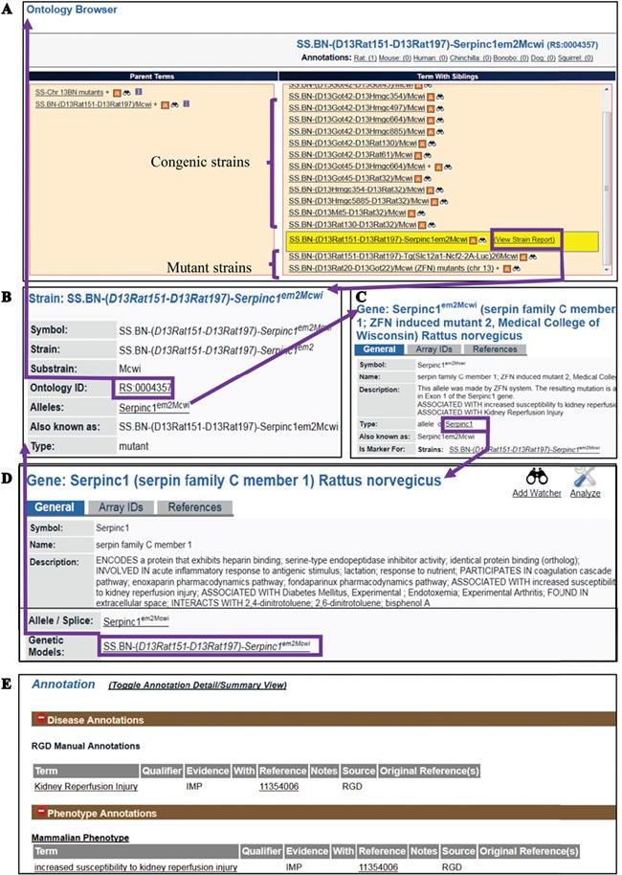
Figure 2 (A) The RS Ontology browser displaying the selected mutant strain ...
Notes:
Figure 2 (A) The RS Ontology browser displaying the selected mutant strain ‘SS.BN-(D13Rat151-D13Rat197)-Serpinc1em2Mcwi’ with its congenic and mutant siblings listed in the same column and its parents on the left. The browser provides the link to the rat strain report page (B), which displays ontology ID and associated data. The report pages for strain (SS.BN-(D13Rat151-D13Rat197)-Serpinc1em2Mcwi), allele (Serpinc1em2Mcwi) (C) and the parent gene (Serpinc1) (D) are integrated by hyperlinks to each other. Annotations (E) are found in all the report pages and are expanded to show links to the curated terms and original references.
Unless provided in the caption above, the following copyright applies to the content of this slide: © The Author(s) 2019. Published by Oxford University Press.This is an Open Access article distributed under the terms of the Creative Commons Attribution License (http://creativecommons.org/licenses/by/4.0/), which permits unrestricted reuse, distribution, and reproduction in any medium, provided the original work is properly cited.

