Slide 1
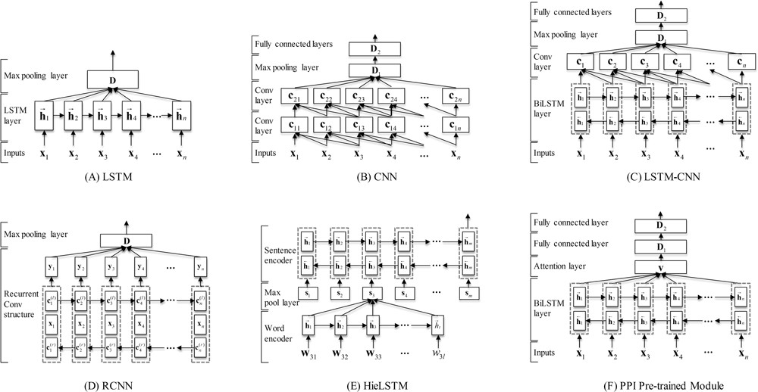
Figure 2 The neural network architectures of our models. (A) The LSTM model. (B) The CNN model. (C) The LSTM-CNN ...
Notes:
Figure 2 The neural network architectures of our models. (A) The LSTM model. (B) The CNN model. (C) The LSTM-CNN model. (D) The RCNN model. (E) The HieLSTM model. (F) The PPI pre-trained module.
Unless provided in the caption above, the following copyright applies to the content of this slide: © The Author(s) 2018. Published by Oxford University Press.This is an Open Access article distributed under the terms of the Creative Commons Attribution License (http://creativecommons.org/licenses/by/4.0/), which permits unrestricted reuse, distribution, and reproduction in any medium, provided the original work is properly cited.

