Slide 1
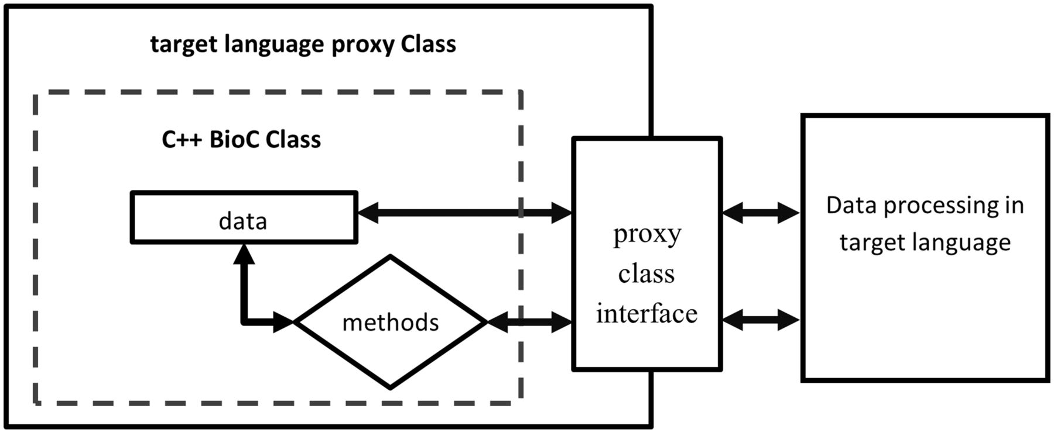
Figure 3. Access C++ BioC class through target language proxy class wrapper interface.
Notes:
Figure 3. Access C++ BioC class through target language proxy class wrapper interface.
Unless provided in the caption above, the following copyright applies to the content of this slide: Published by Oxford University Press 2014. This work is written by US Government employees and is in the public domain in the US.

