Slide 1
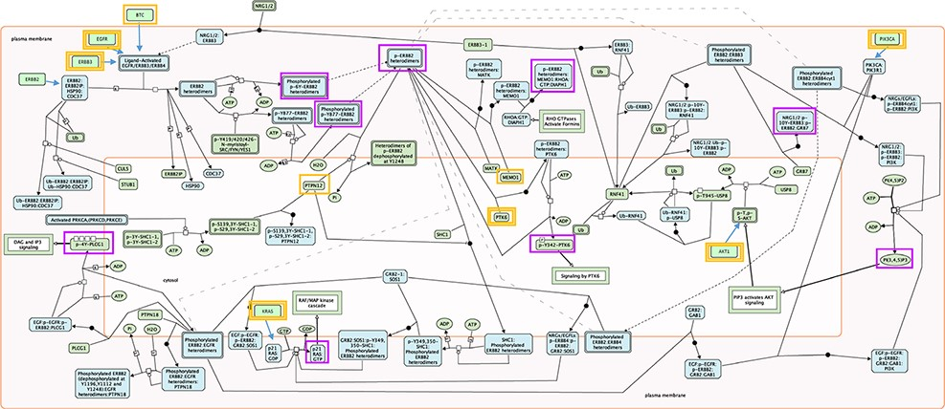
Figure 1. Root inputs and key outputs selected for Reactome pathway ‘Signaling by ERBB2’. Root inputs are circled ...
Notes:
Figure 1. Root inputs and key outputs selected for Reactome pathway ‘Signaling by ERBB2’. Root inputs are circled orange, with double border if they are in Cancer Gene Census list. Key outputs are circled purple. If root inputs are not directly shown in the diagram they have been redrawn and connected with the root complex/set.
Unless provided in the caption above, the following copyright applies to the content of this slide: © The Author(s) 2022. Published by Oxford University Press.This is an Open Access article distributed under the terms of the Creative Commons Attribution License (https://creativecommons.org/licenses/by/4.0/), which permits unrestricted reuse, distribution, and reproduction in any medium, provided the original work is properly cited.

Slide 2
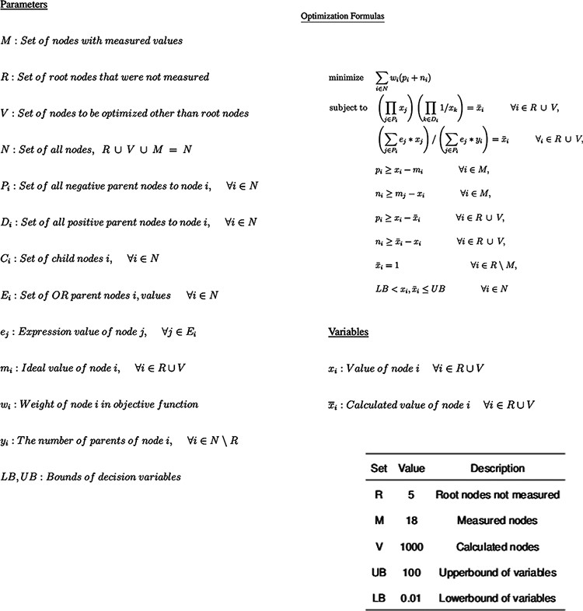
Figure 2. Optimization Model for inferring perturbation impact on pathway nodes. The top is the parameters available in ...
Notes:
Figure 2. Optimization Model for inferring perturbation impact on pathway nodes. The top is the parameters available in the model, followed by the non-linear model itself and then by the fixed parameter values.
Unless provided in the caption above, the following copyright applies to the content of this slide: © The Author(s) 2022. Published by Oxford University Press.This is an Open Access article distributed under the terms of the Creative Commons Attribution License (https://creativecommons.org/licenses/by/4.0/), which permits unrestricted reuse, distribution, and reproduction in any medium, provided the original work is properly cited.

Slide 3
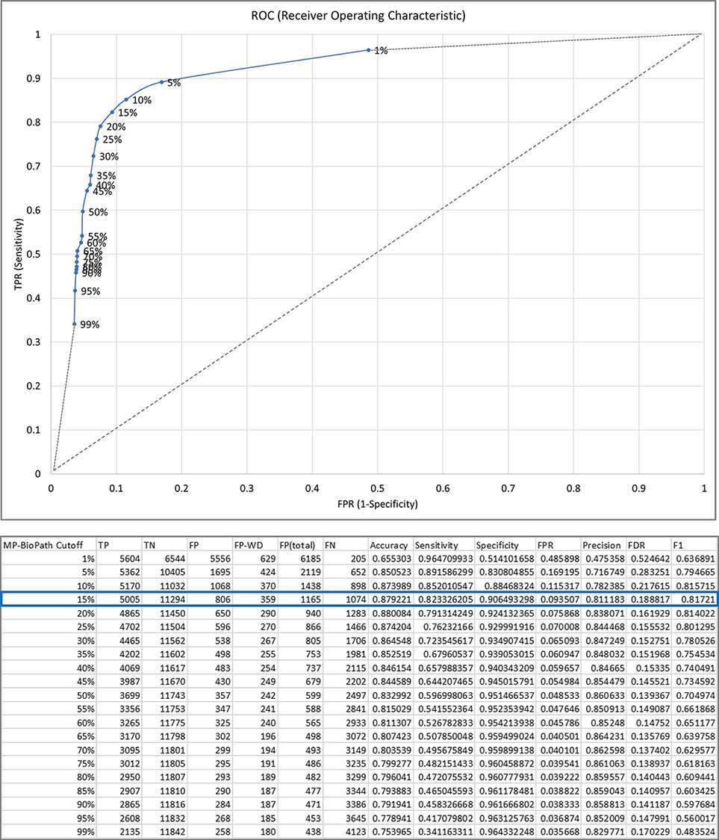
Figure 3. The relationship between MP-BioPath sensitivity (true positive rate, TPR) and false positive rate (FPR) at ...
Notes:
Figure 3. The relationship between MP-BioPath sensitivity (true positive rate, TPR) and false positive rate (FPR) at different cutoffs.
Unless provided in the caption above, the following copyright applies to the content of this slide: © The Author(s) 2022. Published by Oxford University Press.This is an Open Access article distributed under the terms of the Creative Commons Attribution License (https://creativecommons.org/licenses/by/4.0/), which permits unrestricted reuse, distribution, and reproduction in any medium, provided the original work is properly cited.

Slide 4
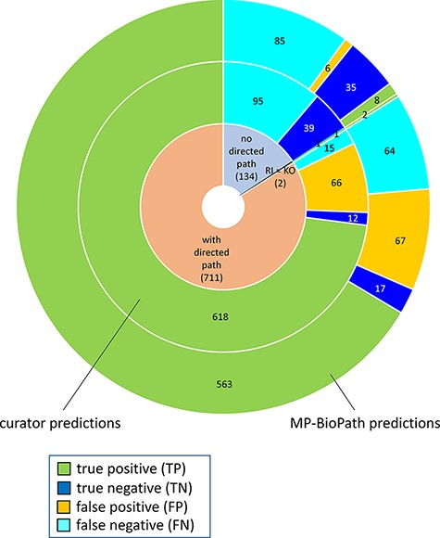
Figure 4. Distribution of true positives, true negatives, false positives and false negatives with respect to existence ...
Notes:
Figure 4. Distribution of true positives, true negatives, false positives and false negatives with respect to existence of directed path between a root input and a key output in Reactome pathway diagrams RI = root input; KO = key output.
Unless provided in the caption above, the following copyright applies to the content of this slide: © The Author(s) 2022. Published by Oxford University Press.This is an Open Access article distributed under the terms of the Creative Commons Attribution License (https://creativecommons.org/licenses/by/4.0/), which permits unrestricted reuse, distribution, and reproduction in any medium, provided the original work is properly cited.

Slide 5
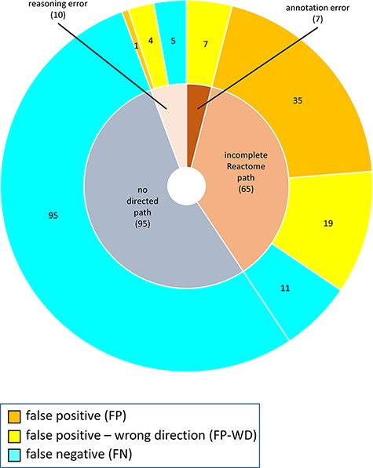
Figure 5. Reasons for discordance between curator-based predictions and published evidence.
Notes:
Figure 5. Reasons for discordance between curator-based predictions and published evidence.
Unless provided in the caption above, the following copyright applies to the content of this slide: © The Author(s) 2022. Published by Oxford University Press.This is an Open Access article distributed under the terms of the Creative Commons Attribution License (https://creativecommons.org/licenses/by/4.0/), which permits unrestricted reuse, distribution, and reproduction in any medium, provided the original work is properly cited.

Slide 6
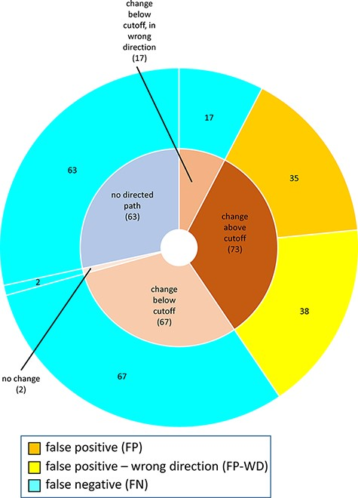
Figure 6. Reasons for discordance between MP-BioPath-based predictions and published evidence.
Notes:
Figure 6. Reasons for discordance between MP-BioPath-based predictions and published evidence.
Unless provided in the caption above, the following copyright applies to the content of this slide: © The Author(s) 2022. Published by Oxford University Press.This is an Open Access article distributed under the terms of the Creative Commons Attribution License (https://creativecommons.org/licenses/by/4.0/), which permits unrestricted reuse, distribution, and reproduction in any medium, provided the original work is properly cited.

