Slide 1
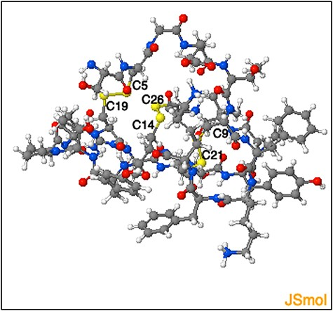
Figure 9. Representation of the three-dimensional structure segment obtained using ‘Modelling peptide’ tool. The ...
Notes:
Figure 9. Representation of the three-dimensional structure segment obtained using ‘Modelling peptide’ tool. The three-dimensional structure segment of the homologue identified by querying ‘C4 - C19, C9- C21 and C14 - C26’ disulphide connectivity. The cysteine residues and the corresponding disulphide bridges are highlighted.
Unless provided in the caption above, the following copyright applies to the content of this slide: © The Author(s) 2022. Published by Oxford University Press.This is an Open Access article distributed under the terms of the Creative Commons Attribution License (https://creativecommons.org/licenses/by/4.0/), which permits unrestricted reuse, distribution, and reproduction in any medium, provided the original work is properly cited.

