Slide 1
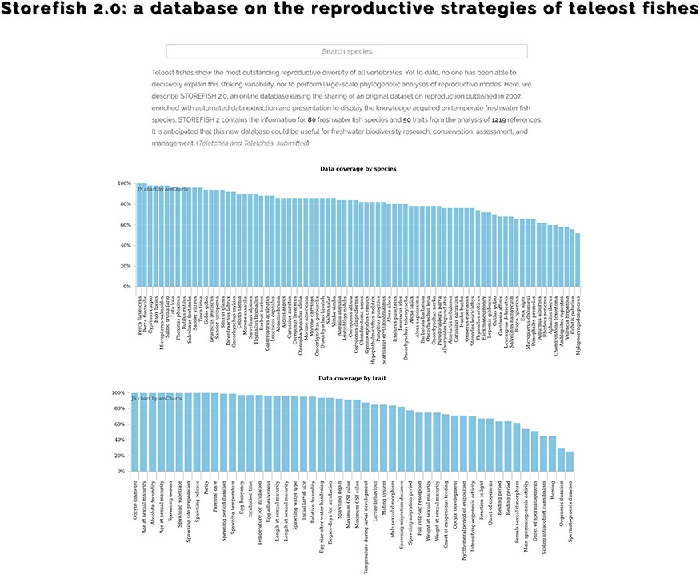
Figure 2. STOREFISH home page. Accessible data are available by species, traits or by reference. A search-as-you-type ...
Notes:
Figure 2. STOREFISH home page. Accessible data are available by species, traits or by reference. A search-as-you-type box allows to rapidly find a species of interest.
Unless provided in the caption above, the following copyright applies to the content of this slide: © The Author(s) 2020. Published by Oxford University Press.This is an Open Access article distributed under the terms of the Creative Commons Attribution License (http://creativecommons.org/licenses/by/4.0/), which permits unrestricted reuse, distribution, and reproduction in any medium, provided the original work is properly cited.

