Slide 1
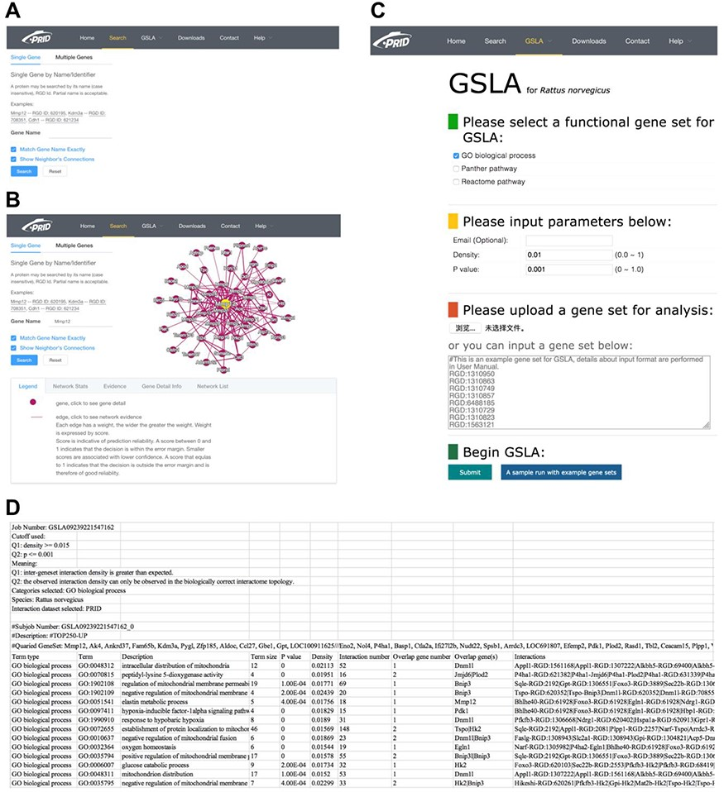
Figure 3. PRID website. (A) Single gene search and multiple gene search. (B) Search result page. Right-clicking on an ...
Notes:
Figure 3. PRID website. (A) Single gene search and multiple gene search. (B) Search result page. Right-clicking on an interaction in the diagram will show its details. (C) GSLA interface. (D) GSLA result file.
Unless provided in the caption above, the following copyright applies to the content of this slide: © The Author(s) 2020. Published by Oxford University Press.This is an Open Access article distributed under the terms of the Creative Commons Attribution License (http://creativecommons.org/licenses/by/4.0/), which permits unrestricted reuse, distribution, and reproduction in any medium, provided the original work is properly cited.

