Slide 1
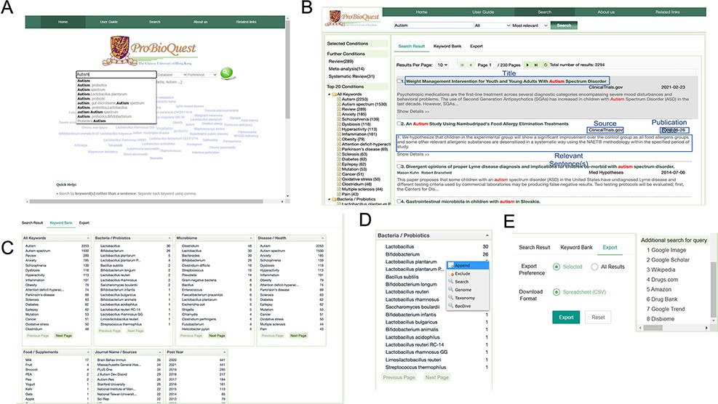
Figure 3. An overview of the user interface of ProBioQuest. (A) Home page includes a keyword cloud of the most frequent ...
Notes:
Figure 3. An overview of the user interface of ProBioQuest. (A) Home page includes a keyword cloud of the most frequent keywords from all seed articles, a search bar which offers suggestions while the user is typing and a help box for users unfamiliar with the system’s details. (B) Autism as an example of input and the search result. Each article is linked out to ClinicalTrials.gov, PubMed.gov or PatentsView with a simple click. (C) Novel feature in Keyword Bank tab. This tab shows relevant keywords in descending order of the number of articles they co-existed, which aids secondary key concept discovery of the interested topic. All keywords are divided into categories. (D) The secondary keyword can be appended into the search bar or linked out. (E) Search result can be exported as CSV format or linked out to search for additional information.
Unless provided in the caption above, the following copyright applies to the content of this slide: © The Author(s) 2022. Published by Oxford University Press.This is an Open Access article distributed under the terms of the Creative Commons Attribution-NonCommercial License (https://creativecommons.org/licenses/by-nc/4.0/), which permits non-commercial re-use, distribution, and reproduction in any medium, provided the original work is properly cited. For commercial re-use, please contact journals.permissions@oup.com

